Slide 1
X-HD: Fast Hausdorff Distance
Computation with Ray Tracing
Liang Geng, Zhehu Yuan, Rubao Lee, Fusheng Wang*, Xiaodong Zhang
The Ohio State University, USA | *Stony Brook University, USA
Notes:
Hello everyone, my name is Liang Geng, a PhD candidate at the Ohio State University. Today, I will be presenting our work, 'X-HD: Fast Hausdorff Distance Computation with Ray Tracing. This research was conducted collaboratively between The Ohio State University and Stony Brook University.

Slide 2
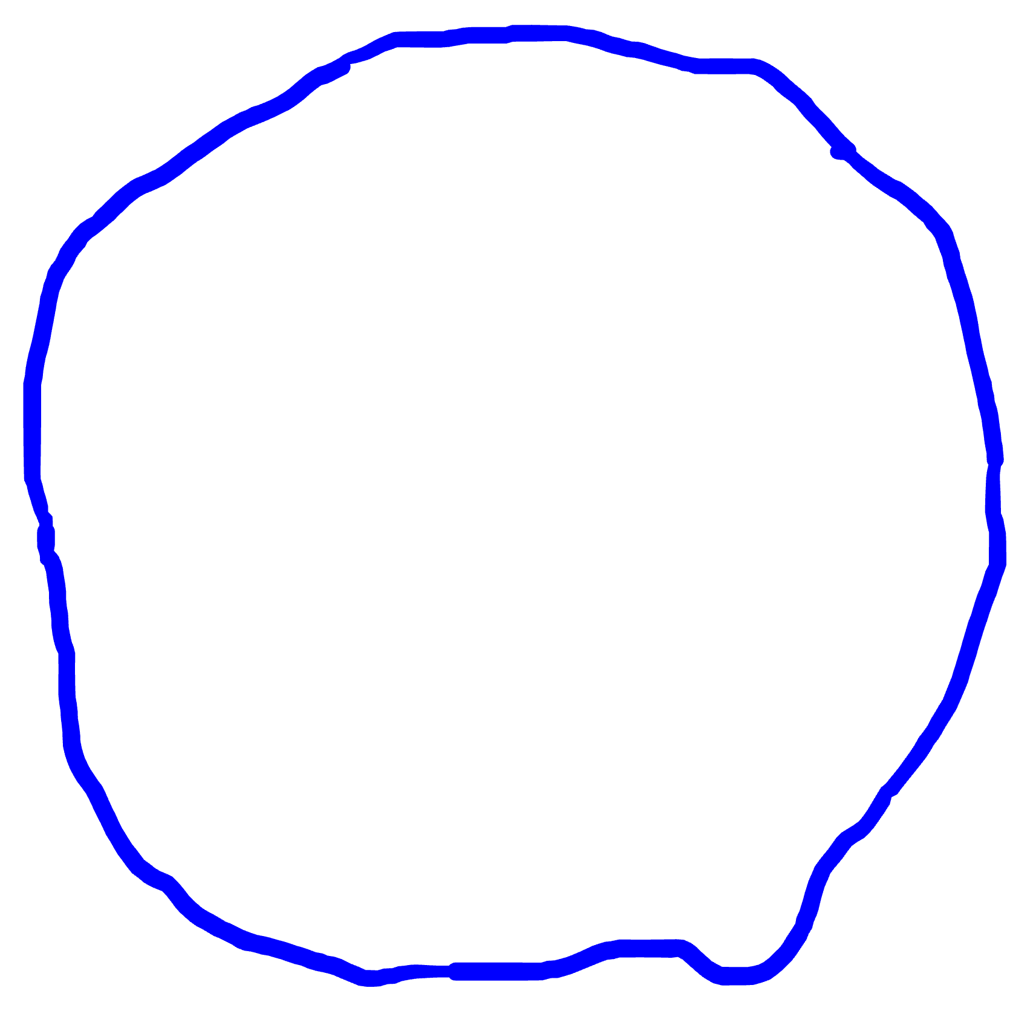



What is the Hausdorff Distance (HD)?
The Hausdorff Distance is a spatial metric used to measure the dissimilarity between two sets of points.
?
It quantifies the maximum distance from a point in one set to its nearest point in the other set.
$$\overset{⃑}{H}\left(A, B\right)$$
(Directed) Hausdorff Distance:
Point Set A
$$\overset{⃑}{H}\left(A, B\right)=\max_{a∈A}\{\min_{b∈B}\{|\left|a,b\right||\}\}$$
Point Set B
Felix Hausdorff (1868-1942), German mathematician
Notes:
Remember that we want to find the maximum of nearest distances between the two sets, so this red circle is the most possible place that gives us the anser
We draw a circle from the black point, and the dashed line is the maximum value of the nearest distance

Slide 3






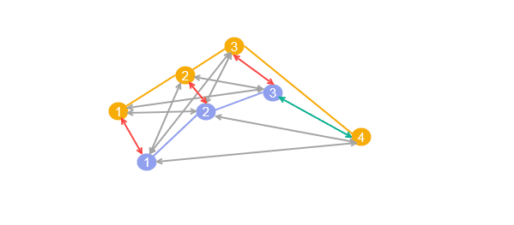
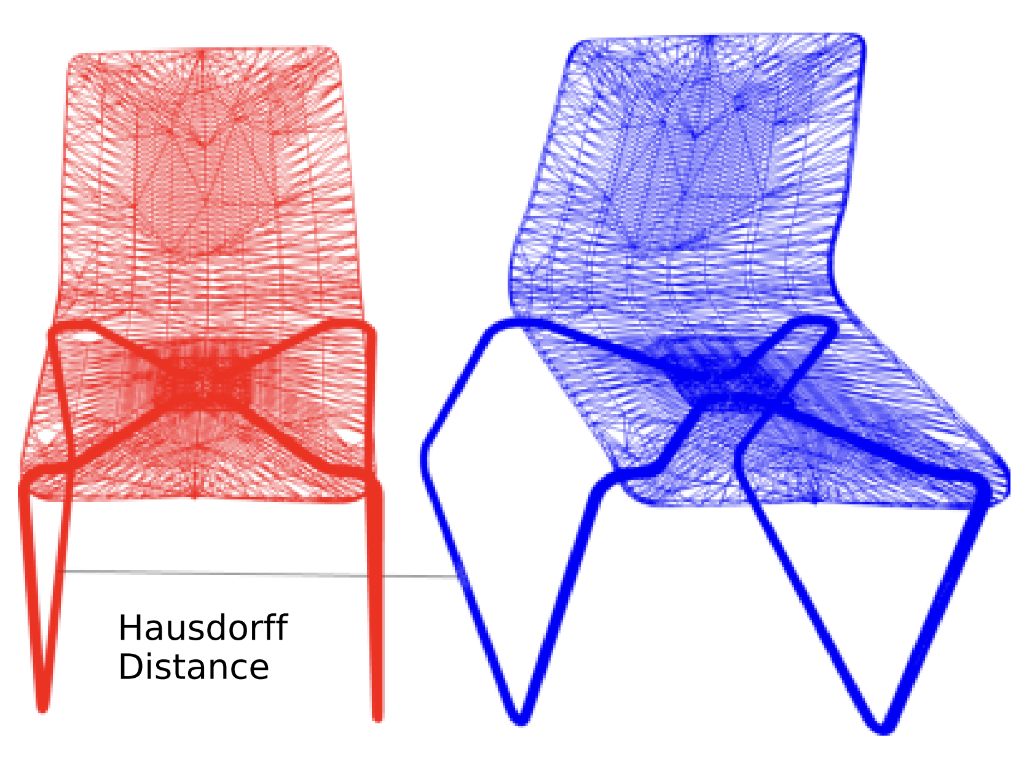
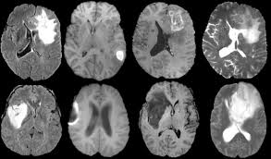
Applications of HD
Medical Imaging
Geospatial
CAD/Graphics
Evaluating the quality of segmentations in MRI scans by comparing ground truth to predicted boundaries.
Comparing LiDAR point clouds and analyzing moving object trajectories
Shape matching, mesh comparison, and similarity assessment for automated design.

Slide 4



We need Fast HD Computation
Explosion of Spatial Data
Time-Sensitive Workloads
The Scalability Wall
The volume of spatial data is expanding rapidly due to high-resolution sensors like LiDAR, GPS, and advanced medical imaging.
Real-world spatial workloads are often highly time-sensitive, with a sub-second requirement.
Traditional HD approaches rely on optimized double-loop or nearest-neighbor search schemes, which have a high time complexity.
Applications like autonomous navigation and real-time medical diagnostics require super-fast HD algorithms to be practically viable.
For example, an MRI image may contain millions of voxels
This is extremely time-consuming and not scalable for massive datasets.

Slide 5

Solving Hausdorff Distance
Definition: $\overset{⃑}{H}\left(A, B\right)=\max_{a∈A}\{\min_{b∈B}\{|\left|a,b\right||\}\}$
cmax ← 0 // Global Maximum Distance
for each a ∈ A do
cmin ← ∞ // Minimum Distance from point a
Double Loop
for each b ∈ B do
dist ← ||a, b||
cmin ← min(cmin, dist)
end for
cmax ← max(cmax, cmin) // Update Global Max
end for
Early Break
Nearest Neighbor
Breaking the inner loop early under a condition
Building an index over Points B to facilitate nearest neighbor search
Taha et al. An Efﬁcient Algorithm for Calculating the Exact Hausdorff Distance, TPAMI, 2015
Notes:
Following its mathematical definition, we will use a double loop to solve the HD
We can further optimize the inner loop, the first method is called early break; and the second is the nearest neighbor search.

Slide 6
General Purpose HD Algorithms
Early Break (EB)
Nearest Neighbor (NN)
Breaking the inner loop early if the current minimum cannot increase the global maximum.
No index overhead
Performance dynamics (break may not trigger)
Using a spatial index like KD-trees to avoid visiting all points by finding the closest neighbor directly.
Scalable and predictable performance
Indexing cost
cmax ← 0 // Global Maximum Distance
for each a ∈ A do
cmin ← ∞ // Nearest Neighbor Distance
Essential NN search!
for each b ∈ B do
dist ← ||a, b||
cmin ← min(cmin, dist)
if dist ≤ cmax then break // Early Break
end for
cmax ← 0
Index ← BuildSpatialIndex(B) // Build Index
for each a ∈ A do
nearest_b ← Index.NNSearch(a) // Offload to RT
dist ← ||a, nearest_b||
cmax ← max(cmax, dist)
end for
cmax ← max(cmax, cmin) // Update Global Max
end for

Slide 7
This Work: X-HD
The EB and NN algorithms have their strength and weaknesses
Our goal: a unified HD solution called X-HD
      Taking the best of both algorithms
      Works well for datasets across various domains
GPU acceleration for high-performance HD computation
      Using both CUDA cores and Ray-tracing (RT) cores
      NN as its foundation – powered by RT cores
      EB for load-imbalanced cases – running on CUDA cores

Slide 8
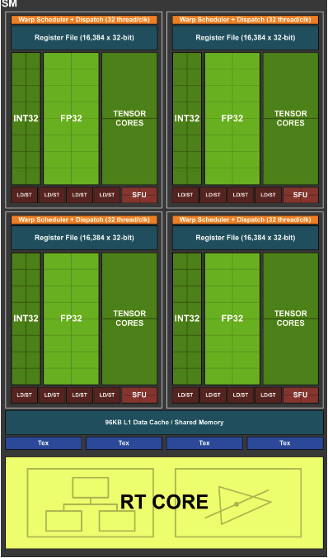
RT Cores Overview
What are the RT cores
Designed for accelerating ray-tracing rendering
Specialized units in modern GPUs to accelerate:
  Ray-triangle intersection tests
  Bounding Volume Hierarchy (BVH) traversal
  10x faster than the software emulation for BVH search
  Free up SMs to do other computing works
How to “Program” RT cores?
Actually, you can’t!
The only way you can use it is to convert your problem into ray-geometry intersection problems
Geometries are organized into a spatial index - BVH tree
You cast rays, and intersections are reported to the SMs by RT cores

Slide 9



Original NN Search
Radius search from query point
$$P_{1}$$
$$P_{3}$$
r
Query
$$P_{2}$$

Slide 10
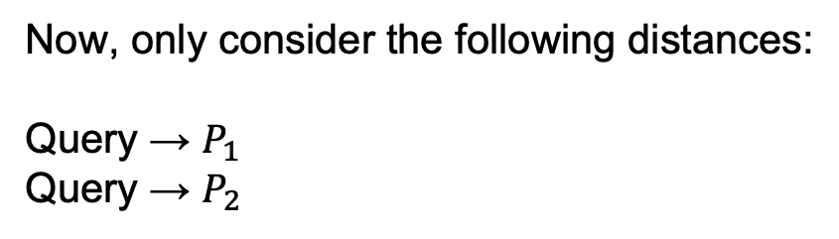
RT-accelerated NN Search
Inverse search
$$P_{1}$$
$$P_{3}$$
Query
Short Ray
$$P_{2}$$
Now, only consider the following distances:
Query → $P_{1}$
Query → $P_{2}$
Zhu, RTNN: accelerating neighbor search using hardware ray tracing, PPoPP, 2022
Notes:
Finding the point-box intersection is accelerated by the RT cores

Slide 11






Challenges of directly using an RT-backed library?
Intersection Overhead
Redundant Computation
Load Imbalance
Too many intersections can be a bottleneck, as they trigger frequently SM/RT core switches.
Existing libraries lack domain-specific pruning logic, causing unnecessary distance calculations.
Single-ray programming model handles intersections in serial, underutilizing GPU resources.

Slide 12
Intersection Overhead & Solution
Grouping Proximal Points
We partition the space with a uniform grid to group spatially close points into cells.
Create Minimum Bounding Rectangles (MBRs) enclose the points
Expand MBR corners by search radius r
We iterate the points in the MBR to maintain minimum distance
Reducing the boxes, so we have a smaller BVH and less intersections
Hit
Notes:
In the previous example, we map each point to an AABB, and this design results in many intersections, suffering from intersection processing overheads due to the swach between RT cores and SMs

Slide 13
Infeasibility of using an RT-backed Library
Intersection Overhead
Redundant Computation
Load Imbalance
Single-ray programming model handles intersections in serial, underutilizing GPU resources.
Too many intersections can be a bottleneck, as it triggers frequently SM/RT core switches.
Existing libraries lack domain-specific pruning logic, causing unnecessary distance calculations.

Slide 14



Redundant Computation & Solution
$$a_{1}$$
cmax
NN Candidate
Pruning non-contribution points with distance estimators
All the points in an MBR can be pruned if the upper bound <= cmax (the current global distance)
None of points in the box help to increase the global maximum, so we don’t have to visit them
$$a_{2}$$
NN Candidate
Upper Bound <= cmax

Slide 15
Why not just use an RT-backed Library?
Intersection Overhead
Redundant Computation
Load Imbalance
Single-ray programming model handles intersections in serial, underutilizing GPU resources.
Too many intersections can be a bottleneck, as it triggers frequently SM/RT core switches.
Existing libraries lack domain-specific pruning logic, causing unnecessary distance calculations.

Slide 16
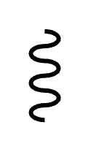
Imbalanced Workload Challenge
Imbalanced Load & Limited Tools
Shader’s Thread
Introducing a uniform grid to partition points may result in a severely imbalanced grid, due to the nature of spatial datasets
RT shaders execute serially to process intersections. If a grid cell contains thousands of points (skewed data), the shader becomes a bottleneck.
Shader’s Thread
The points will be sequentially visited by the thread casting the ray to maintain local minimum distance
Synchronizations are not available for RT cores, so existing load-balancing methods cannot be used here to distribute workloads.

Slide 17
Solution to Imbalanced Workload
Two-tier Load Balance Strategy
The limitation of synchronizations suggests us that we can only address the LB issue within the CUDA kernel
Classified the cells into two tiers, heavy cells and lightweight cells according to its the number of points
Thread Block
RT Shader
Heavy Cell: Running EB algorithm with a thread block
Lightweight Cell: Follow the NN algorithm within the RT shader

Slide 18
Experimental Environment
Hardware Settings
CPU: Intel i9-12900
GPU: NVIDIA RTX 3090
Software: Optix 9 and CUDA 13
Baselines
Implementations | Device | Notes
ITK | CPU | Insight Toolkit, a popular industry medical image processing tool
Implementations | Device | Notes
ITK | CPU | Insight Toolkit, a popular industry medical image processing tool
NN-KD | GPU | NN Search with KD-tree in CUDA
Implementations | Device | Notes
ITK | CPU | Insight Toolkit, a popular industry medical image processing tool
NN-KD | GPU | NN Search with KD-tree in CUDA
NN-Clover (ICS’25) | GPU | NN Search with Clover, a SOTA graph-based NN search library
Implementations | Device | Notes
ITK | CPU | Insight Toolkit, a popular industry medical image processing tool
NN-KD | GPU | NN Search with KD-tree in CUDA
NN-Clover (ICS’25) | GPU | NN Search with Clover, a SOTA graph-based NN search library
EB | GPU | Early Break implementation in CUDA
Implementations | Device | Notes
ITK | CPU | Insight Toolkit, a popular industry medical image processing tool
NN-KD | GPU | NN Search with KD-tree in CUDA
NN-Clover (ICS’25) | GPU | NN Search with Clover, a SOTA graph-based NN search library
EB (TPAMI’2015) | GPU | Early Break implementation in CUDA
RT-HDIST (Computer Graphics Forum’25) | GPU | The only HD work with RT cores (no pruning, no load balancing)

Slide 19
Datasets
Name | Type | # of Points | Skewness | Notes
BraTS | 400+ MRI Images | Avg 1.5M | Low | Multimodal Brain Tumor Segmentation Challenge
Name | Type | # of Points | Skewness | Notes
BraTS | 400+ MRI Images | Avg 1.5M | Low | Multimodal Brain Tumor Segmentation Challenge
Dragon | Graphics | 0.4M | Mid | The Stanford 3D Scanning Repository
AsianDragon | Graphics | 3.6M | Mid | The Stanford 3D Scanning Repository
HappyBuddha | Graphics | 0.5M | Mid | The Stanford 3D Scanning Repository
ThaiStatuette | Graphics | 4.9M | Mid | The Stanford 3D Scanning Repository
USCounty | Geospatial | 9.4M | High | US County Boundaries
USZipcode | Geospatial | 43.9M | High | U.S. ZIP Code Areas
Lakes | Geospatial | 301.7M | High | Boundaries of water areas, worldwide
Parks | Geospatial | 403.7M | High | Boundaries of parks or green areas, worldwide
USWater | Geospatial | 22.8M | High | Detailed Water Bodies in the United States
USCensus | Geospatial | 52.3M | High | US Census Populated Place Areas
Name | Type | # of Points | Skewness | Notes
BraTS | 400+ MRI Images | Avg 1.5M | Low | Multimodal Brain Tumor Segmentation Challenge
Dragon | Graphics | 0.4M | Mid | The Stanford 3D Scanning Repository
AsianDragon | Graphics | 3.6M | Mid | The Stanford 3D Scanning Repository
HappyBuddha | Graphics | 0.5M | Mid | The Stanford 3D Scanning Repository
ThaiStatuette | Graphics | 4.9M | Mid | The Stanford 3D Scanning Repository
These are the frequently used datasets in their domains, all available online

Slide 20
Main Results - MRI Images
Since the MRI datasets have hundreds of images, we randomly pick a pair of them and calculate HD.
The datasets have low skewness and medium number of points
We plot the running time distribution
4.80X average speedup over ITK
16.10X average speedup over RT-HDIST
4.99X average speedup over NN-KD
8.55X average speedup over NN-Clover
5.35X average speedup over EB

Slide 21
Main Results - Graphics
Graphics datasets have medium skewness and large volume of points (0.4M~4.9M)
36.72X average speedup over RT-HDIST
172.40X average speedup over NN-KD
12.43X average speedup over NN-Clover
1.73X average speedup over EB

Slide 22
Main Results - Geospatial
Graphics datasets have high skewness and very large number of points, 9M~400M
13.73X average speedup over NN-KD
23.44X average speedup over NN-Clover
4.68X average speedup over EB

Slide 23
Conclusion
Directly using RT cores or RT-based NN solutions for HD does not work well.
The paper introduces X-HD, a consistently fast algorithm for computing the Hausdorff Distance.
X-HD achieves its speed by leveraging both CUDA cores and specialized RT cores on modern GPUs.
Its high performance across diverse workloads comes from combining hardware acceleration with domain-specific optimizations.
X-HD is open-source for public use.

Slide 24
Questions?
X-HD: Fast Hausdorff Distance Computation with Ray Tracing
Source code: github.com/pwrliang/X-HD
ICS '26 | Belfast, UK

Slide 25



RT-accelerated NN Search
Ray
Ray-Box Intersection
Collect Intersections
$$t_{max}$$
Box
Direction d
$$t_{min}$$
Hit
Origin O
Build a BVH with the Boxes
RayGen Shader:
CastRay from O toward d with the BVH
$$R\left(t\right)=O+t∗d$$
IsIntersection Shader:
ray potentially hits a box
Notes:
Let’s dive into some basic ray tracing concepts
First things first, everything we are dealing with is in 3D Euclidean space.
A ray is an infinite line defined by an origin O and a direction vector.
We can take a part of the ray by setting t_min and t_max, and an intersection only happens on this range will be considered.
Basically, we use RT cores for us to find ray-box intersections. There are two cases considered as ray-box intersections
First, the ray origin is out of the box and the ray hits the boundary of the box
Second, as long as the ray origin is within the box, we consider it as an intersection. We need this.
Here’s whole ray-tracing workflow. To use RT cores, we program a series shaders, which are a subset of the CUDA language.
We first build a BVH with the boxes.
Then, in the ray generation shader, we cast rays by providing ray origin and direction
Whenever a ray hits a box, the intersection is reported to the SM by RT cores, and we program the IS shader to handle the intersection

Slide 26
A Tool: HD Estimators
Point-Box Distance Bounds
Estimators allow us to compute lower and upper distance bounds between a point and an MBR enclosing other points without visiting every point inside.
Lower Bound
Upper Bound
MinDist: Distance from query point to the closest face of the MBR.
MaxDist: Distance from query point to the farthest corner of the MBR.
Notes:
To relieve the redundant computation, we introduce a tool – called HD Estimator
We then introduce HD Estimators to compute the lower bound (MinDist) and upper bound (MaxDist) between a point and an MBR.
We have three points and a bounding box that enclose many other points and we want to estimate the distance bounds between them

Slide 27
/Users/liang/CLionProjects/X-HD/.venv/bin/python /Users/liang/CLionProjects/X-HD/expr/draw_end2end_stepwise.py
Method: ITK | Average (Mean): 45.280036 | Median: 45.088499999999996
Saved mri_step_1.pdf
Method: ITK | Average (Mean): 45.280036 | Median: 45.088499999999996
Method: RT-HDIST | Average (Mean): 152.00670160000004 | Median: 77.20115
Saved mri_step_2.pdf
Method: ITK | Average (Mean): 45.280036 | Median: 45.088499999999996
Method: RT-HDIST | Average (Mean): 152.00670160000004 | Median: 77.20115
Method: NN-KD | Average (Mean): 47.130012 | Median: 46.0905
Saved mri_step_3.pdf
Method: ITK | Average (Mean): 45.280036 | Median: 45.088499999999996
Method: RT-HDIST | Average (Mean): 152.00670160000004 | Median: 77.20115
Method: NN-KD | Average (Mean): 47.130012 | Median: 46.0905
Method: NN-Clover | Average (Mean): 80.74601200000001 | Median: 81.864
Saved mri_step_4.pdf
Method: ITK | Average (Mean): 45.280036 | Median: 45.088499999999996
Method: RT-HDIST | Average (Mean): 152.00670160000004 | Median: 77.20115
Method: NN-KD | Average (Mean): 47.130012 | Median: 46.0905
Method: NN-Clover | Average (Mean): 80.74601200000001 | Median: 81.864
Method: EB | Average (Mean): 50.503168 | Median: 20.231
Saved mri_step_5.pdf
Method: ITK | Average (Mean): 45.280036 | Median: 45.088499999999996
Method: RT-HDIST | Average (Mean): 152.00670160000004 | Median: 77.20115
Method: NN-KD | Average (Mean): 47.130012 | Median: 46.0905
Method: NN-Clover | Average (Mean): 80.74601200000001 | Median: 81.864
Method: EB | Average (Mean): 50.503168 | Median: 20.231
Method: X-HD | Average (Mean): 9.442052799999999 | Median: 8.8752
--- Speedups for MRI (BraTS) over X-HD (9.44 ms) ---
X-HD vs ITK : 4.80x speedup
X-HD vs RT-HDIST : 16.10x speedup
X-HD vs NN-KD : 4.99x speedup
X-HD vs NN-Clover : 8.55x speedup
X-HD vs EB : 5.35x speedup
Saved mri_step_6.pdf
Saved geo_step_1.pdf
Saved geo_step_2.pdf
Saved geo_step_3.pdf
--- Average Speedups for (b) Performance of Geospatial Datasets ---
X-HD vs NN-KD : 13.73x avg speedup (min: 9.68x, max: 17.43x)
X-HD vs NN-Clover : 23.44x avg speedup (min: 7.79x, max: 40.36x)
X-HD vs EB : 4.68x avg speedup (min: 3.61x, max: 6.26x)
Saved geo_step_4.pdf
Saved graphics_step_1.pdf
Saved graphics_step_2.pdf
Saved graphics_step_3.pdf
Saved graphics_step_4.pdf
--- Average Speedups for (c) Performance of Graphics Datasets ---
X-HD vs RT-HDIST : 36.72x avg speedup (min: 10.63x, max: 84.76x)
X-HD vs NN-KD : 172.40x avg speedup (min: 11.84x, max: 618.13x)
X-HD vs NN-Clover : 12.43x avg speedup (min: 2.58x, max: 24.09x)
X-HD vs EB : 1.73x avg speedup (min: 0.87x, max: 3.53x)
Saved graphics_step_5.pdf
Process finished with exit code 0

Slide 28

The Load Imbalance Issue
Serial
Single-Ray Model Bottleneck
RT shaders (OptiX) execute serially for each ray. If a grid cell contains thousands of points (skewed data), the shader becomes a bottleneck.
One "heavy" ray can stall the HD execution, leaving CUDA cores idle while the RT shader struggles.
RT Shader Execution

Slide 29


Pruning Rule #2
$$a_{1}$$
cmin
$$b_{1}$$
Pruning non-decreasing points to the local minimum
MinDist
MinDist >= cmin ?
All the points in an MBR can be pruned if the lower bound of point-MBR distance is not lower than the local minimum distance (cmin)

Slide 30
Utilizing HD Estimators
r
MinDist > r ?
Pruning out-of-bound points
MinDist
Some MBRs may still be considered in the nearest neighbor search due to the BVH traversal, because IsIntersection shader’s false-negative reports
We can filter out this case at low cost by checking whether the lower bound exceeds the current search radius.

Slide 32


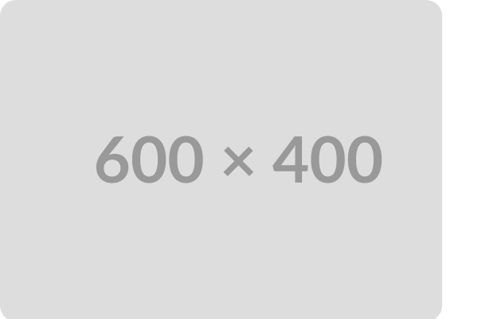
Inverse Search: Step 1
MBR and AABB Creation
For each non-empty grid cell, X-HD calculates a Minimum Bounding Rectangle (MBR). This MBR is then expanded by an initial search radius r0.
This expansion creates the AABBs that serve as the input for the Bounding Volume Hierarchy (BVH) built on the RT cores.

Slide 33


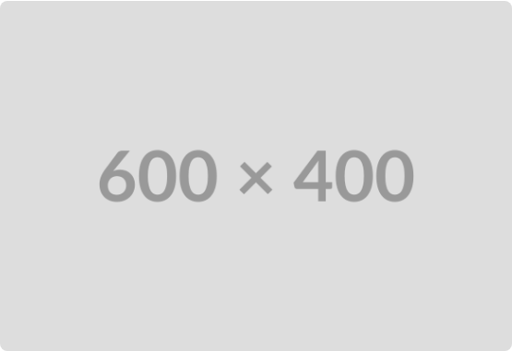
Hardware Acceleration
The Inverse Test
NN search is reformulated for RT cores by asking: "Which spheres containing a point contain the query point?"
Every data point is enclosed in an Axis-Aligned Bounding Box (AABB) expanded by radius r. Ray tracing quickly finds all hit AABBs.

Slide 34


Inverse Search: Step 2
BVH Traversal
Query points from Set A cast short rays. The hardware-accelerated BVH traversal quickly identifies ray-AABB intersections.
When an intersection is detected, the IsIntersection shader is triggered to perform precise point-to-point distance calculations within the cell.

Slide 35

Inverse Search: Step 3
Handling Misses
If a query point's ray misses all AABBs, it means no neighbors were found within the current radius r.
These "missed" points are moved to a waitlist to be re-searched with an expanded radius in the next iteration until every point finds its nearest neighbor.

Slide 36

Adaptive Radius Strategy
Dynamic Growth: Expansion factors (8, 4, 2, 1) are applied based on the shrinking rate of the worklist.
Efficiency: Rapid growth early on reduces the total number of iterations for outlier points.
Safety: Careful growth later avoids excessive false-positive intersections in dense clusters.
Termination: The process continues until all points in Set A find their closest counterparts in Set B.

Slide 37



Pruning Case 1: Query Point
Condition: MaxDist ≤ cmax
Action: Cull Query Point
If the farthest corner of the MBR is closer than the global maximum distance discovered so far, this point cannot increase the Hausdorff Distance.
We discard the query point entirely for the rest of the computation. It cannot contribute to the result.

Slide 38


Pruning Case 2: Cell Culling
Condition: MinDist ≥ cmin
Action: Skip Cell
If the closest face of the cell is already further away than the current minimum distance found for this query point, the cell cannot contain a closer neighbor.
We skip the distance calculations for all points inside this grid cell for the current query.

Slide 39


Pruning Case 3: Radius Pruning
Condition: MinDist > r
Action: Skip Iteration
If the lower bound distance to the cell is greater than the current search radius, the cell is outside the search area for this iteration.
The cell is ignored for now, reducing unnecessary intersections and point-wise distance checks.

