Slide 1
RayJoin: Fast and Precise Spatial Join
Liang Geng⁺, Rubao Lee*, Xiaodong Zhang⁺
+ The Ohio State University
* Freelancer
Notes:
Hi everyone, I’m Liang from the Ohio State University. Our work is called “RayJoin: fast and precise spatial join”. We finished this work with my two colleagues Dr. Lee and Prof. Zhang.

Slide 2
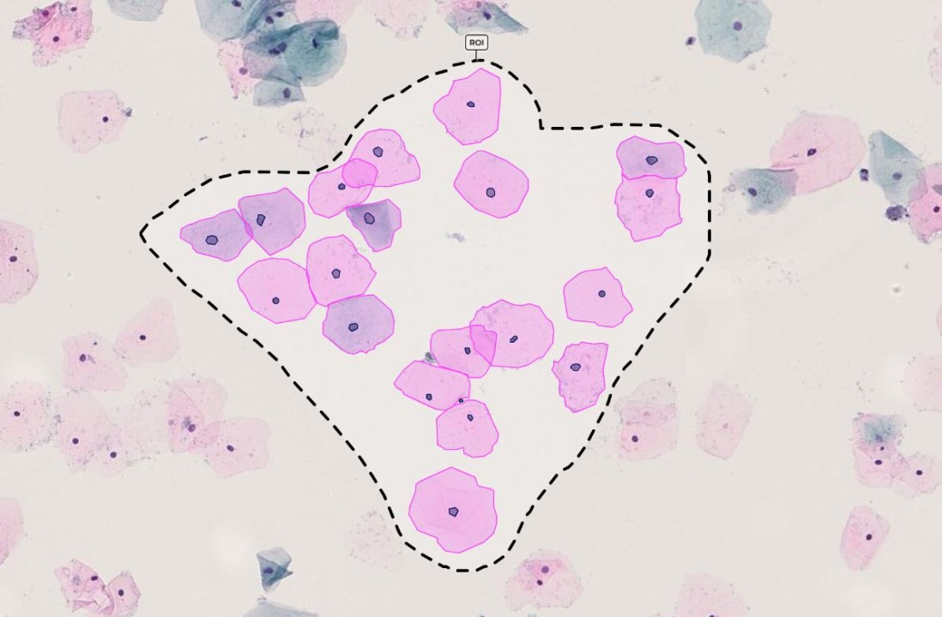
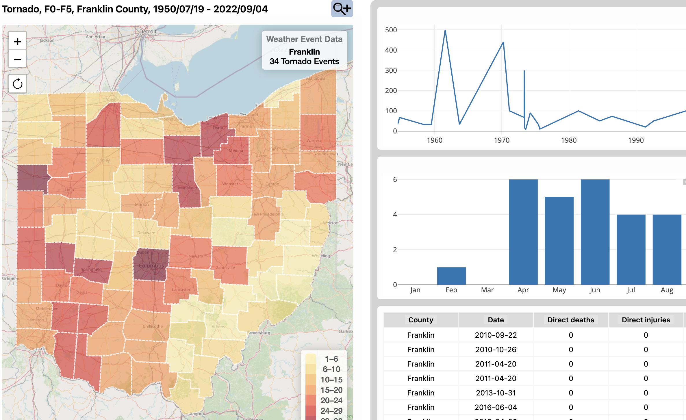
Spatial Data is Critical for Many Applications
Location-based Internet Services
Pathology
Emergency Management
Notes:
Location-based Services rely on spatial data, such as Google Maps provide nevigation to the users.
Spatial data is also useful in pathology because cells can be represented by polygons.
In emergency management, spatial data is used to monitor severe weather.

Slide 3
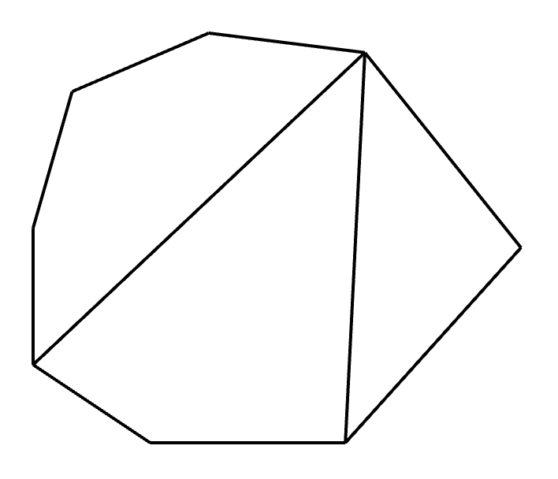
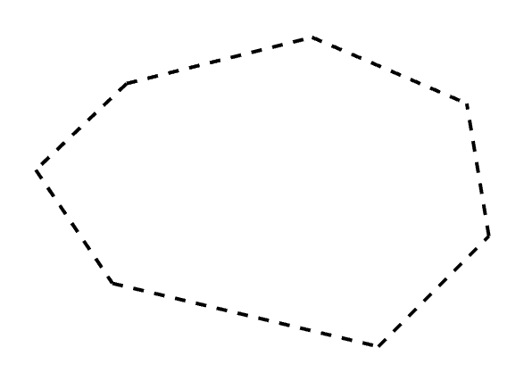
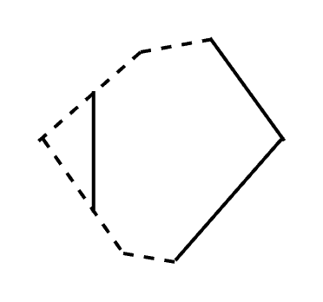
What is Spatial Join?
Spatial Join ⋈
Takes two sets of geometries, R and S
A spatial predicate θ, e.g., overlap
R⋈θ S returns the geometries satisfying θ
${\text{R}\text{ ⋈}}_{overlap} S$
R
S
Notes:
This work focuses on an accelerating spatial join, an important spatial query.
We introduce spatial join with an example called polygon overlay, which is the most commonly used spatial join case
The query takes two sets of geometries R and S and a spatial predicate, such as overlap, and returns the geometries satisfying the predicate.

Slide 4
Why Spatial Join is Important?
Exists in almost every spatial database
Compute-intensive, therefore slow
Many tasks require real-time (<1s) spatial join
Interactive exploration, disaster warning, etc.
Spatial data could be constantly changing
Collected from mobile devices, vehicles, etc.
Notes:
because it exists in almost every spatial database. Spatial join is time-consuming because of its compute-intensive nature.
However, real-time spatial join is desirable by considering the time-sensitive nature of real-world applications, such as interactive exploration, disaster warnings, etc.
In addition, some spatial data could be always changing, such as the data collected on mobile devices, and cars.
Without a fast spatial join solution, we will always have outdated query results

Slide 5
A Real-world Example
Example: cuSpatial
SOTA commercial software from NVIDIA
Point in Polygon (PIP)
Quad-tree-based spatial index
3K Polygons, 24M points
Our Goal!
53 seconds
on RTX 3090
RayJoin
< 1 seconds
Same Hardware
Notes:
Here is a practical example to give you a sense of how much time it takes for a typical spatial join query PIP.
We have evaluated cuSpatial, the state-of-the-art spatial data analytical software from NVIDIA.
It takes about 53 seconds on PIP queries with 3K polygons and 24M points.
Our work, RayJoin, aims to cut down the execution time to less than 1 second on the same hardware.

Slide 6
Why the Existing Solutions are Slow?
Rasterization
Optimal complexity
Difficult to parallelize
Cannot achieve real-time processing (< 1s)
Algorithmic efficient
Hardware friendly
Accurate
No preprocessing
Customized
Plane-sweep
Offering parallelism
Intensive preprocessing
Mismatch between algo. design and architecture
Learned
Index
Efficient query and storage
Training costs/Inaccurate
Can we break the bottlenecks?
General
Tree-based
Index
Algorithmic efficient
Hardware inefficient
Yes, we can use RT Cores
Grid-based
Index
Hardware efficient
Cannot handle skewed data
Notes:
After more than 40 years of development, there are 5 typical spatial data processing approaches, including customized methods and general index-based methods on both CPUs and GPUs.
Unfortunately, our evaluations show that none of them can achieve real-time processing mainly due to the mismatch between the design of algorithms and hardware architecture.
Can we break the performance bottlenecks? Yes, we can utilize a hidden unit on the RTX GPUs, called RT Cores.
Our solution, RayJoin, exploits RT Cores to accelerate spatial join queries by translating them into ray tracing problems. RayJoin is algorithmic efficient, hardware friendly, accurate, and does not require preprocessing.

Slide 7
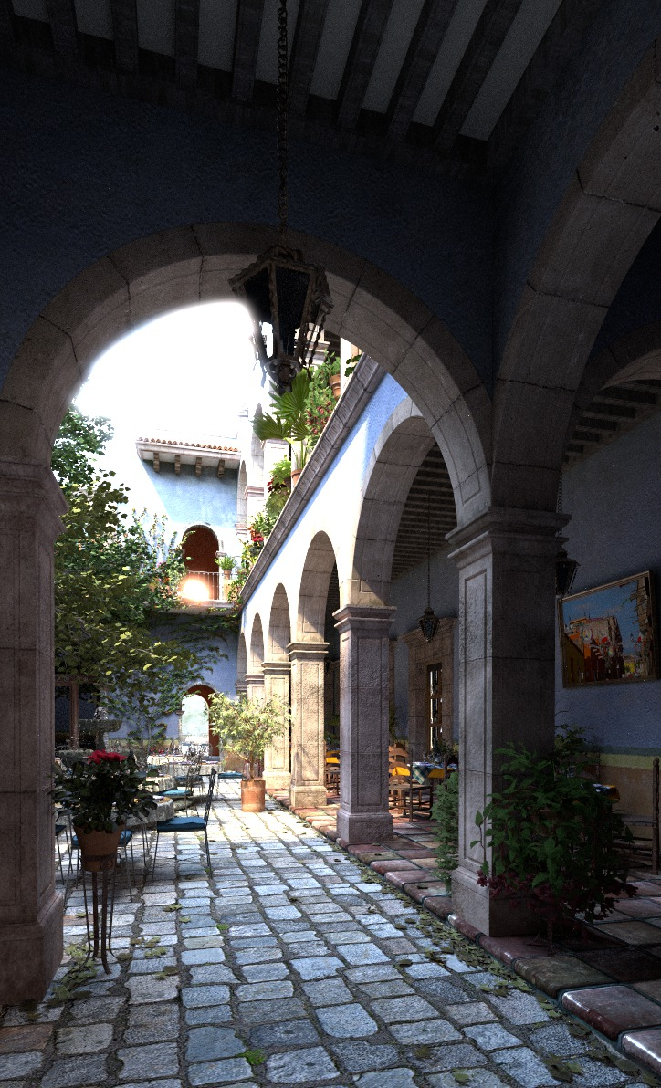
Ray Tracing Basics
What is Ray Tracing (RT)
A photorealistic rendering technique
How does it work?
Simulation of the light transportation
Bounding Volume Hierarchy (BVH) tree to
accelerate the search for intersections
Light Source
View Ray
Camera
Screen
Scene
Notes:
We need to introduce some ray tracing basics before we dive into RT Cores.
Ray tracing is a photorealistic rendering technique.
The principle of ray tracing is to simulate light transportation.
A rendering system has three components, camera, screen and scene. We also need a light source, otherwise we see nothing. The camera is a component in the rendering system to observe the scene.
Ray tracing based rendering begins by casting rays from the camera through the screen to find intersections.
If the ray hits a geometry, we cast rays from the geometry toward the light source to get how much energy will be reflected on the surface to the camera.
Since a scene consists of millions of geometries, we need a spatial index to identify which geometries are hit by a ray. Currently, BVH is the predominant data structure used in ray tracing.

Slide 8
Ray Tracing Basics
Bounding Volume Hierarchy - a tree-based spatial index
Partitions geometries with Axis-Aligned Bounding Box (AABB)
Each node N_{i} corresponds to an AABB B_{i}
Geometries are stored in the leaf nodes
$$Q_{}$$
$$B_{1}$$
$$N_{1}$$
$$B_{2}$$
Hit
$$N_{2}$$
$$N_{3}$$
$$B_{3}$$
$$Q_{}$$
$$B_{4}$$
$$B_{5}$$
$$N_{4}$$
$$N_{5}$$
Hit
Notes:
BVH is essentially a tree, which partitions geometries with AABB. Each node in the tree is associated to an AABB and the geometries are stored in the leaf node.
Given a ray Q, we first test whether the ray intersects with the root node. If it does, we continually test whether it intersects the bounding boxes belonging to their child nodes.
In such case, the ray intersects B2 and also hits the triangle enclosed by B2, we have successfully identified an intersection. However, the ray does not intersect bounding box B3, so the right subtree can be eliminated. Therefore we reduced the search space.

Slide 9
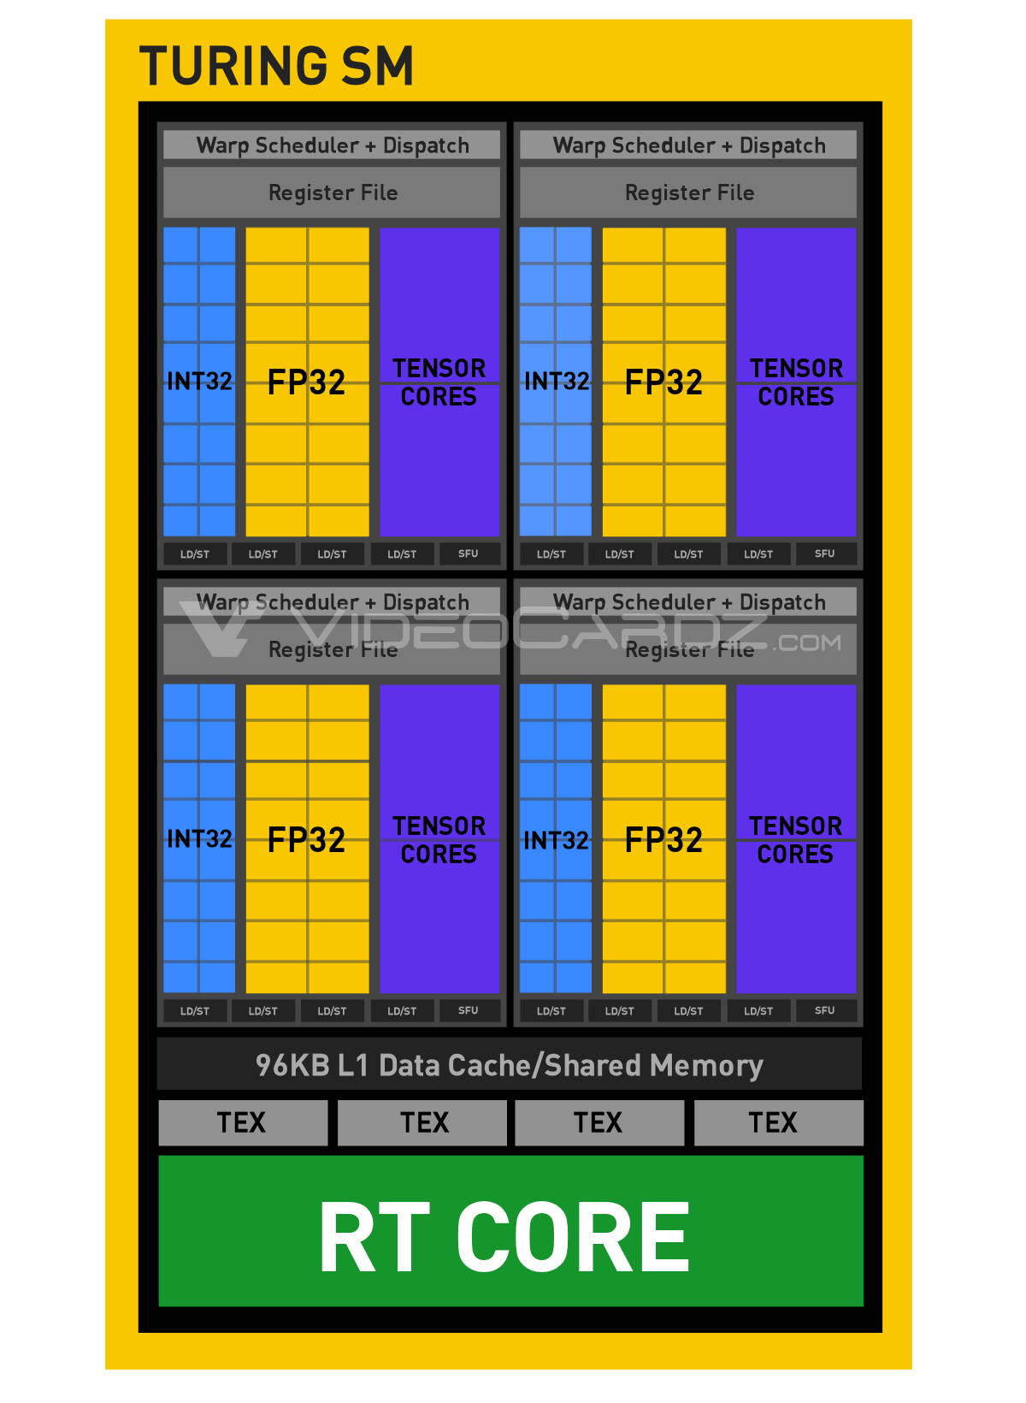
NVIDIA RT Cores
BVH Traversal is expensive
A lot of random memory accesses
Need intensive ray-geometry intersection test
Implemented in software is slow
NVIDIA RT Cores
Accelerate BVH traversal
Ray-box, and ray-triangle intersection tests in hardware
Available on NVIDIA RTX GPUs
Notes:
BVH Traversal is expensive, because it involves a lot of random memory accesses and needs intensive ray-geometry intersection tests.
Therefore, some hardware vendors have implemented these functions in hardware, such as NVIDIA RT Cores.
As shown in the Figure, each streaming multiprocessor (SM) processor contains an RT Core.
Each RT Core has two specialized units, the left one is designed for ray-box intersection test, and the right one is for ray-triangle test.

Slide 10
RT Programing Model
RT programming with NVIDIA OptiX
Written in CUDA with restrictions (e.g., shared mem.)
Implementing shaders (callbacks) to handle intersections
OptiX Workflow:
Traversal completes
Geometries
Build BVH
RayGen
Shader
BVH Traversal
Ray-AABB Test
Yes
ClosestHit
Shader
Found a hit
No
Leaf Node
No
AnyHit
IsIntersection
Shader
Yes
AnyHit
Shader
Miss
Shader
Miss
Ray geometry
intersection
AnyHit
ClosestHit
Notes:
Let’s look at how to use RT Cores. OptiX is a ray tracing framework that runs on RT Cores. In OptiX, users implement shaders in CUDA to cast rays and handle intersections.
Here’s the workflow of OptiX. Initially, users provide geometries to build a BVH. The BVH construction is a fixed function. RayGen shader is the place to cast a ray.
Then the BVH traversal starts. If a ray hits the bounding box in the leaf node, the IsIntersection shader is triggered, allowing the user to verify whether the ray hits the geometry enclosed by the bounding box.
If the ray hits the bounding box but does not intersect the triangle in the bounding box, the BVH traversal continues. If the ray does hit the triangle, the user may report the intersection to OptiX. Then, the AnyHit shader will be triggered, allowing the user to do the rendering task.
When the traversal completes, the ClosestShader will be invoked, which returns the closest geometry to the ray origin.

Slide 11
Key Challenges
Efficient Problem Formulation
Line Segment Intersection (LSI)
Point in Polygon (PIP)
Limited Precision
RT Cores only support FP32
Geospatial data stored in FP64
BVH Construction Overhead
Time and Space
Notes:
We face several technical challenges when designing RayJoin.
First, we must translate the query into a ray tracing problem because this is the only way to use RT Cores. We focus on two queries, line segment intersection and point in polygon.
Second, RT Cores only support single-precision, while spatial data is often stored in double precision.
Finally, BVH Construction is expensive in terms of both time and space.

Slide 12
Line Segment Intersection
Line Segment
Defined by two endpoints $p_{1}$, $p_{2}$
Line Segment Intersection (LSI)
Given two sets of line segments R, S
Identifying all the intersections of $r,s$ where $r∈R$, $s∈S$
$$p_{1}$$
$$p_{2}$$
$$r_{1}$$
$$s_{2}$$
$$s_{1}$$
Notes:
Let’s look into the first RT-accelerated query: line segment intersection.
We need to first introduce the definition of the line segment. A line seg is defined by two endpoints, p1 and p2
LSI needs two sets of inputs, R and S, consisting of an array of line segments. LSI just finds all the intersection points from R and S.
Here's an example showing a segment r1 intersects two segments, s1 and s2, from S, resulting in two intersection points.

Slide 13
Transform LSI into a RT Problem
A ray is a semi-infinite line ($R\left(t\right)=O+t∗\overset{⃑}{d}$)
Take a part of the ray $→$ Line Segment
Enclose another line segment with a bounding box!
Ray hit a box $→$ could have an intersection
Find the common solution of line seg. equations
Collect intersection with AnyHit shader
$$\overset{⃑}{d}$$
False Positive
$$t_{max}$$
$$t_{min}$$
O
Notes:
Here's our method.
A ray is a semi-infinite line defined by an origin O and direction vector d. We can simulate a line segment by taking a part of a ray. For the line segment from another dataset, we introduce a bounding box to enclose them.
Then, the LSI problem is converted into a ray-box intersection problem, so we ask RT Cores to solve this problem. If a ray hits a box, we may identify an intersection.
However, we still need to verify the intersection because a ray hitting a box does not mean two line segments intersect. To filter out false positives, we can solve the common solution of the line segment equations. Finally, we collect the intersections in the AnyHit shader.

Slide 14
Point in Polygon
Point in Polygon (PIP)
Given two sets of polygons R and points $S$
For a given point $s∈S$, PIP returns which polygon the point falls into
$s1$ returns r$1$
$$s1$$
$$r1$$
$s2$ returns r$2$
$$r2$$
$$s2$$
$s3$ returns r$0$
$$r3$$
$$s3$$
$$r0$$
Notes:
Point in polygon is another RT-accelerated spatial join query. It also takes two inputs, which are polygons and points respectively.
As shown in this figure, the polygons are labeled with r1, r2, r3.
Three dots are the PIP query points.
For a given point s, PIP query returns which polygon the point falls into
For example, point s1 falls in polygon r1, and s2 is in r2 but query s3 does not fall in any polygon, so it returns r0.

Slide 15
Transform Point in Polygon into a RT Problem
Each line segment carries neighboring polygon IDs
Cast a ray upwards from the query point
Find the closest line segment from the query
Hit, but not the closest
Check the label on the line seg.
$$r0$$
$$r1$$
$$r1$$
Closest Hit
ClosestHit shader tells the closest hit
$$r2$$
$$r2$$
$$s_{1}$$
Read the label on the line seg.
$$r3$$
$$r3$$
$$r0$$
Notes:
To facilitate the PIP query, each line segment is labeled with neighboring polygon IDs.
For a given query s1, we cast a ray upwards from the query point. Then we identify the closest line segment hit by the ray. By checking the label on the closest line segment hit by the ray, we can tell the query falls in which polygon.
Rember OptiX provides a specialized shader to find the closest hit, so the process will be very fast.

Slide 16
Limited Precision
Geospatial data typically requires double precision
RT Cores only support single precision for performance
Mantissa bits are truncated
IEEE 754 - ”roundTiesToEvent” rules
Rounding up/down depends on the left-over bits
FP32
FP16
Here we show the conversion from FP32 to FP16 for convenience.
Notes:
We also face some technical issues when using RT Cores.
Geospatial data is stored in double precision but RT Cores only support single precision
When casting a double precision to a single precision, the Mantissa bits of floating point numbers are truncated.
According to the ”roundTiesToEvent” rule, the downcast floating point number could be greater, equal, or less than the high precision number depending on the left-over bits.

Slide 17
Consequences: Geometric inconsistencies
False-positive is acceptable
False-negative leads to intersections missing
Intersections missing for LSI and wrong results for PIP!
High Precision
False positive
False Negative
Notes:
As a result, the rounding errors from the floating point downcasting will lead to geometry inconsistencies.
If the right boundary rounds up, making a ray hit the bounding box but the ray does not intersect the line segment, we have a false-positive case, which is acceptable
However, if a ray actually intersects a line segment, but the line segment is not enclosed by the bounding box due to rounding errors, we never have a chance to identify the intersection.
As a result, we will have intersections missing for LSI query and wrong results for PIP query.

Slide 18
Our Solution in RayJoin
Create an overlarge bounding box?
Not big enough $→$ False negatives
Too big $→$ Too many false positives, hurting performance
Conservative Representation
Add 1 to mantissa bits to the downcast number
Guarantee to enclose line seg in high-precision
Downcast
Mantissa + 1
y
Mantissa Bits
$$x_{r}$$
$$x_{r}^{d}$$
$$x_{r}^{′}$$
O
x
$$x_{r}^{d}$$
$$x_{r}$$
$$x_{r}^{′}$$
Notes:
The intuition for addressing the issue is to create a large bounding box that ensures enclosing the line segment even if we experience rounding errors.
We have a question, how big is sufficient to offset the rounding errors? If the bounding box is not big enough, we have false negatives anyway. If the box is too large, we have too many false positives, hurting performance.
Our method is called “Conservative Representation”, which is achieved by tweaking the mantissa bits to create a low-precision bounding box that is just barely enough to enclose the high-precision line segment.
As shown in the figure, x_{r} is the right boundary in high precision. x_{r}^{d} is the boundary in low precision being downcasted from x_{r}.
The secret is to add 1 to mantissa bits to the downcasted number. This new boundary x_{r}' guarantees to enclose the line segment in high precision because it is greater than x_{r}.

Slide 19
Reduce BVH Construction Cost
An AABB bounds only one line segment
Put spatially close line segments together
Time and space costs
Building time is 9.4x ~ 11.8x longer than queries
BVH takes 2.4 GB of device memory for 69M line segments
Notes:
Another technical issue is the high BVH construction cost.
Our initial idea is to use an Individual bounding box to enclose each line segment. As a result, we will have a huge BVH and a long construction time.
A better solution would be using a bounding box to enclose multiple line segments. When a bounding box is hit by a ray, we iteratively check the ray intersects which line segment in the box.
Our grouping strategy is to put spatially close line segments together to reduce false positives.
The figure on the left is an ideal case while the right is not. Because if a ray hits a huge bounding box, it is unlikely the ray hits the line segment in the box.

Slide 20
Experimental Setup
NVIDIA OptiX 8.0, CUDA 12
For GPU baselines: NVIDIA RTX 3090
For CPU baselines: AWS r5.4xlarge,16 Cores, 128 GB Memory
Artifact | Platform | Description
Uniform Grid | GPU | grid-based spatial index
LBVH | GPU | software emulated BVH
cuSpatial | GPU | spatial library from NVIDIA, quad-tree
PSSL | GPU | plane-sweep in CUDA
RasterJoin | GPU | rasterization-based PIP in OpenGL
GLIN | CPU | Learned index
EPUG-Overlay | CPU | two-level uniform grid
Kinetica | CPU | in-memory spatial database
PostGIS | CPU | disk-based spatial database
RasterIntervals | CPU | rasterization-based
Notes:
Here is the experimental setup.
We have covered all the open-sourced solutions for spatial join, including grid-based spatial index, tree-based even machine learning-based spatial indexes, classical plane sweep, and rasterization-based implementation on both CPUs and GPUs.

Slide 21
Datasets
Worldwide datasets: Parks and Lakes from OpenStreetMap
US-based datasets
Dataset | Line Segs | Polygons | Description
LKAF | 1.8M | 18.2K | Water areas in Africa
PKAF | 1.3M | 25.7K | Parks or green areas in Africa
LKAS | 10.3M | 151.6K | Water areas in Asia
PKAS | 11.9M | 172.6K | Parks or green areas in Asia
LKAU | 1.2M | 14.5K | Water areas in Australia
PKAU | 567.1K | 12.8K | Parks or green areas in Australia
LKEU | 27.9M | 654.8K | Water areas in Europe
PKEU | 65.9M | 1.9M | Parks or green areas in Europe
LKNA | 69.3M | 1.6M | Water areas in North America
PKNA | 26.9M | 303.0K | Parks or green areas North America
LKSA | 2.4M | 32.6K | Water areas in South America
PKSA | 3.2M | 49.5K | Parks or green areas in South America
Dataset | Line Segs | Polygons | Description
County | 1.0M | 3.1K | Boundaries of the U.S. Counties
Zipcode | 23.9M | 32.2K | ZIP Code areas for the USPS
Block | 29.3M | 239.2K | Census block groups in the U.S.
Water | 25.6M | 463.6K | Major water features in the U.S.
Notes:
For datasets, we use US-based datasets because they are very large and widely available, allowing RayJoin to showcase its performance.
We also evaluate RayJoin with worldwide datasets. To verify its performance under different geospatial distributions.

Slide 22
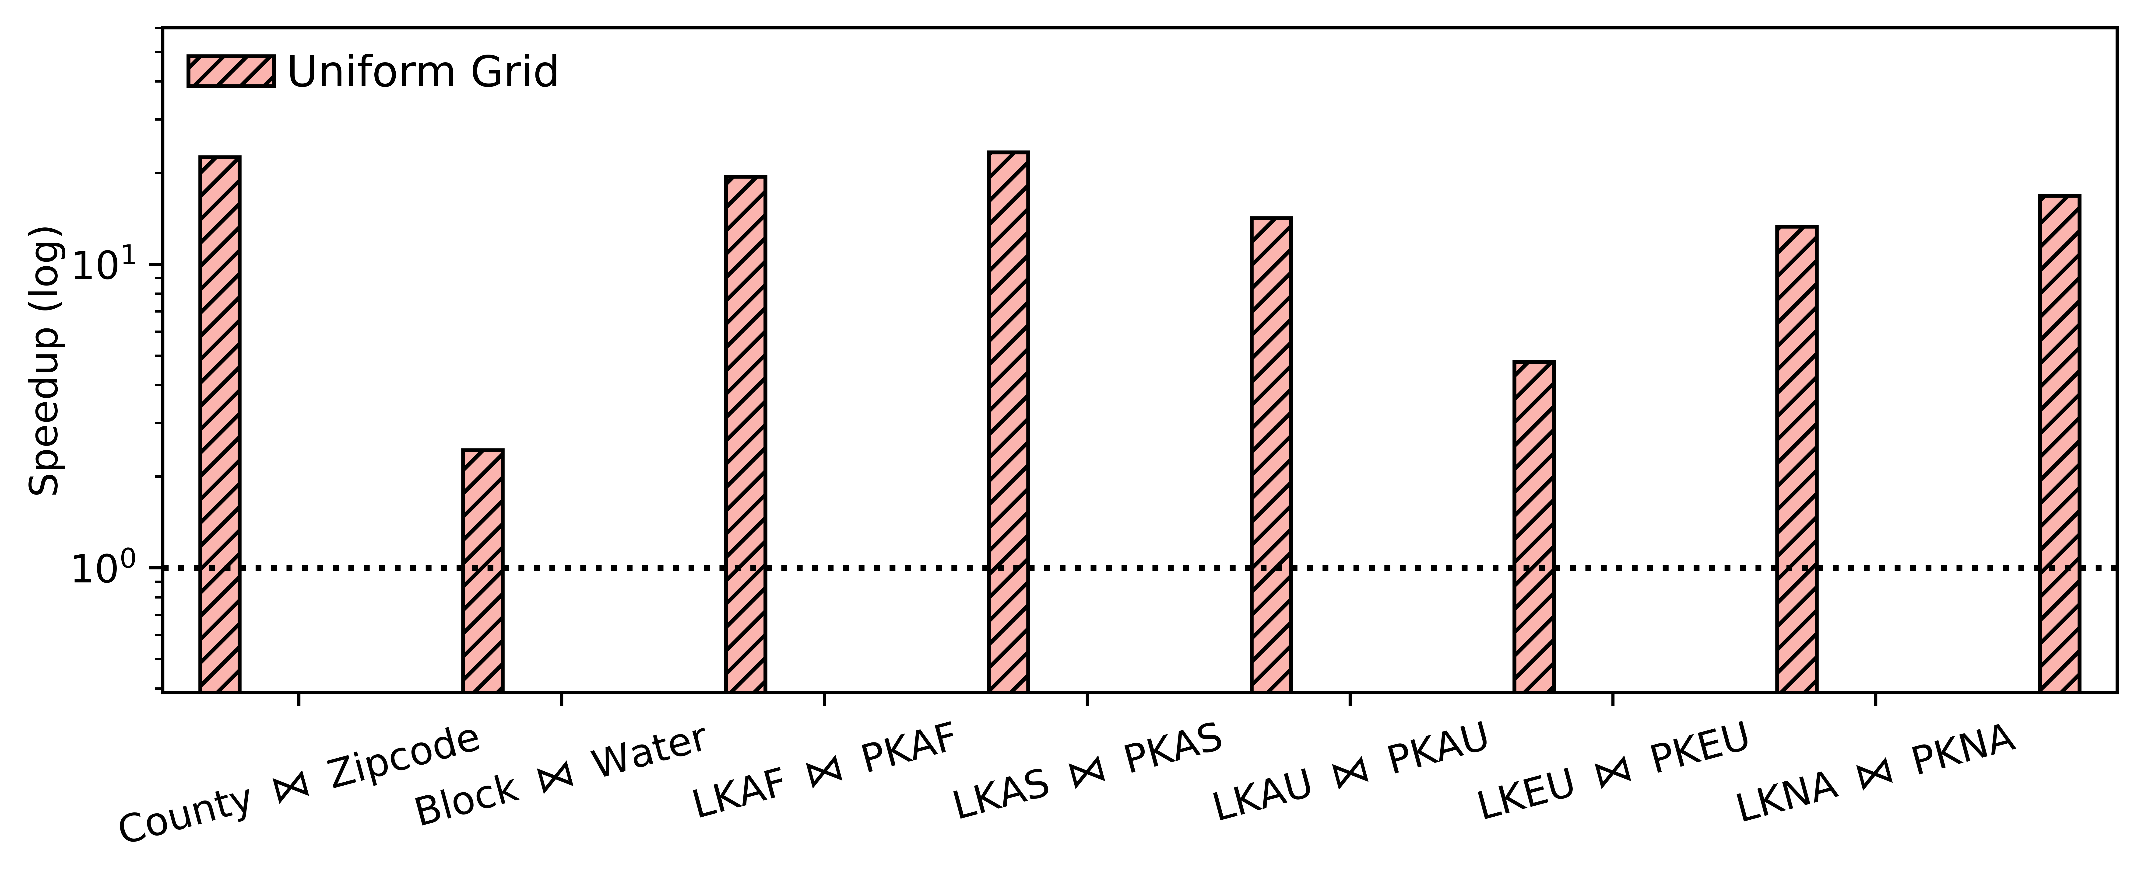
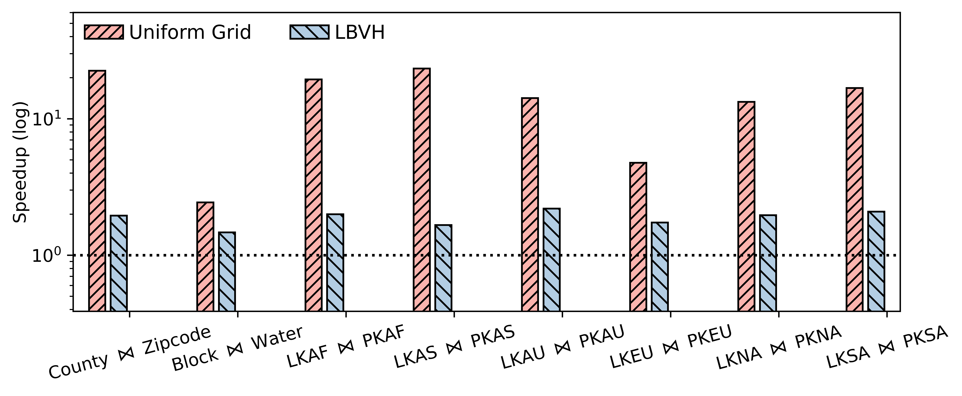
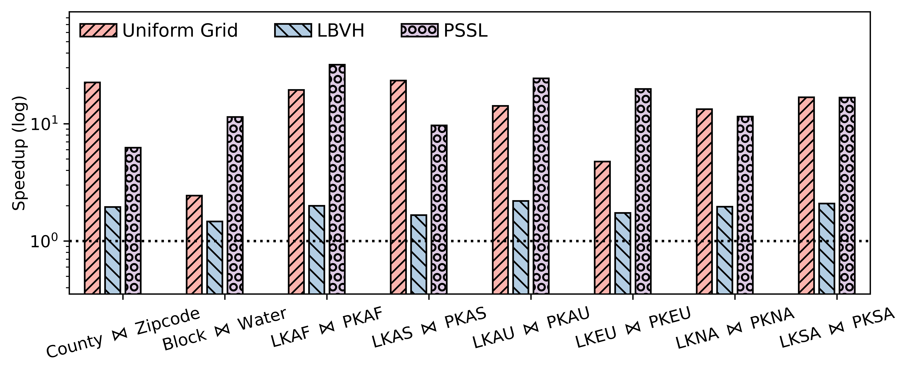
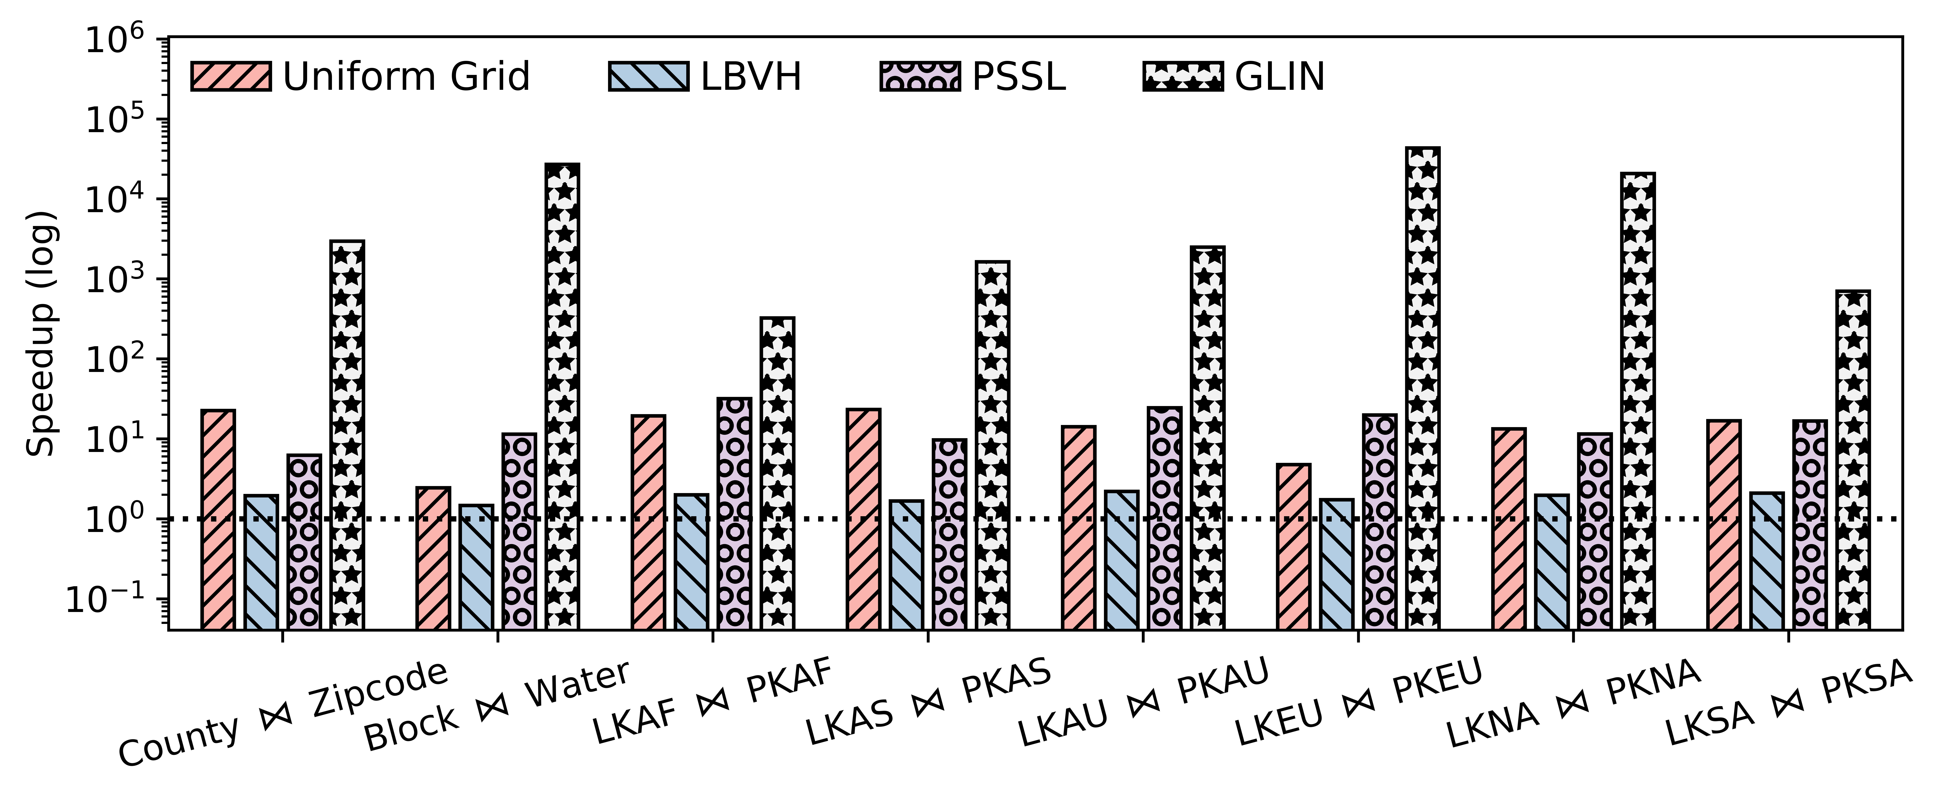
LSI Performance
Speedups over the baseline
End to end: H2D, BVH Construction, and Query
Speedups: 1.5x $\sim$ 2.4x over the best baseline
Longest execution time: 208ms
The best baseline 409 ms
GPU-based
Notes:
Here is the performance summary of RayJoin. We measure the end-to-end performance of RayJoin and baselines, including host-to-device, BVH construction, and query time.
RayJoin achieves speedups from 1.5x to 2.4x over the best baseline performance.
The longest execution time is only about 208 ms, while the best baseline takes 409 ms.

Slide 23
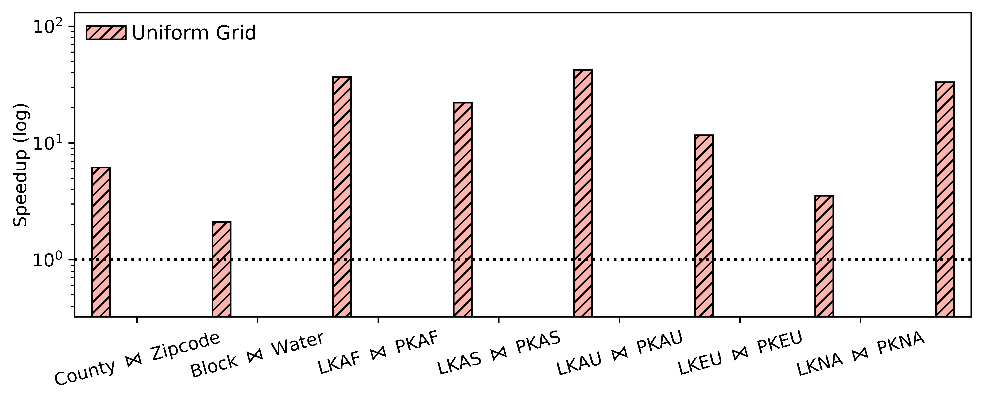
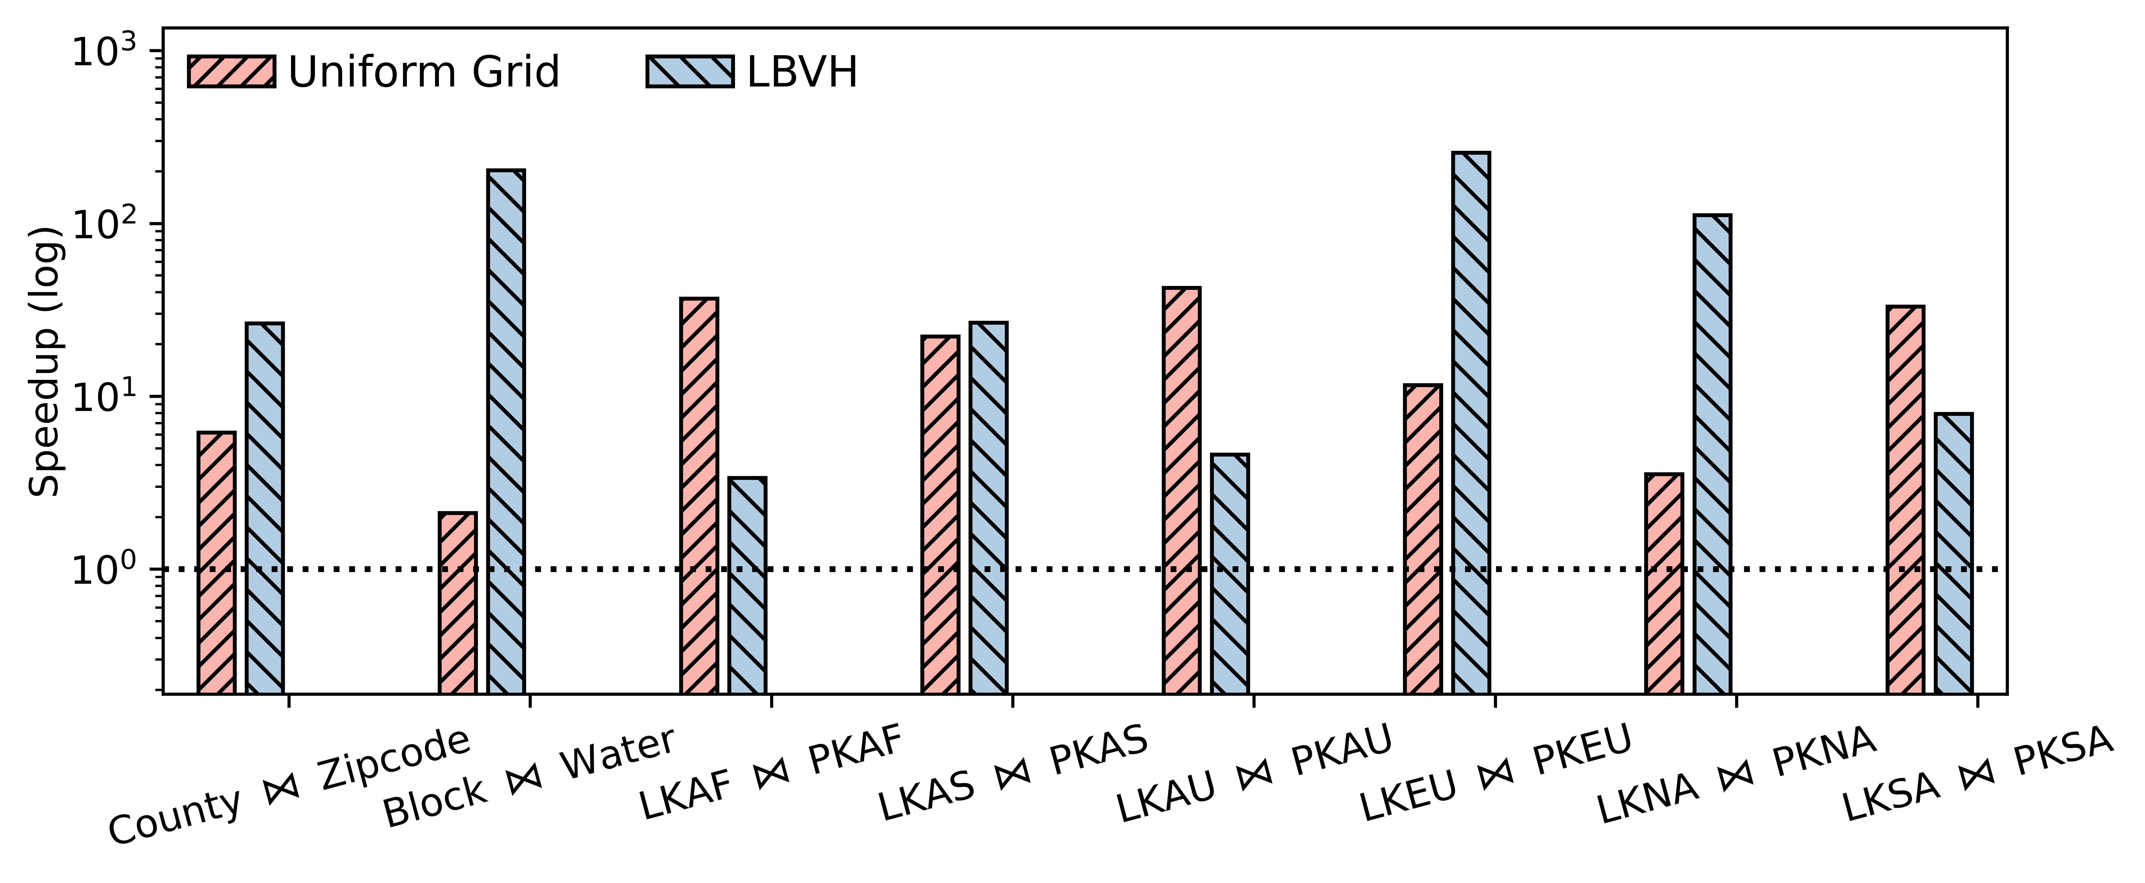
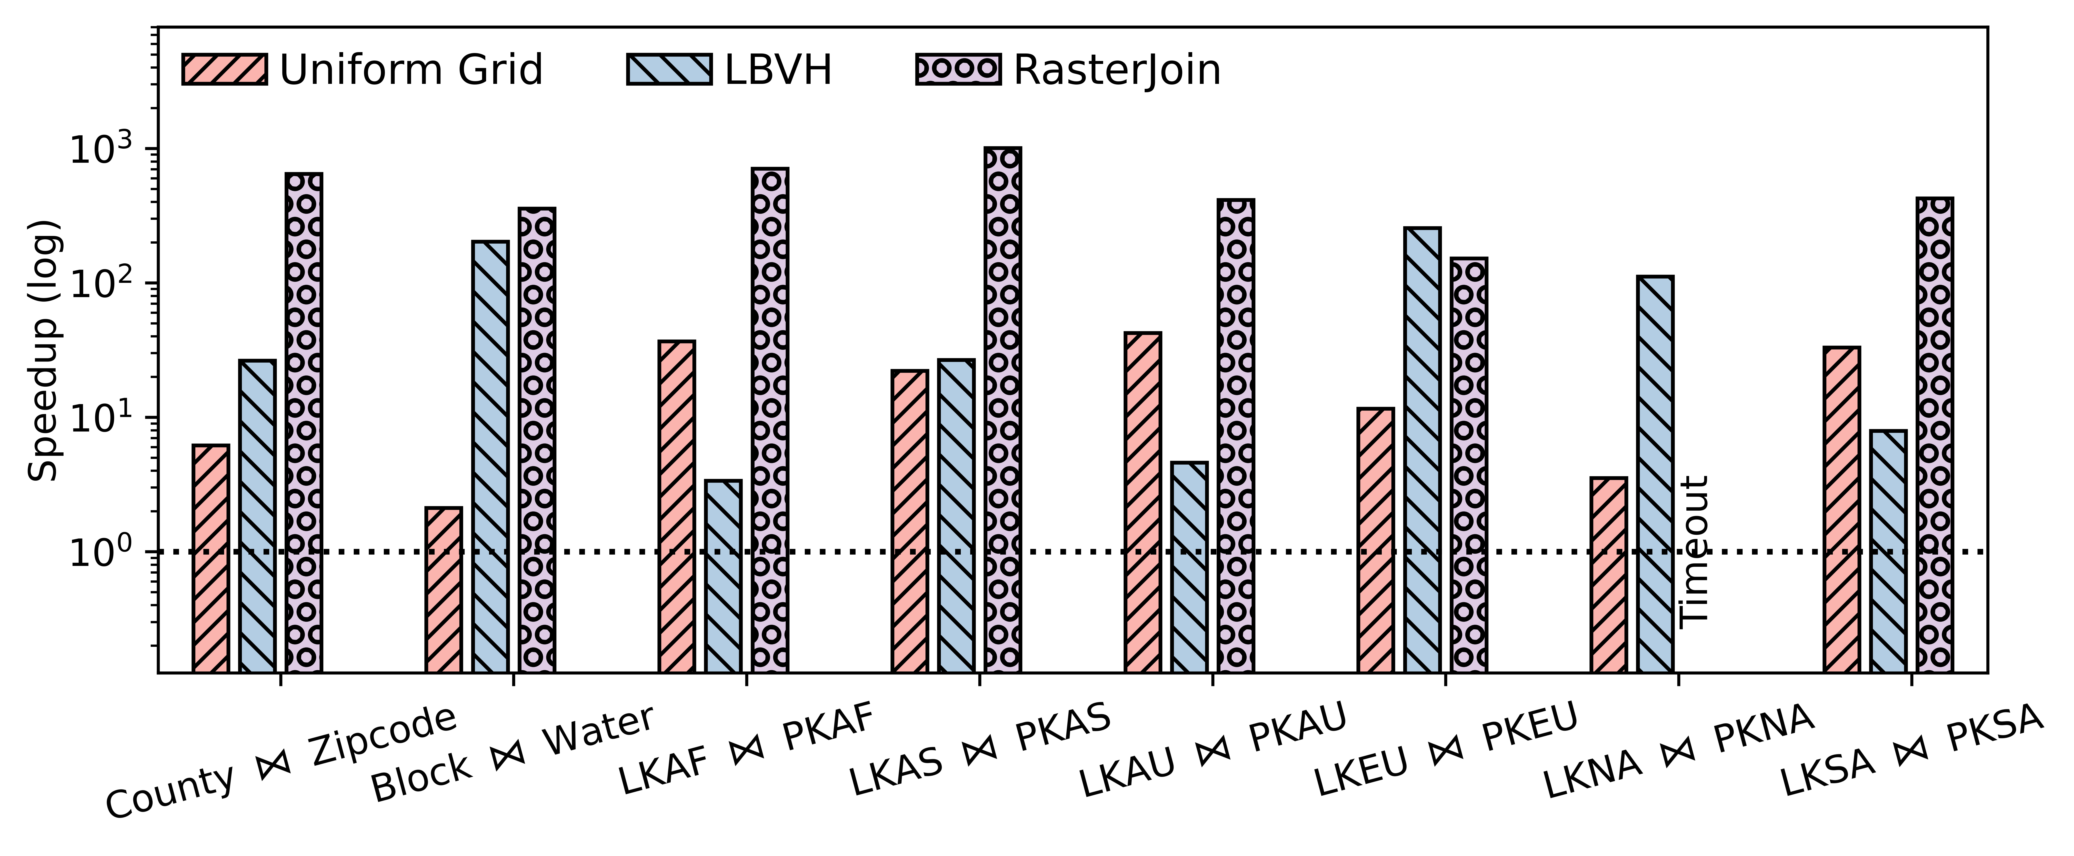
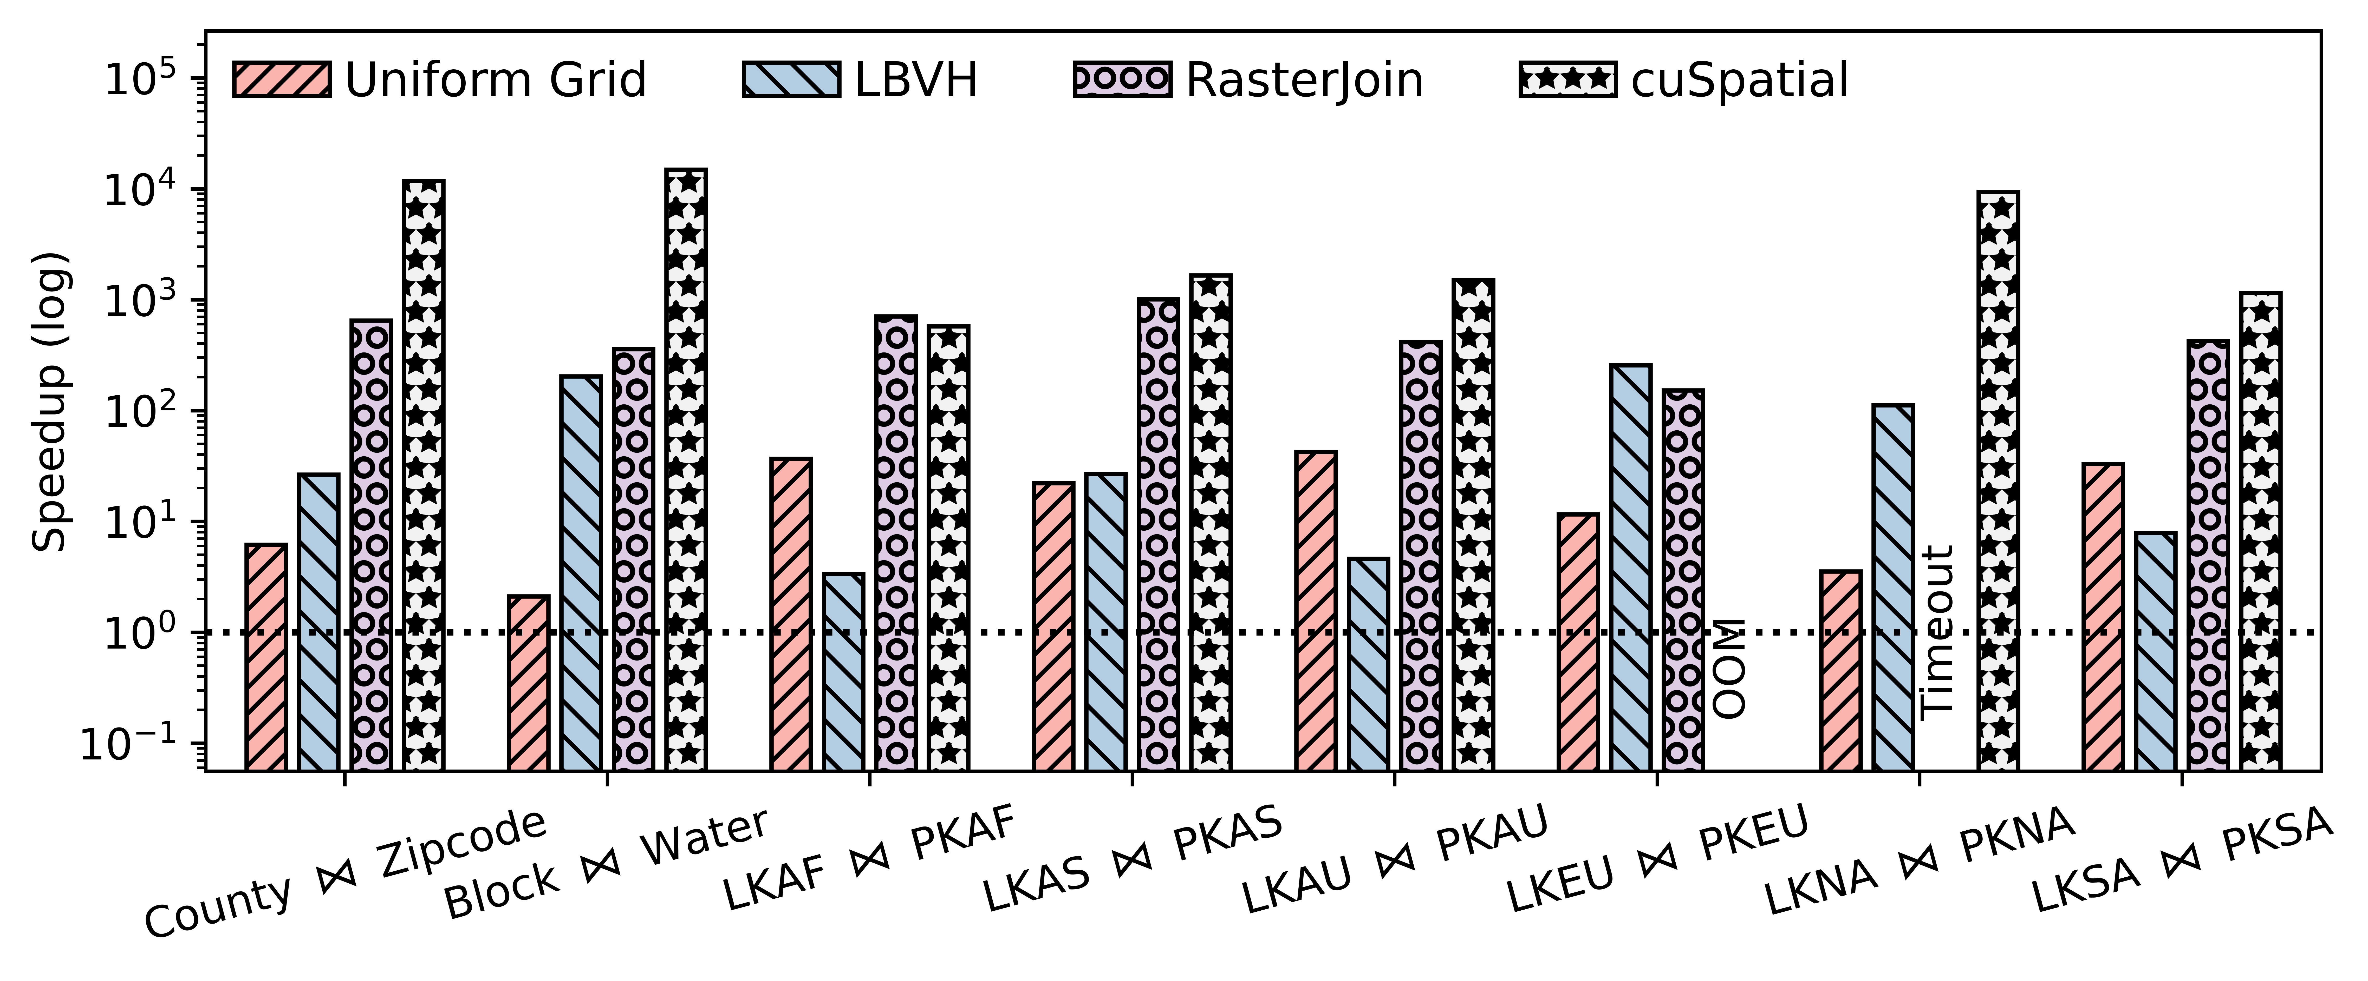
PIP Performance
Speedups over the best baseline
All baselines are GPU-based
End to end: 2.1x $\sim$ 22.2x
Longest execution time: 253 ms
The best baseline 2942 ms
Not real time
Notes:
Here are the PIP speedups over the best baseline. PIP query is RT-favored workload because it only needs to find the closest hit and RT Cores are designed for this purpose.
Considering the total execution time, RayJoin achieves speedups from 2.1x to 22x
The longest execution time of RayJoin is only about 253 ms on the Europe dataset, while the best baseline takes almost 3 seconds. Therefore, none of the existing solutions achieves real-time processing.

Slide 24
Conclusion
RT Core
A potential accelerator for spatial data processing
Must formulate the problem as an RT problem
Without introducing too much overhead
Precision limitation
Can be overcome by using the conservative bounding box
RayJoin joins millions of polygons with only 460 ms
We accomplish our goal!
Thank you!
Email: geng.161@osu.edu
Source code & Dataset https://github.com/pwrliang/RayJoin
Notes:
Here’s the conclusion.
RT Core is not exclusive to the rendering workloads. It fits well with spatial data processing tasks. Because rendering workloads and spatial workloads are both 2D/3D spatial data.
The key to using RT Cores is to formulate your problem as an RT problem without introducing too much overhead.
The limited precision issue can be overcome by using the conservative bounding box.
Our experiments show that RayJoin joins millions of polygons within only 460ms, so we accomplish our goal.
Finally, RayJoin and datasets are open-sourced, so you can easily reproduce the experiments.
Thank you.

Slide 26
Backups

Slide 27
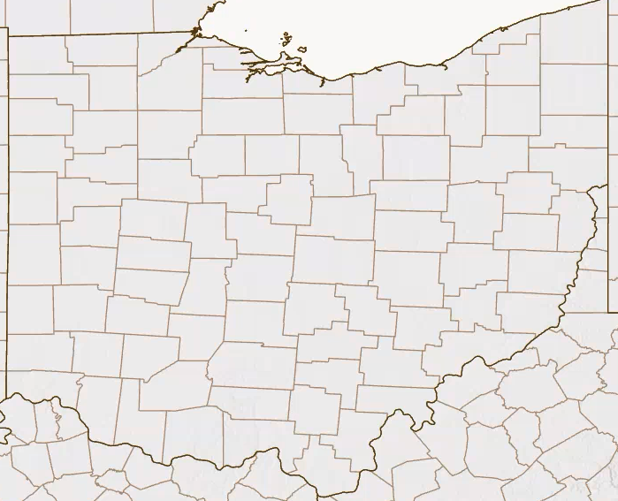
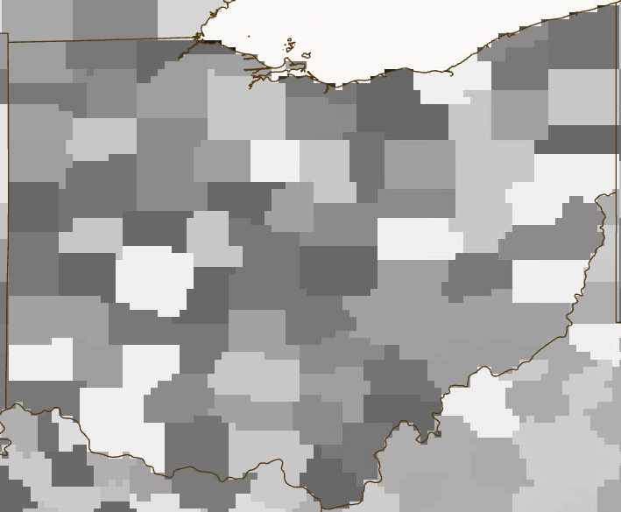
Vector vs Raster Spatial Data
Vector Data: consists of geometries
Raster data: made up of pixels
This work
Ohio Counties (Vector)
Ohio Counties (Raster)
Notes:
There are two commonly used data formats, vector and raster, for spatial data
Vector data is about geometries, such as points and polygons. This work only focuses on vector data. The left picture shows the county boundaries of Ohio, where each county is represented by a polygon.
While raster data is made up of pixels.

Slide 28
Ray Tracing Basics
Ray Definition
$R\left(t\right)=O+t∗\overset{⃑}{d}$
Origin
$$t_{max}$$
Direction
$$\overset{⃑}{d}$$
$$t_{min}$$
$$t_{hit}$$
Ray-box intersection
$R(t_{hit})=O+t_{hit}∗\overset{⃑}{d}$
$$O$$
Filter intersections
K$eep intersections only if t_{min}$ $≤t_{hit}{≤t}_{max}$
Notes:
A ray is just a semi-infinite line determined by an origin and a direction vector. The parameter t controls how far the ray can go.
This figure shows a scenario of ray-box intersection. The ray hits the left edge of the box with a parameter t_{hit}. Carrying t_{hit} to this formula, we can get the intersection point.
Sometimes, we are only interested in the intersection that happens on a segment of a ray. We can use t_{min} and t_{max} to filter out the intersections out of range

Slide 29
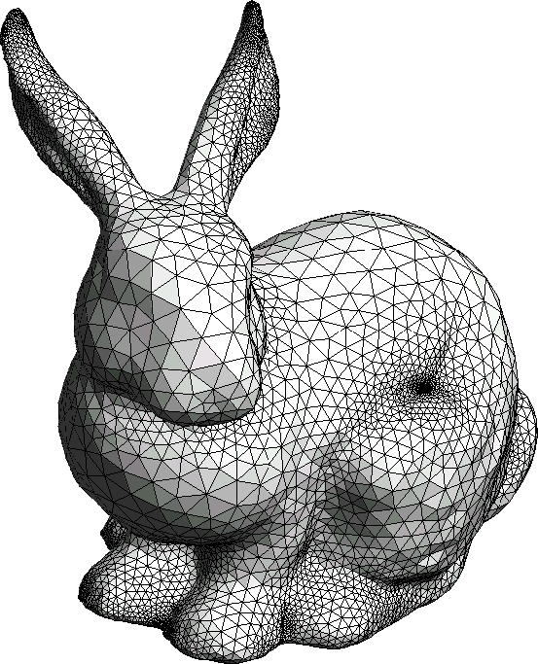
Ray Tracing Basics
Rendering needs a model
millions of triangles
Identify ray-geometry intersection
Straightforward method
Iterate every triangle
Test Ray-triangle intersection
Slow! O(# of rays * # of triangles)
Reduce search space
Using a spatial index to find intersections
Bounding Volume Hierarchy (BVH) tree
Hit which triangle?
Model
https://www.cleanpng.com/png-stanford-bunny-polygon-mesh-computer-science-compu-2777389/
Notes:
3D rendering needs a geometric model, which typically consists of millions of triangles.
We need to know which triangle is hit by a ray, so we can compute energy according to the material properties on the intersection point.
Is straightforward method would be an exhaustive search. Iterate every triangle and run ray-triangle intersection tests. It can be very slow because of the high time complexity.
We need to reduce the search space. Using a spatial index to find intersections is helpful, such as a BVH tree.

Slide 30
Technical Issue 2: BVH Construction Cost
An AABB bounds only one line segment
Put spatially close line segments together
Time and space costs
Building time is 9.4x ~ 11.8x longer than queries
BVH takes 2.4 GB of device memory for 69M line segments
Notes:
Another technical issue is the high BVH construction cost.
Our initial idea is to use an Individual bounding box to enclose each line segment. As a result, we will have a huge BVH. Our experiments show that the building time is about 10 times longer than the queries. In terms of memory space consumption, the BVH takes several gigabytes for large-scale spatial datasets.
A better solution would be using a bounding box to enclose multiple line segments but we need to put spatially close line segments together to reduce false positives.
The figure on the left is an ideal case while the right is not. Because if a ray hits a huge bounding box, it is unlikely the ray hits the line segment in the box

Slide 31
Reducing the number of AABBs
Merge boxes by constraining area growth
Traverse the line segs if a ray hits a box
Notes:
To group spatially proximate line segments, we constrain the area growth when merging bounding boxes.
You can see that initially, there are 8 line segments enclosed by individual bounding boxes.
Here is the running processing of our grouping algorithm.
We merge bounding boxes only if the resulting bounding box will not grow too big. This effecitively reduces the chance of false positives.
When the algorithm is finished, the 8 bounding boxes are now reduced to only four. We use the four bounding boxes to build a much smaller BVH.
If a ray hits the merged bounding box, we traverse each line segment to run intersection tests.

Slide 32
Effectiveness of Adaptive Grouping
Effectiveness of the merging threshold s
A large s allows to merge spatially distant AABBs (more aggressive)
Build time goes down but query time goes up
Need to find a “sweat point”
Notes:
Now, we have a parameter to tune, which is the merging threshold s.
Currently, we have fixed the merging threshold to 3.5 for all datasets. (Could be auto tuned with linear regression or other ML techniques)
AG is very effective. It cuts the BVH construction time from 165ms to about 30ms, which is more than 5x faster. The query times experience a little increase. Overall, AG achieves 29% reduction in total execution time. For the memory space, it cuts the BVH memory space cost from about 2.5GB to only 408MB.

Slide 33
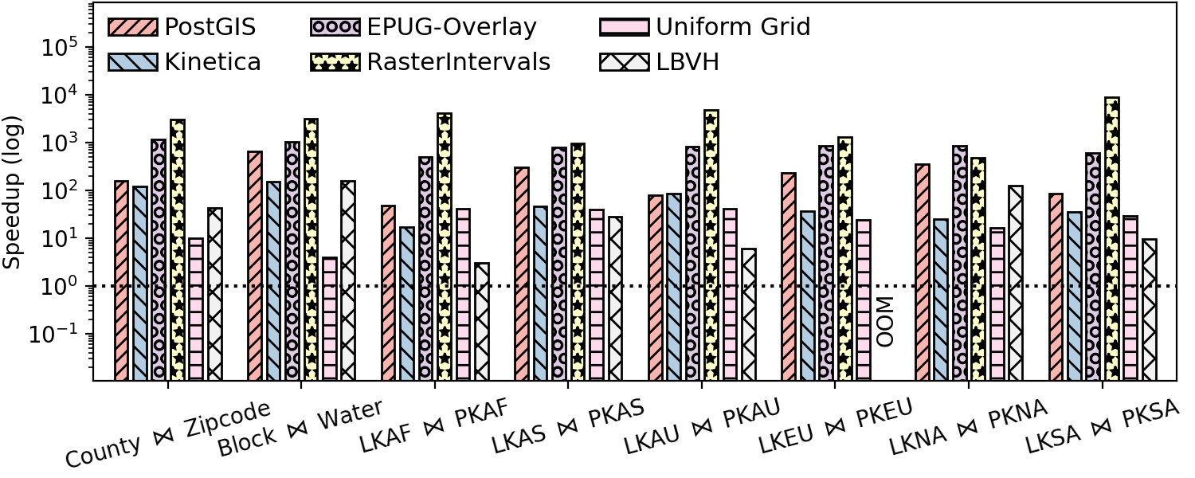
Polygon Overlay
Speedups over the best baseline
End to end: 3.0x to 28.3x
460 ms to join 1.6M with 303K polygons!
2nd fastest 7.49 s
Not real time
GPU-based
Notes:
Finally, the most complex query: Polygon Overlay, which combines the LSI and PIP queries and generates the resulting polygons.
Longest execution time is only about 0.4s. The second fast solution takes more than 7 seconds.
We conclude that RayJoin achieves the goal of real-time spatial join of large-scale datasets.

Slide 34
LSI: How to determine ray parameters
Given a line segment
two endpoints $p_{1}$ and $p_{2}$
Calculate ray parameters
Ray origin $O$, direction vector $\overset{⃑}{d}$
$t_{min}$ and $t_{max}$
Why the parameters work
$R\left(t\right)=O+t∗\overset{⃑}{d}=p_{1}+t(p_{2}−p_{1})$
$R\left(t_{min}\right)=R\left(0\right)=p_{1}$
$R\left(t_{max}\right)=R\left(1\right)=p_{1}+1\left(p_{2}−p_{1}\right)=p_{2}$
$$p_{2}$$
$$p_{1}$$
$$t=1$$
$$t=0$$
$t_{min}=0$ and $t_{max}=1$
Any intersections on the ray can be captured
$${\overset{⃑}{d}= p}_{2}−p_{1}$$

Slide 35
Polygon Representation
Define the direction of a line segment
Each line segment carries neighboring information
$$r0$$
$$r1$$
On the left
$$r0$$
Left
$$p_{2}$$
Left
$$r1$$
$$r1$$
$$r1$$
$$p_{1}$$
Right
$$r2$$
On the right
Right
$$r2$$
$$r2$$
$$r3$$
$$r3$$
Assuming $p_{1}.x$ < $p_{2}.x$
exterior face $r0$
$$r3$$
$$r0$$
Notes:
Before we look into how to transform the PIP query into a ray tracing problem, it is necessary to introduce the polygon representation.
Look at the line segment on the left, face r1 is on the right of the line segment because the x-coordinate of the left point is less than the right. For another line segment, face r1 is on the left side.
This representation helps to implementation of PIP by providing neighboring information.

Slide 36
Put together
Real-life Example
Overlaying hazard maps with population/infrastructure maps
Identifying impacted areas
LSI Query
PIP Query
Overlay
R
S
R⋈ S
Notes:
Given a polygon R and polygon S, run both LSI and PIP queries. Then connecting these dots to construction the resulting polygon

Slide 37
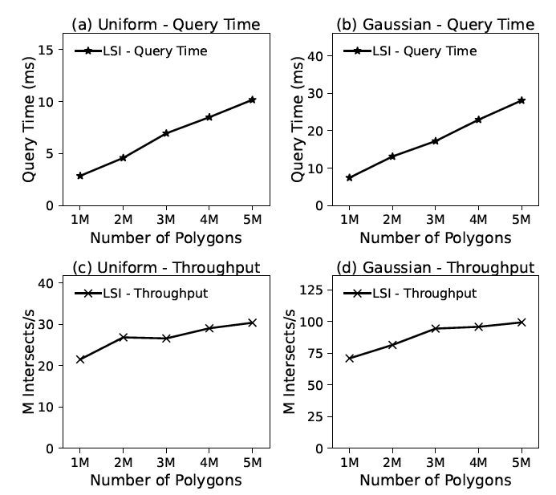
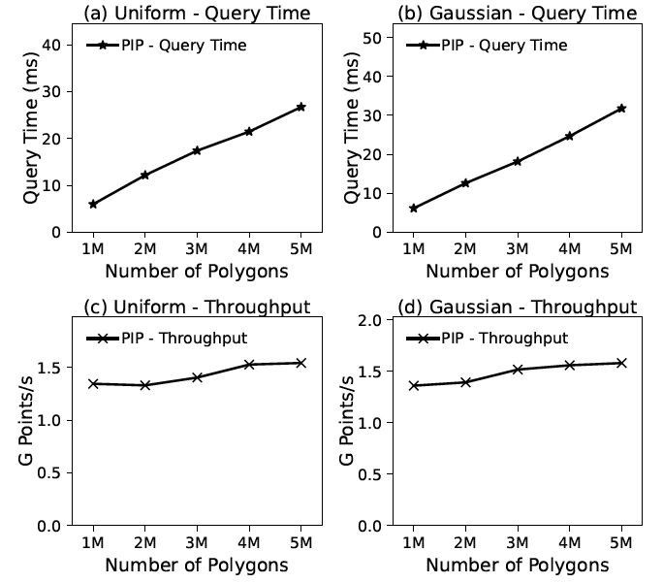
Scalability
Fixed dataset R to 5M polygons
Varying the number of polygons from S
Linear increase
Complexity: $S logR$
Throughput is stable
LSI Scalability
PIP Scalability
Notes:
We use synthetic datasets to evaluate the scalability of RayJoin.
We first generate the dataset R containing 5M polygons, then increase the number of dataset S from 1M to 5M polygons.
We notice a linear increase in running time, this fits the time complexity of RayJoin, which is S log R.
The throughput is also stable, implying the performance does not drop as we feed more queries.
For PIP queries, the conclusion still holds.

