Slide 1


RayBooster: A Ray Tracing Engine to Accelerate SedonaDB
Liang Geng⁺, Rubao Lee⁺, Dewey Dunnington*, Feng Zhang*, Jia Yu*, Xiaodong Zhang⁺
⁺The Ohio State University, USA | *Wherobots Inc., USA
Notes:
80% spatial
Sedona (big data)->SedonDB (low latency)
Challenge one page, solution one page

Slide 2
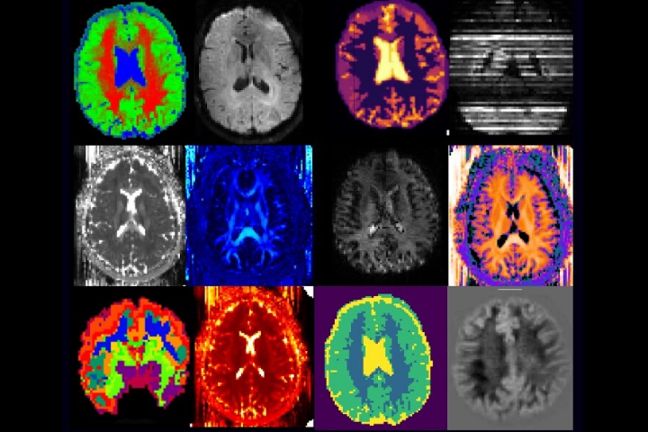







Spatial Data and Apache Sedona(DB)
“80% of big data is spatial.” — ESRI
  OLAP DBs are the most popular tools for analyzing spatial data
  Explore and analyze spatial SQLs with spatial DBs
– process spatial datasets of any scale
  Distributed system working with Spark echo systems (70M+ Downloads)
  Massive datasets (Big Data) – for BI dashboards, business analyst etc.
– process medium-size datasets locally (This talk)
  Single-node system based on Apache DataFunsion
  Simple architecture for interactive data processing tasks or embed into other systems
(Location-based Social Media)
(Ridesharing)
(Medical Imaging)
(Autonomous Driving)
Apache
SedonaDB
Notes:
Most of the existing DBs support spatial data types in the form of extensions, such as PostGIS and DuckDB
This practice faces many challenges, such as architecture mismatch…

Slide 3
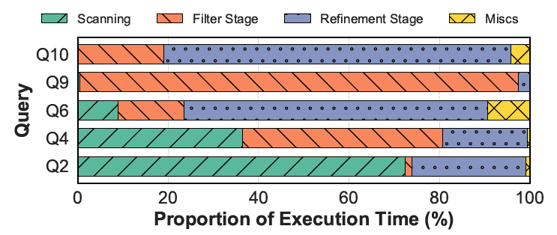
SedonaDB is Fast, But Not Enough
Exponential growth of geospatial data
  Rich data sources: Mobile devices, Satellite, LiDAR…
  Moving objects - constantly updating
  Need fast query response, otherwise, outdated results
Single node still has very limited power!
A spatial query is significantly more compute-expensive than a regular SQL query
  Complex data types (geometries) vs scalars
  Expensive predicates vs regular boolean expr.
  Multi-dim index (R-tree) vs single-dim (B-tree)
Spatial join is the major performance bottleneck
  Following the “Filter-and-Refine” paradigm
  Both can be performance bottlenecks
Example: Dynamic Driver Dispatch for Food Delivery
-- Finding all drivers in downtown
SELECT drivers.driver_id
FROM delivery_zones -- City zones in polygons
, drivers -- The latest driver positions in Points
WHERE
-- Is the driver (point) within the delivery zone (polygon)?
ST_Contains(delivery_zones.geom,
drivers.location)
AND delivery_zones.zone_name = 'Downtown';
Notes:
Although SedonaDB is blazing fast, it can still be bottlenecked due to the limited power of a single node.
First, we have the exponential growth of spatial data, and running a spatial query is significantly more expensive than a regular SQL query.
In this example, we can see that most of the running time is spent on the filter and refinement stages in a spatial join, and both stages can be performance bottlenecks

Slide 4
GPU Acceleration for Spatial? Does Not Work Well!
GPUs are getting powerful
  High memory bandwidth (H100, ~3TB/s)
  High memory capacity (B300, 288GB)
  Getting heterogeneous (CUDA cores, Tensor cores, RT cores, hardware compression, unified memory…)
  Becoming affordable (previous gen.)
Pioneer & Emerging GPU-accelerated databases
  MapD (Heavy.ai), BlazingSQL, RateupDB, Theseus
  SQLRealm, Kinetica, PG-Strom, cuDF, Sirius
  Support for GPU-accelerated spatial queries is RARE
Execution patterns of spatial queries are not GPU-friendly
  Heavily rely on a spatial index (e.g., tree) to reduce search space
  Traversing a tree requires point-chasing
Tree traversal challenges on the GPU
  Branch divergence
  Stack management overhead
  Random memory access
N_{A}
N_{B}
N_{D}
N_{E}
N_{C}
a Bounding Volume Hierarchy (BVH) tree
Logical Pointers
Nodes
N_{A} | N_{B} | N_{C} | N_{D} | N_{E}
Boxes
A | B | C | D | E
Memory Layout
Notes:
As the GPUs are getting more powerful, one may think of using the GPU to make a single-node system faster.
Indeed, we have seen many pioneering and emerging GPU-accelerated databases.
However, among them, GPU acceleration for spatial queries is very rare.
The main reason is that the execution pattern of spatial queries is not GPU-friendly
Tree traversal faces the following challenges on the GPU.

Slide 5
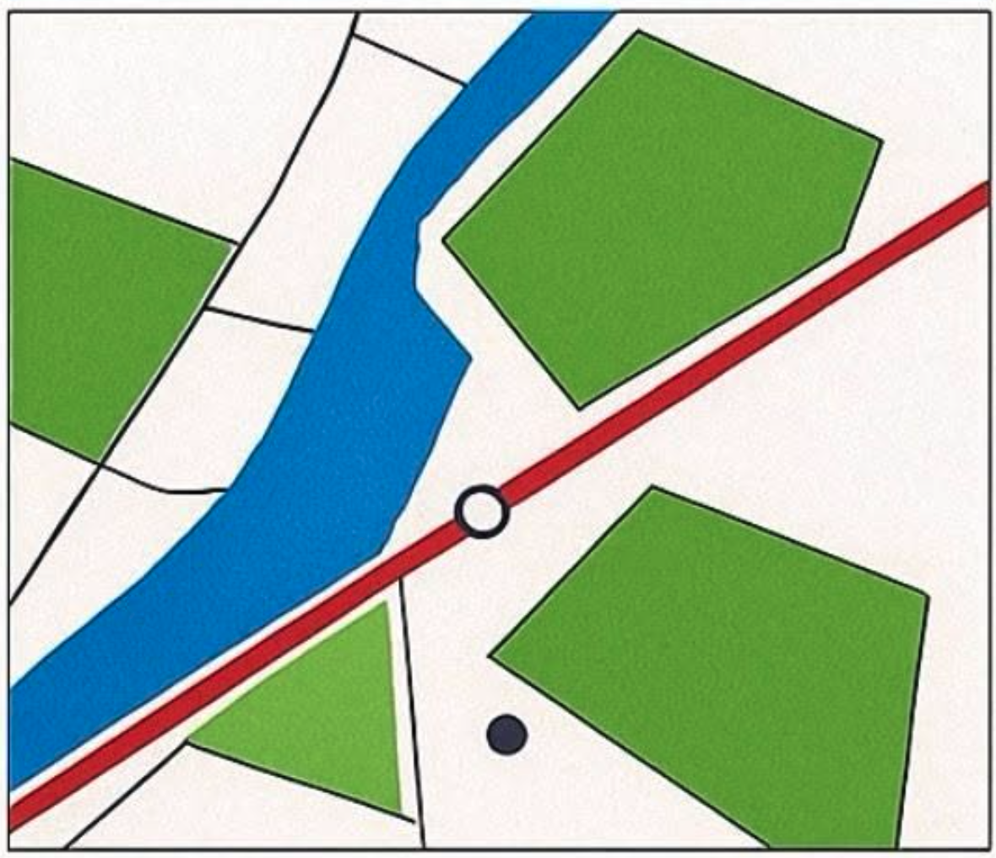
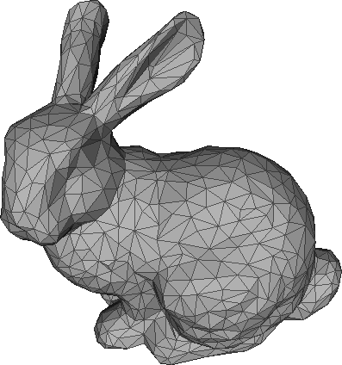
Graphics and Spatial are highly relevant
 | Spatial Domain | Graphics Domain
Example
Data | 2D Coordinates | 3D Coordinates
Geometry Primitives | Point, Line String, Polygons, Bounding Box (Vector data) | Triangle, Bounding Box
Operations | Evaluating geometry relations | Finding intersections (Ray-tracing rendering)
Given the high relevance between the two domains
Can we exploit the existing hardware units on the GPU to accelerate spatial queries?
https://www.lix.polytechnique.fr/~maks/Verona_MPAM/TD/TD2/
https://www.facebook.com/photo?fbid=801112259739831&set=a.127525900431807
Notes:
Let’s do a comparison between the two domains of graphics and spatial

Slide 6
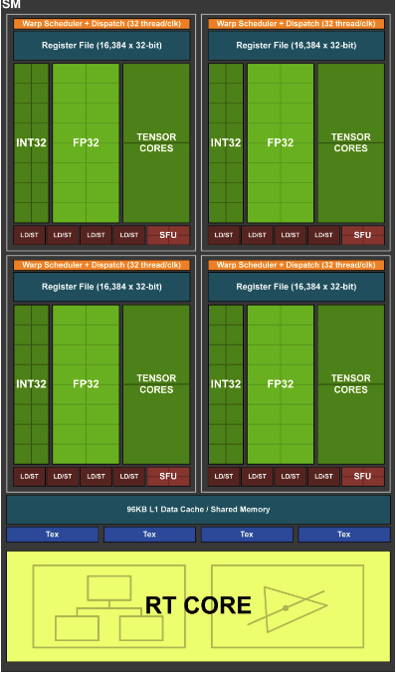
New Opportunity for Spatial DB: RT Cores
NVIDIA introduced RT Cores in the Turing architecture
  Bounding Volume Hierarchy (BVH) tree Traversal Unit
  Ray-triangle Intersection Unit
Benefits of using RT Cores
  Accelerating BVH traversal and ray-geometry intersection tests
  Streaming Multiprocessors (SMs) are freed up to do other workloads
  10X Speedups compared to CUDA cores
Similar between Spatial Domain and Graphics
  RT core is essentially a spatial index (BVH) accelerator
  In spatial DBs, we use an R-tree, which is very similar to a BVH tree
How about using this new hardware to accelerate spatial queries?

Slide 7
Built Upon Our Previous Research Prototypes
Idea: using different forms of rays to simulate geometries
Spatial Joins
  RayJoin: RT-accelerated spatial joins and polygon clipping (ICS’24)
General Spatial Index
  LibRTS: Repurposing RT cores as a general-purpose spatial index (PPoPP’25)
Spatial Metrics
  X-HD: Using RT cores to compute Hausdorff distance (ICS’26)
However, we have to address several engineering challenges
Geometry
Point
LineString
Polygon
Point-MBR Containment
MBR-MBR Intersection
Ray Casting
Short Ray
Segment Rays
Boundary Ring Rays
Short Ray
Cast Diagonal Rays

Slide 8
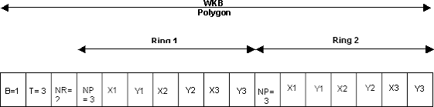
The Systematic Challenges in RT-acceleration
Data Format Mismatch
  SedonaDB adopts Well-known Binary (WKB) to efficiently store geometries
  But not good for computation – does not support random geometry access
  Need to design a compact & GPU-friendly geometry format
Indexing Scalability
  We need a table-level index for the filter stage
  May also need a row-level index to speed up queries over complex geometries
  Huge number of small indexes leading to index build-up overhead
Combinatorial Complexity
  There are tens of spatial predicates X 7 geometry types (each side of join)
  ~500 combinations of operators! Huge development efforts and maintenance costs
  Can we avoid writing 500+ CUDA kernels?
https://help.arcgis.com/en/geodatabase/10.0/sdk/arcsde/concepts/geometry/representations/binary.htm
Notes:
We have addressed all RT repurposing problems in the previous topics
However, we have to address several engineering challenges

Slide 9
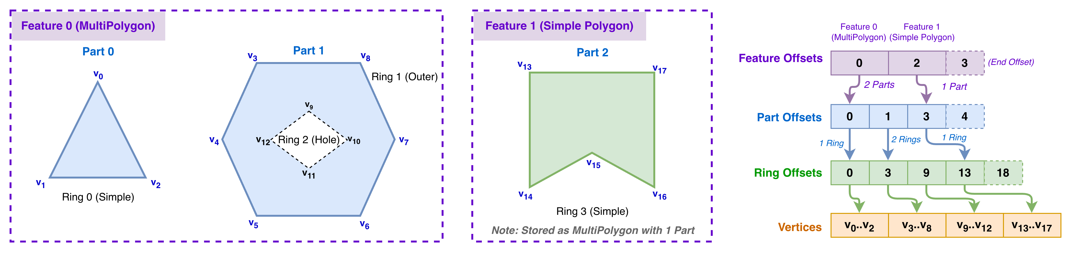
GPU-friendly Geometry Format
CSR-like format to represent all types of geometries
  Hierarchical offset arrays and a vertices array
  Features → Parts → Rings → Vertices
  Compact storage and facilitate coalesced memory access
Converting WKBs to this format on-demand
  WKBs are stored in Arrow arrays
  Parallel conversion on the CPU for incoming queries
  Only keep geometries on device memory to reduce memory usage
Notes:
SedonaDB internally adopts the WKB format, which is efficient for storage purposes, but it is inefficient for computation because it does not support accessing geometries arbitrarily.
We designed a CSR-like format, which is used in the linear algebra domain. It contains several offset arrays to get the positions of geometry elements, such as features, parts, rings, and vertices.
We convert the WKBs to this format online for a given query.

Slide 10
Accelerating the Filter Stage with RT cores
The filter stage finds geometries that potentially have intersections
  Using MBRs, approximate the outline of geometries
  Point query: MBR-Point intersection test
  Range query: MBR-MBR intersection test
Maps spatial index search to ray casting operations:
  Point Queries: Cast short rays from the probe points.
  Range Queries: Dual-pass diagonal/anti-diagonal ray casting.
RT Acceleration
BVH Tree
Build-side
INTERMEDIATE
NODES
Node 1
Probe-side
② Cast Rays
from Geometry Outlines
Feature ID | Geometry
P₁
P₂
P₃
P₄
Feature ID | Geometry
Q₁
Q₂
Q₃
① BVH over
Feature MBRs
Node 2
Node 3
Node 4
Node 5
Node 6
Node 7
LEAF
NODES
Q₁
Q3
Q₂
Candidate Pairs
P₁
P₂
P₃
P₄
(P₁, Q₁) | (P₁, Q₂) | (P₄, Q₃)
③ Write back intersections
Notes:
The next thing we want to accelerate is the filter stage.
With the method we demonstrated before, we translate point queries and range queries into different forms of rays. Then, we cast rays and collect intersections, which are subsequently stored in a concurrent queue. The intersections are ready to be refined by the next layer – refinement layer.

Slide 11








Refinement Stage by Ray-casting
Geometry can also be very complex (thousands of line segs)
  For example, PreparedPolygon in the GEOS library
Requiring fine-grained indexes, requring a BVH for each geometry
  Building millions of tiny BVHs degrades performance due to memory alloc./sync. overhead.
Z-Stacking: Places 2D geometries at distinct Z-planes in a single 3D scene, eliminating multi-BVH allocation and synchronization overhead.
RT Acceleration
Candidate Pairs
$$z$$
(P₁, Q₁) | (P₁, Q₂) | (P₄, Q₃)
4
P₁
① Extract Unique Feature IDs
Q₁
Query Side
Feature ID
Q₂
x-y plane
Q₁
Indexed Side
③ Cast rays from geometry elements
Start
② BVH over Line Segs.
Q₃
Q₂
1
P₄
P₁
Stop
$$y$$
x-y plane
P₄
Q₃
$$O$$
Original x-y coordinates of the features
$$x$$
④ Calculate Intersection Matrices
Candidate Pairs | DE-9IM
(P₁, Q₁)
(P₁, Q₂)
(P₄, Q₃)
$$\begin{matrix}F & F & 2 \\ F & F & 1 \\ 0 & F & 2\end{matrix}$$
Intersection Mask
&
$$\begin{matrix}0 & F & 2 \\ F & F & 1 \\ F & F & 2\end{matrix}$$
&
$$\begin{matrix}T & T & ∗ \\ T & T & ∗ \\ ∗ & ∗ & ∗\end{matrix}$$
&
$$\begin{matrix}2 & 1 & 2 \\ 1 & 0 & 1 \\ 2 & 1 & 2\end{matrix}$$
(a) Polygons being Indexed by the BVH
(b) Scene of Indexed Polygons and Rays from Query Side
(c) Cast Rays from Query Points and Polygon
(d) Filter out entries not satisfying the given predicate
Notes:
In the refinement layer, we need a fine grained index for each geometry, as a geometry may contain thousands of line segments.
We use a similar strategy to GEOS’ PreparedPolygon, building a separate index for each polygon. However, this method may result in a large number of indexes, leading to poor GPU utilization.
To address this limitation, we adopt a unique method called Z-stacking. By reusing the spare z-axis in the space, we arrange the AABBs for the geometries layer by layer. Therefore, we have a monolithic index, completely eliminating the multi-BVH allocation and synchronization overhead.

Slide 12
GPU Evaluation Settings
Evaluated Products:
  SedonaDB is already faster than DuckDB, GeoPandas, and PostGIS, so we don’t show them in the following evaluations
  GPUs: Desktop and datacenter-grade GPUs
GPU | RT Cores | FP64 Perf. | VRAM (Bandwidth) | GPU (RAM) | Platform Unit Price
RTX 3090 | 2nd Gen (82) | 556.0 GFLOPS | 24GB (936 GB/s) | i9-12900 (64GB) | Workstation
GPU | RT Cores | FP64 Perf. | VRAM (Bandwidth) | GPU (RAM) | Platform Unit Price
RTX 3090 | 2nd Gen (82) | 556.0 GFLOPS | 24GB (936 GB/s) | i9-12900 (64GB) | Workstation
A10 | 2nd Gen (72) | 976.3 GFLOPS | 24GB (600 GB/s) | 8 vCPUs (32GB) | AWS g5.2xl $1.21/hr
GPU | RT Cores | FP64 Perf. | VRAM (Bandwidth) | GPU (RAM) | Platform Unit Price
RTX 3090 | 2nd Gen (82) | 556.0 GFLOPS | 24GB (936 GB/s) | i9-12900 (64GB) | Workstation
A10 | 2nd Gen (72) | 976.3 GFLOPS | 24GB (600 GB/s) | 8 vCPUs (32GB) | AWS g5.2xl $1.21/hr
L4 | 3rd Gen (60) | 473.3 GFLOPS | 24GB (300 GB/s) | 8 vCPUs (32GB) | AWS g6.2xl $0.98/hr
GPU | RT Cores | FP64 Perf. | VRAM (Bandwidth) | GPU (RAM) | Platform Unit Price
RTX 3090 | 2nd Gen (82) | 556.0 GFLOPS | 24GB (936 GB/s) | i9-12900 (64GB) | Workstation
A10 | 2nd Gen (72) | 976.3 GFLOPS | 24GB (600 GB/s) | 8 vCPUs (32GB) | AWS g5.2xl $1.21/hr
L4 | 3rd Gen (60) | 473.3 GFLOPS | 24GB (300 GB/s) | 8 vCPUs (32GB) | AWS g6.2xl $0.98/hr
L40S | 3rd Gen (142) | 1.43 TFLOPS | 48GB (864 GB/s) | 8 vCPUs (64GB) | AWS g6e.2xl $2.24/hr
GPU | RT Cores | FP64 Perf. | VRAM (Bandwidth) | GPU (RAM) | Platform Unit Price
RTX 3090 | 2nd Gen (82) | 556.0 GFLOPS | 24GB (936 GB/s) | i9-12900 (64GB) | Workstation
A10 | 2nd Gen (72) | 976.3 GFLOPS | 24GB (600 GB/s) | 8 vCPUs (32GB) | AWS g5.2xl $1.21/hr
L4 | 3rd Gen (60) | 473.3 GFLOPS | 24GB (300 GB/s) | 8 vCPUs (32GB) | AWS g6.2xl $0.98/hr
L40S | 3rd Gen (142) | 1.43 TFLOPS | 48GB (864 GB/s) | 8 vCPUs (64GB) | AWS g6e.2xl $2.24/hr
A100 | SW Emul. | 9.75 TFLOPS | 40GB (1.56 TB/s) | EPYC 7H12 (472GB) | Ohio Super Computing
GPU | RT Cores | FP64 Perf. | VRAM (Bandwidth) | GPU (RAM) | Platform Unit Price
RTX 3090 | 2nd Gen (82) | 556.0 GFLOPS | 24GB (936 GB/s) | i9-12900 (64GB) | Workstation
A10 | 2nd Gen (72) | 976.3 GFLOPS | 24GB (600 GB/s) | 8 vCPUs (32GB) | AWS g5.2xl $1.21/hr
L4 | 3rd Gen (60) | 473.3 GFLOPS | 24GB (300 GB/s) | 8 vCPUs (32GB) | AWS g6.2xl $0.98/hr
L40S | 3rd Gen (142) | 1.43 TFLOPS | 48GB (864 GB/s) | 8 vCPUs (64GB) | AWS g6e.2xl $2.24/hr
A100 | SW Emul. | 9.75 TFLOPS | 40GB (1.56 TB/s) | EPYC 7H12 (472GB) | Ohio Supercomputer Center
H100 | SW Emul. | 33.45 TFLOPS | 94GB (3.36 TB/s) | Xeon 8470 (1TB) | Ohio Supercomputer Center
Name | Category | Device
PGStrom | GPU support for PostGIS (The only open-source with GPU) | GPU (SMs)
SedonaDB | OLAP DB | CPU
RayBooster | GPU support for SedonaDB | GPU (RT Cores)
Notes:
We included the desktop-level GPUs and server-grade GPUs.
We compare the total running time and operational costs in USD.

Slide 13
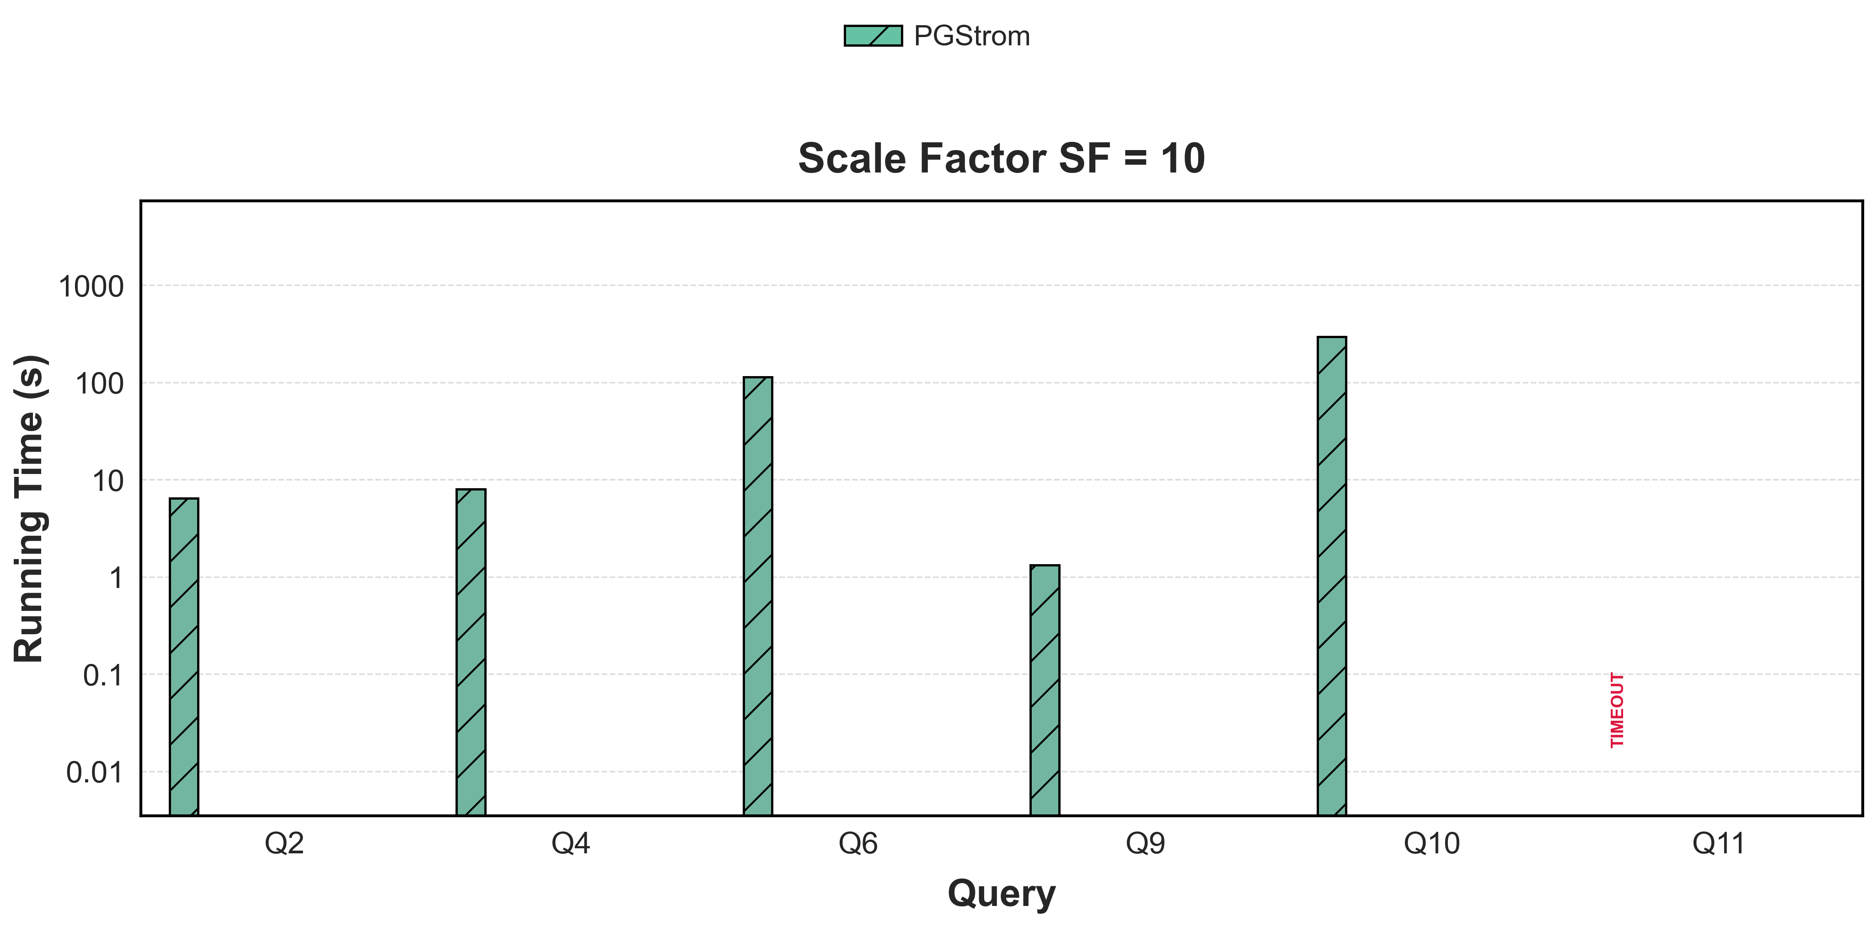
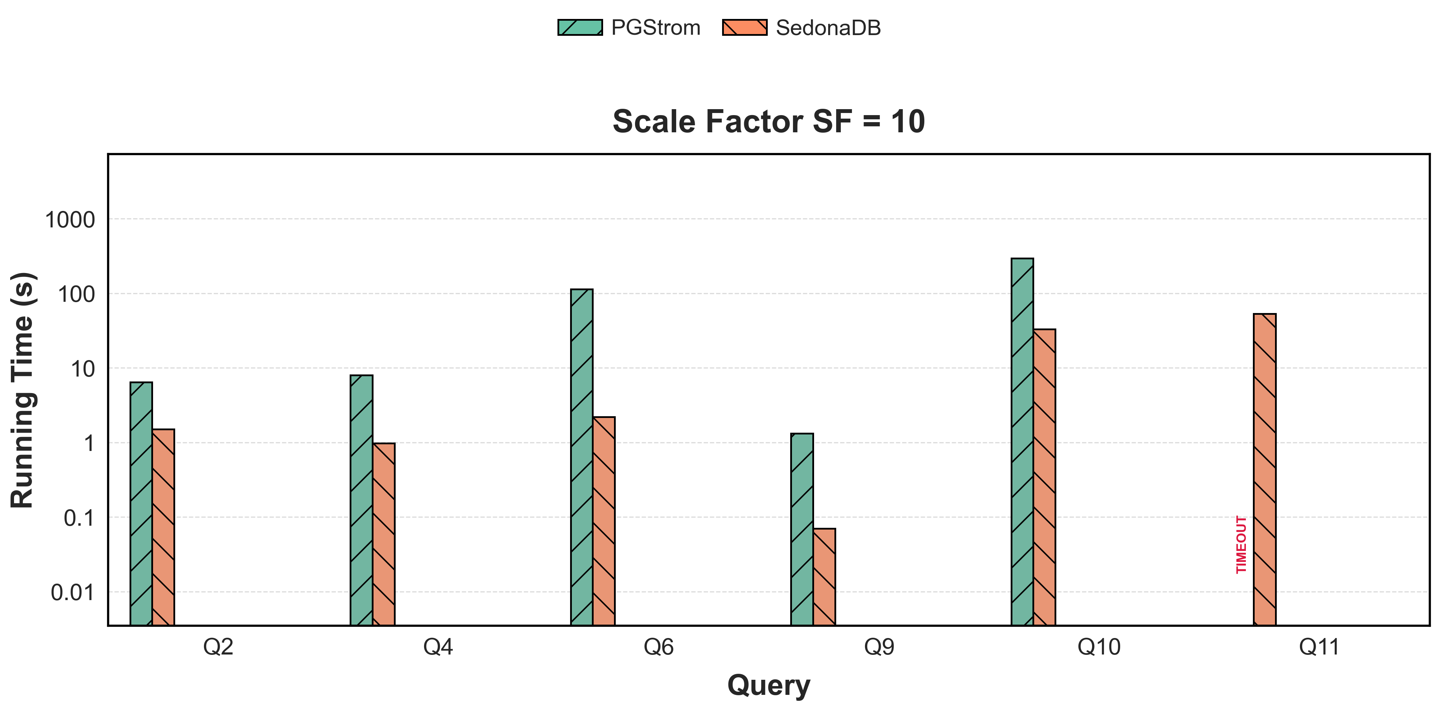
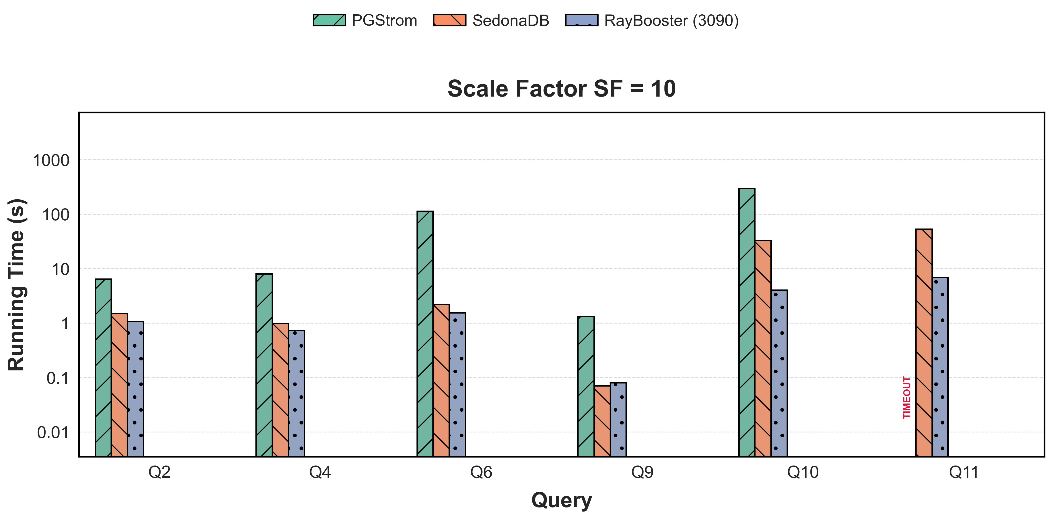
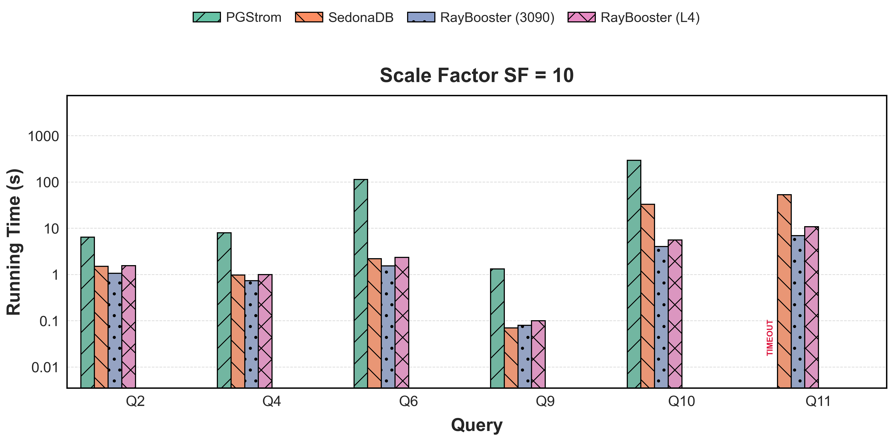
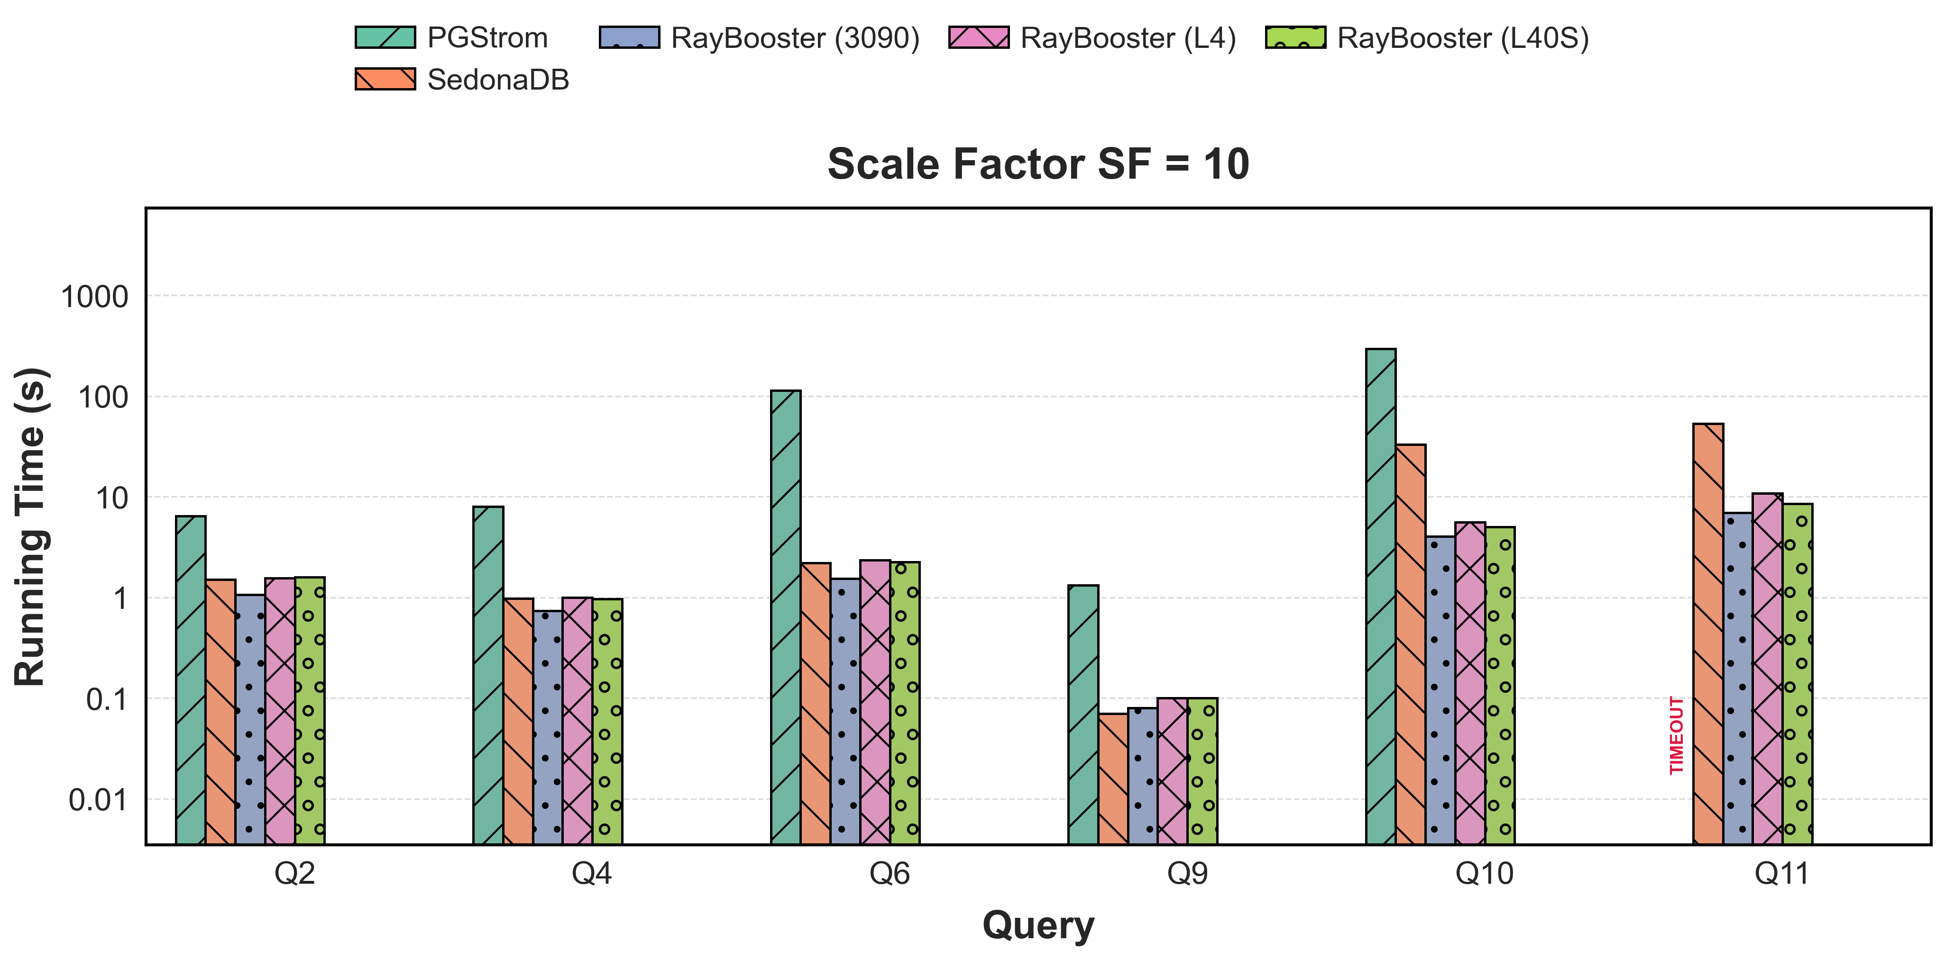
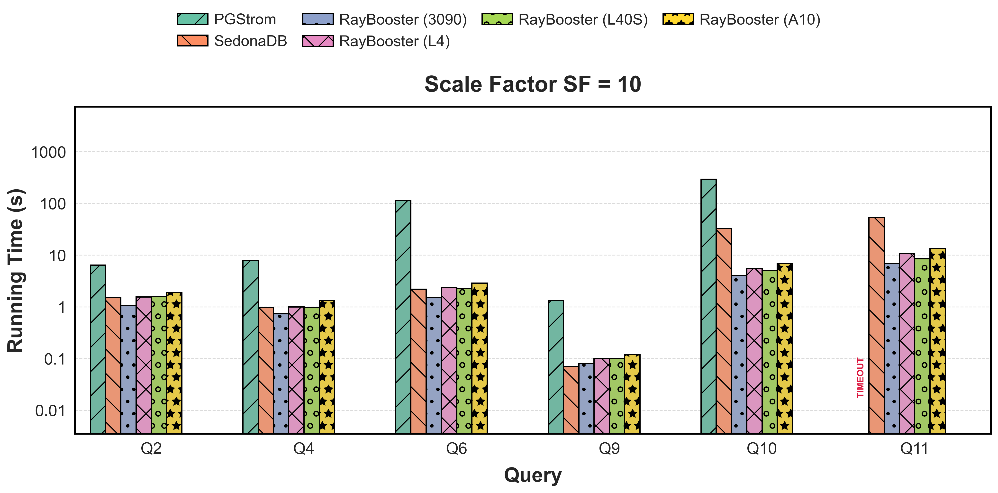
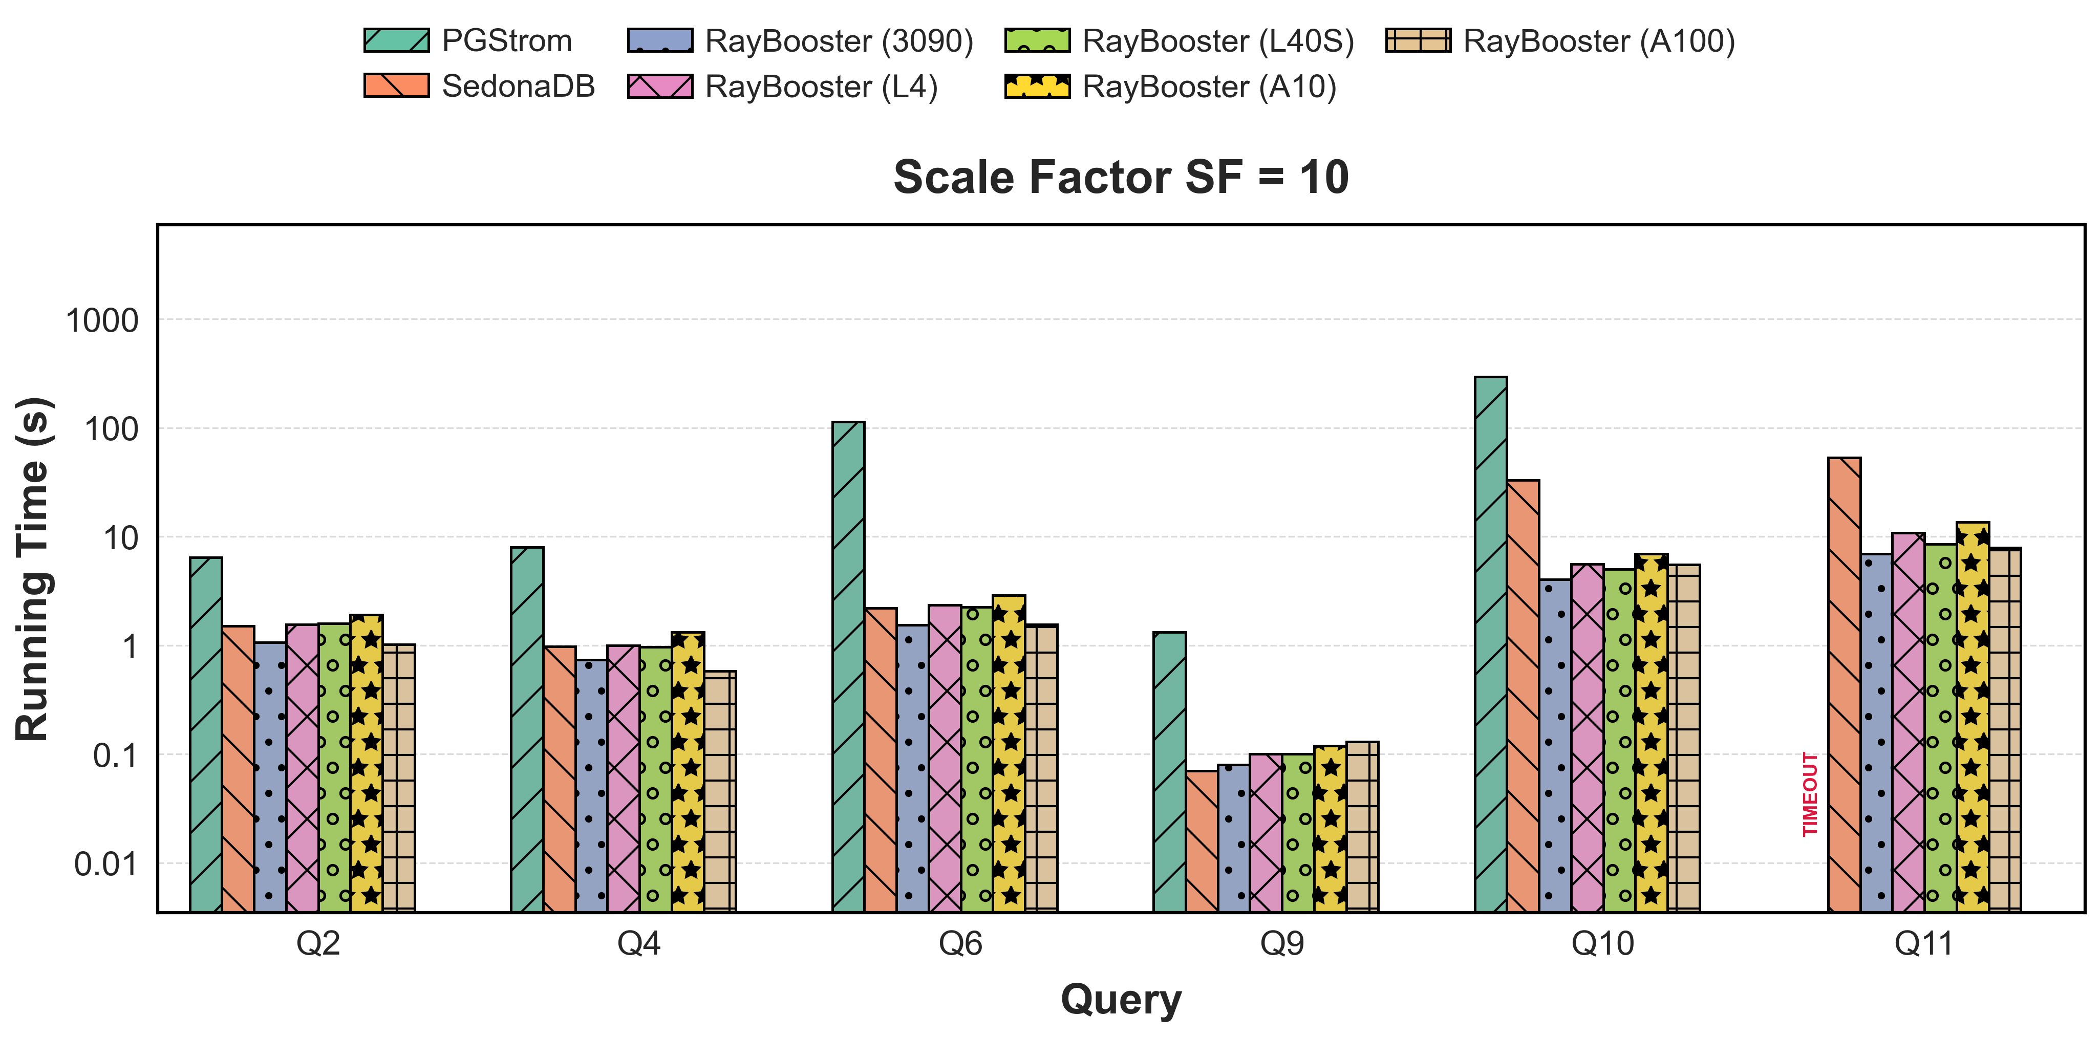
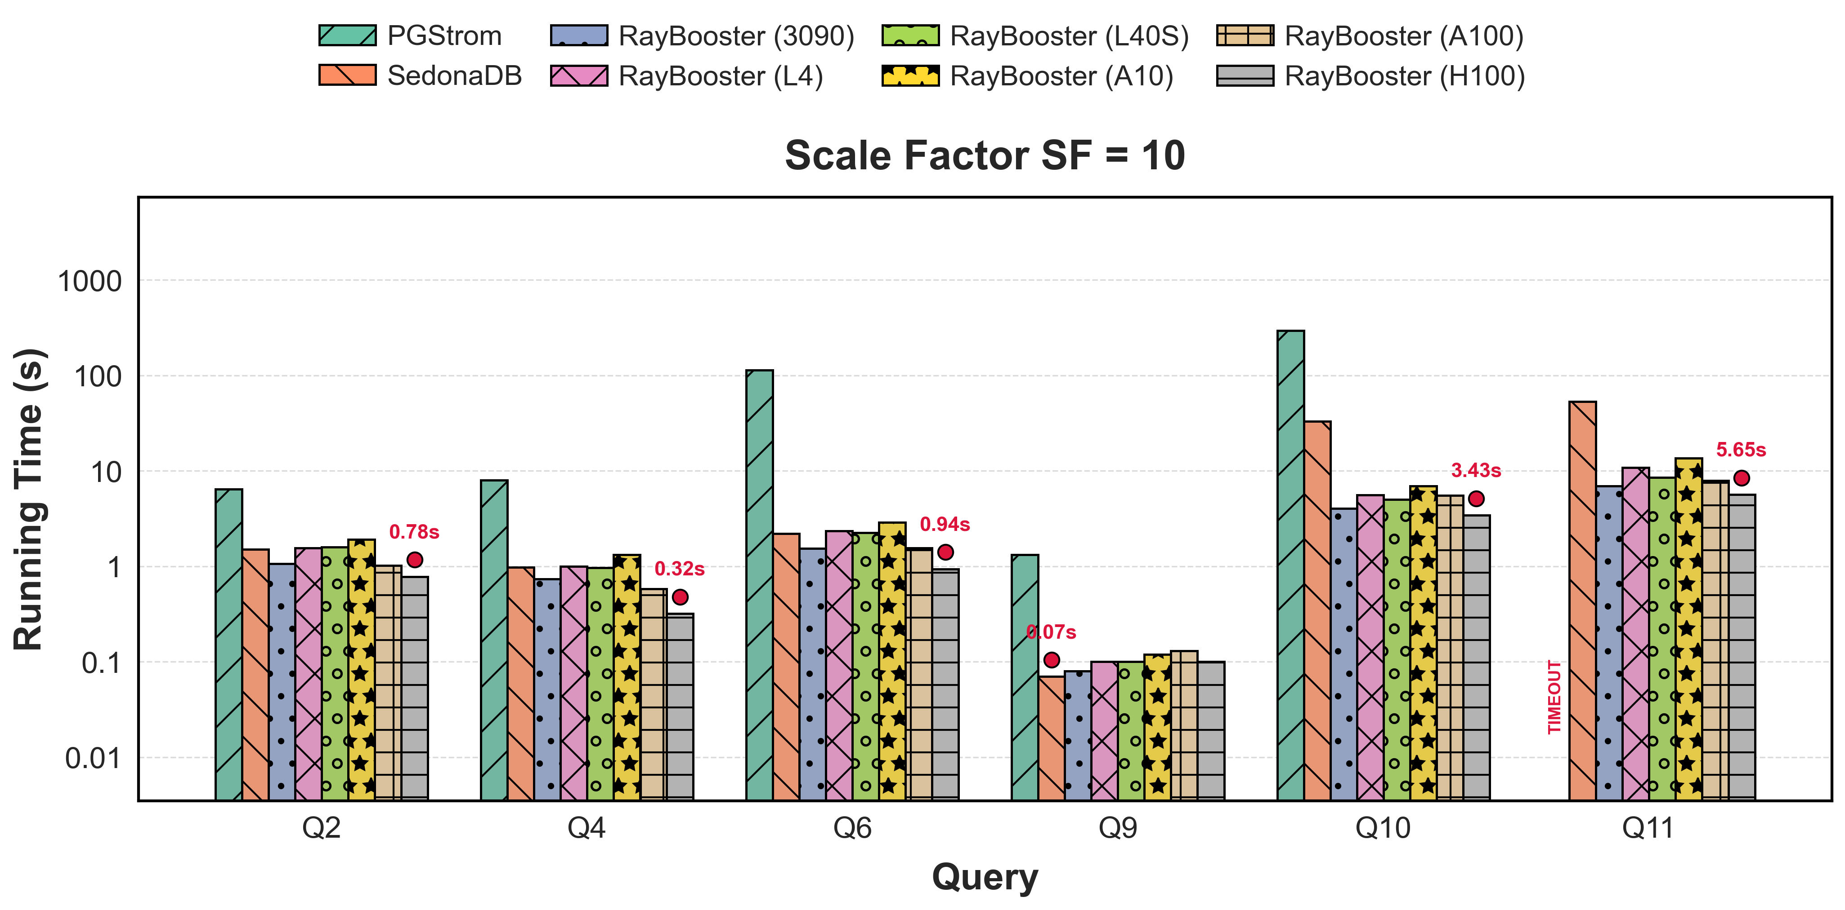
Performance Summary on SpatialBench
Latency-sensitive queries: slightly faster or comparable to SedonaDB
Heavy joins (Q10, Q11) compared to the best baseline
  SF=10, up to 8.24X (3090), 5.93X(L4), 6.66X(L40S), 4.78X(A10), 6.74X(A100), and 9.68X(H100)

Slide 14
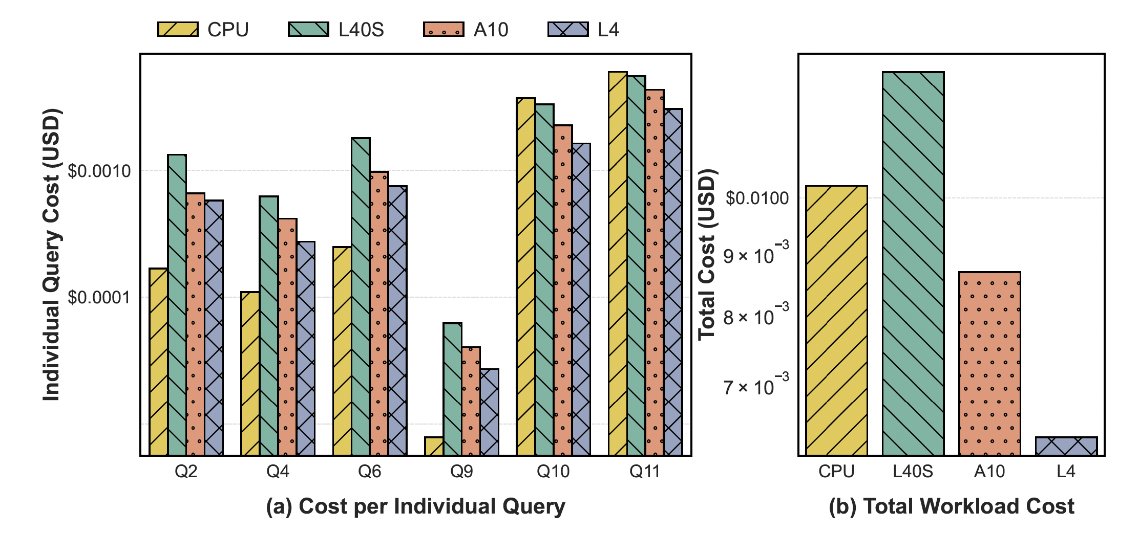
Cost-Effectiveness
Cheapest GPU (L4) yields the lowest cost g6.2xlarge
  Example: Q10
  CPU: $0.00372
  GPU: $0.001524
  59.02% Cost Reduction and 5.93X Speedup compared to SedonaDB on the CPU
Overall cost reduction: 38.11% by running all queries

Slide 15
Conclusion & Key Takeaways
Status of SedonaDB today
Hardware Acceleration is here: RT cores offer immense untapped potential for data analytics.
Production-Ready: RayBooster bridges the architectural gap, fully integrated into Apache SedonaDB.
Results: Highly efficient and cost-effective engine for large-scale spatial analytics.
Code & Artifacts: https://github.com/apache/sedona-db

Slide 17





Emerging Single-Node OLAP DBs
Traditional paradigm: Distributed “scale-out” systems
Designed for large-scale data processing
  Data scientist/Business Analyst
  BI dashboards
  Scalable for massive datasets “For BigData”
More recent trend: Single-node “scale-up” analytical engines
Lightweight systems for processing medium-sized datasets
Why Single-Node?
  Increasingly powerful devices
  Low-latency for agile, interactive exploration
  Low deployment efforts
  Fewer dependencies, can be easily embedded into other applications
Notes:
Traditional OLAP DBs follow the scaled-out paradigm, such as Hive, Spark, and Presto
These systems are designed for large-scale data processing tasks
These systems are scalable, capable of handling TBs of data.
The downside is that they suffer from high execution overhead, as these are distributed systems, as well as deployment efforts because of the dependencies.
More recently, we see the rising of scale-up systems, such as pandas, DuckDB, or DataFusion-based systems.
These systems are lightweight and suitable for medium-sized workloads.
The popularity of these systems comes from the ….

Slide 18
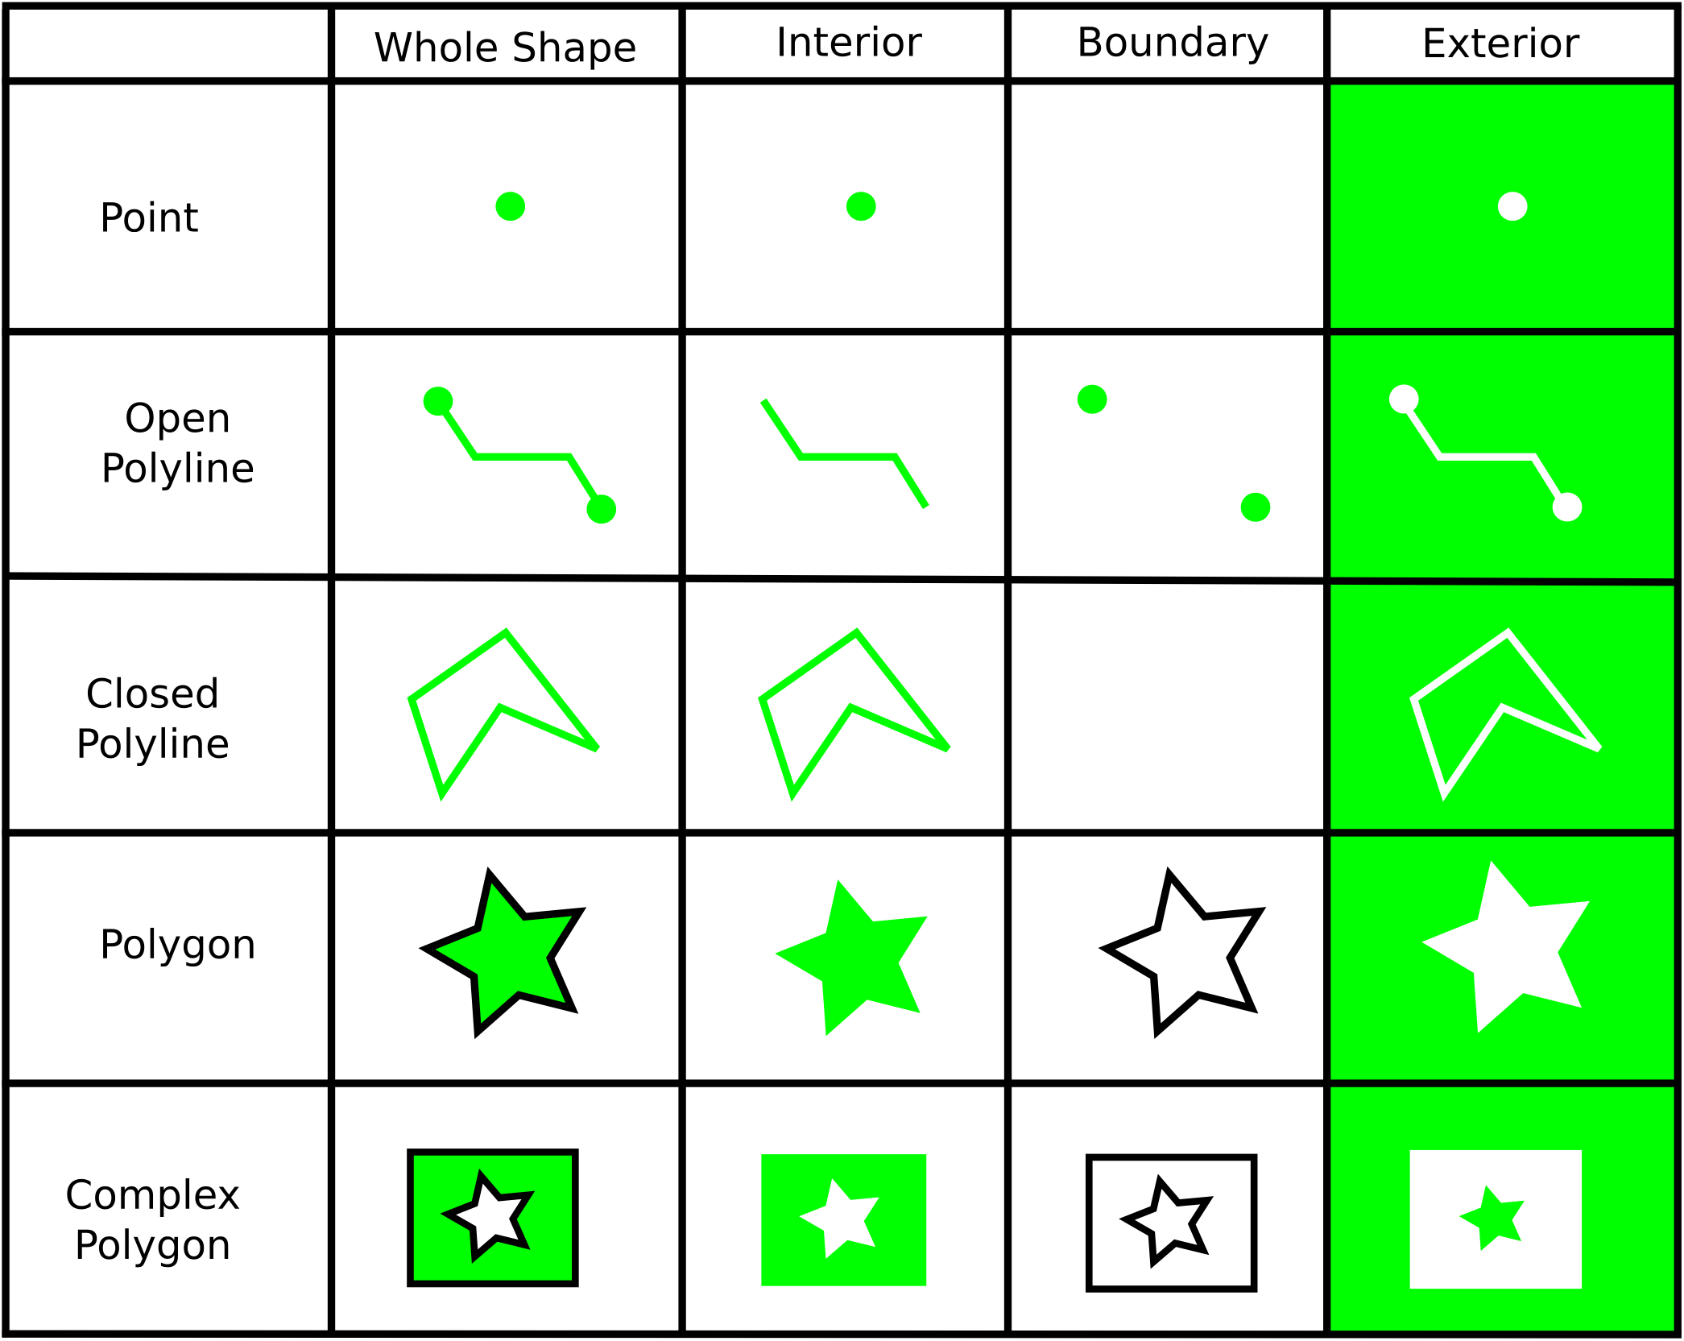
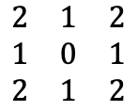
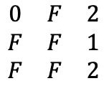
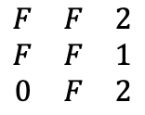


Taming Combinatorial Complexity
Spatial joins have ~500 geometry-predicate combinations.
Hardcoding GPU kernels is unmaintainable.
Solution: RelateEngine
  Computes the Dimensionally Extended 9-Intersection Model (DE-9IM) as a universal topological descriptor.
  Ray casting simulates geometric vertices and line segments to find exact interior/boundary intersections.
  A single code path resolves arbitrary spatial predicates via logical mask matrices.
  Evaluates the universal DE-9IM topological matrix via ray casting → Reduced to ~20 device functions
Indexed Side
Query Side
Hole
AABB
Ray
Hit Point
Intersection Mask
Query Side
Indexed Side
I
B
E
Start
$$\begin{matrix}T & T & ∗ \\ T & T & ∗ \\ ∗ & ∗ & ∗\end{matrix}$$
I
$$\begin{matrix}∗ & ∗ & ∗ \\ ∗ & ∗ & ∗ \\ ∗ & ∗ & ∗\end{matrix}$$
I: Interior
B: Boundary
E: Exterior
B
Q₁
E
&
&
&
Q₂
Stop
Q₁
Q₂
Q₃
$$\begin{matrix}F & F & 2 \\ F & F & 1 \\ 0 & F & 2\end{matrix}$$
$$\begin{matrix}0 & F & 2 \\ F & F & 1 \\ F & F & 2\end{matrix}$$
$$\begin{matrix}2 & 1 & 2 \\ 1 & 0 & 1 \\ 2 & 1 & 2\end{matrix}$$
PIP by Casting Horizontal Rays and Counting Intersections
Polygon Intersection Test by Casting Rays along Boundary
Intersection Matrices for Q1, Q2, and Q3 with Intersection Predicate)
https://dev.luciad.com/portal/productDocumentation/LuciadFusion/docs/articles/guide/geometry/de-9im.html
Notes:
This next challenge is the huge number of operators that need to be implemented on the GPU, as we have tons of geometry types and spatial predicates.
To tackle this challenge, instead of implementing each operator one by one, we compute a unified operator called DE-9IM matrix by evaluating the spatial spatial relationships.
By using this unified strategy, the total number of operators has been cutting down to about 20 device functions.

Slide 19




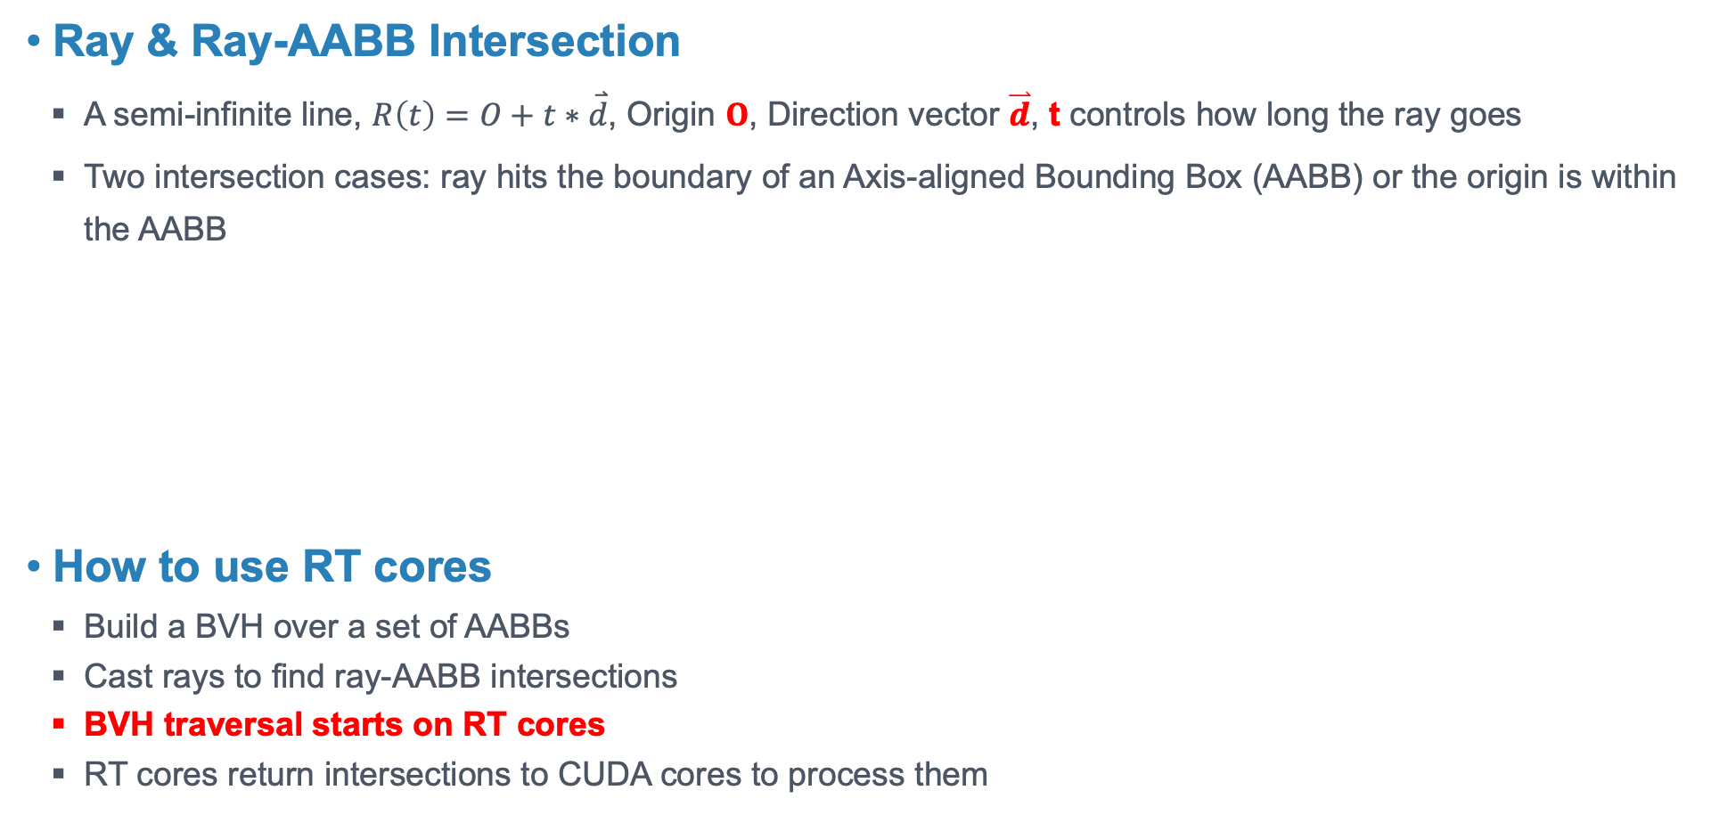
How to use RT Cores
Ray & Ray-AABB Intersection
  A semi-infinite line, $R\left(t\right)=O+t∗\overset{⃑}{d}$, Origin $O$, Direction vector $\overset{⃑}{d}$, t controls how long the ray goes
  Two intersection cases: ray hits the boundary of an Axis-aligned Bounding Box (AABB) or the origin is within the AABB
How to use RT cores
  Build a BVH over a set of AABBs
  Cast rays to find ray-AABB intersections
  BVH traversal starts on RT cores
  RT cores return intersections to CUDA cores to process them
$$O$$
$$O$$
$t_{hit}$
RT Acceleration
$$d$$
AABB
AABB
Case 1: Ray hits boundaries
Case 2: Ray's origin is within the AABB
Build BVH
Return Hits
<RayID, BoxID>
Notes:
A complex geometry is composed of points, line segments, and rings
We can always decompose a geometry into these basic components
RT-accelerated BVH serves as a spatial index
Using AABBs to enclose line segments for one side of the spatial join
Using different forms of rays to simulate them
Casting rays for another side of the join to find intersections

Slide 20
RayBooster: A Suite of Solutions to Accelerate SedonaDB
The first integration of RT-core acceleration into a production database system
Pluggable Accelerator: Offload only the most compute-intensive spatial joins to GPUs
Architecture Overview:
Output
Input
Matched Indices
WKBs &
Predicate
RT Shaders
RT Exec. Engine (NVIDIA OptiX)
Storage Layer
ParallelWKBLoader
Bounding Boxes
WKB Parser
Thread Pool
Type Analyzer
Transfer Manager
Refined Pairs
Indexing Layer
Point Query
Range Query
Point Array /
MultiPoint Array
Candidate Pairs
Refinement Layer
LineString Array /
MultiLineString Array
CUDA Refiner
RT Refiner
Polygon Array /
MultiPolygon Array
Geometries
Notes:
This work is called RayBooster: A Suite of Solutions to Accelerate SedonaDB.
Here’s how we modify upon SedonaDB
In the columnar in-memory data representation of SedonaDB, we provide a GPU-friendly storage format.
In the spatial query processing layer, we replace it with the RT-accelerated indexing and refinement layer.

Slide 21
SedonaDB Outperforms CPU-based DBs
Baselines: Popular OLAP and OLTP DBs with spatial extensions
Benchmark: Sedona SpatialBench (similar to TPC-H)
Query | Description
Q2 | Count trips starting within Coconino County zone
Q4 | Zone distribution of top 1000 trips by tip amount
Q6 | Zone statistics for trips within a 50km radius of Sedona city center
Q9 | Duplicate/overlap detection via Intersection over Union
Q10 | Zone statistics for trips starting within each zone
Q11 | Count trips that cross between different zones
Name | Category | Device
DuckDB | OLAP DB | CPU
GeoPandas | Python Library | CPU
PostGIS | Spatial Extension to OLTP DB | CPU
SedonaDB | OLAP DB | CPU
Notes:
We include the following classical spatial DBs and libraries.
The figures show that SedonaDB is already faster than these baselines, so we don’t show them again in the following experiments.

Slide 22
SpatialBench Overview
Query | Description | Spatial Characteristics | Scenario
Q2 | Count trips starting within Coconino County (Arizona) zone | • Point-in-polygon spatial filtering (ST_Intersects) • Subquery with spatial geometry selection • Simple aggregation on spatially filtered data | Count all trips originating within a specific administrative boundary (county) for regional transportation statistics.
Q4 | Zone distribution of top 1000 trips by tip amount | • Subquery with ordering and limiting; Aggregation on spatially joined results • Point-in-polygon spatial join (ST_Within) • Multi-step query; spatial filtering, and grouping | Analyze the geographic distribution of high-value trips (by tip amount) to understand premium service areas.
Q6 | Zone statistics for trips within a 50km radius of Sedona city center | • Polygon containment check (ST_Contains) • Point-in-polygon spatial join (ST_Within) | Analyze trip patterns in zones within a metropolitan area around a city center.
Query | Description | Spatial Characteristics | Scenario
Q2 | Count trips starting within Coconino County (Arizona) zone | • Point-in-polygon spatial filtering (ST_Intersects) • Subquery with spatial geometry selection • Simple aggregation on spatially filtered data | Count all trips originating within a specific administrative boundary (county) for regional transportation statistics.
Q4 | Zone distribution of top 1000 trips by tip amount | • Subquery with ordering and limiting; Aggregation on spatially joined results • Point-in-polygon spatial join (ST_Within) • Multi-step query; spatial filtering, and grouping | Analyze the geographic distribution of high-value trips (by tip amount) to understand premium service areas.
Query | Description | Spatial Characteristics | Scenario
Q2 | Count trips starting within Coconino County (Arizona) zone | • Point-in-polygon spatial filtering (ST_Intersects) • Subquery with spatial geometry selection • Simple aggregation on spatially filtered data | Count all trips originating within a specific administrative boundary (county) for regional transportation statistics.

Slide 23
SpatialBench Overview
Query | Description | Spatial Characteristics | Scenario
Q9 | Building Conflation (duplicate/overlap detection via Intersection over Union (IoU)) | •Self-join with spatial intersection (ST_Intersects); Area calculations (ST_Area) • Geometric intersection operations; Complex geometric ratio calculations | Detect duplicate or overlapping building footprints in GIS datasets to identify data quality issues.
Query | Description | Spatial Characteristics | Scenario
Q9 | Building Conflation (duplicate/overlap detection via Intersection over Union (IoU)) | •Self-join with spatial intersection (ST_Intersects); Area calculations (ST_Area) • Geometric intersection operations; Complex geometric ratio calculations | Detect duplicate or overlapping building footprints in GIS datasets to identify data quality issues.
Q10 (Heavy-join) | Zone statistics for trips starting within each zone | • Point-in-polygon spatial join (ST_Within) • Aggregation with multiple metrics • LEFT JOIN on zones with no trips | Analyze trip patterns and performance metrics for each administrative zone.
Query | Description | Spatial Characteristics | Scenario
Q9 | Building Conflation (duplicate/overlap detection via Intersection over Union (IoU)) | •Self-join with spatial intersection (ST_Intersects); Area calculations (ST_Area) • Geometric intersection operations; Complex geometric ratio calculations | Detect duplicate or overlapping building footprints in GIS datasets to identify data quality issues.
Q10 (Heavy-join) | Zone statistics for trips starting within each zone | • Point-in-polygon spatial join (ST_Within) • Aggregation with multiple metrics • LEFT JOIN on zones with no trips | Analyze trip patterns and performance metrics for each administrative zone.
Q11 (Heavy-join) | Count trips that cross between different zones | •Multiple point-in-polygon spatial joins • Filtering based on spatial relationship results | Identify inter-district/city trips to analyze cross-boundary travel.

Slide 24
New Opportunity for Spatial DB: RT Cores
Tree traversal is not GPU-friendly
How about having a new unit to serve this purpose?
We already have that in your GPU! This thing is called RT Cores
Two dedicated circuits in RT Cores
  Accelerating BVH Traversal (a type of spatial index, think of an R-tree)
  Accelerating Ray-triangle intersection test
  Streaming Multiprocessors (SMs) are freed up to do other works
10X Speedups compared to software-emulated BVH traversal
  1.1 Giga Rays on GTX 1080 Ti
  10+ Giga Rays on RTX 2080 Ti
NVIDIA, Turing Architecture Whitepaper

Slide 25
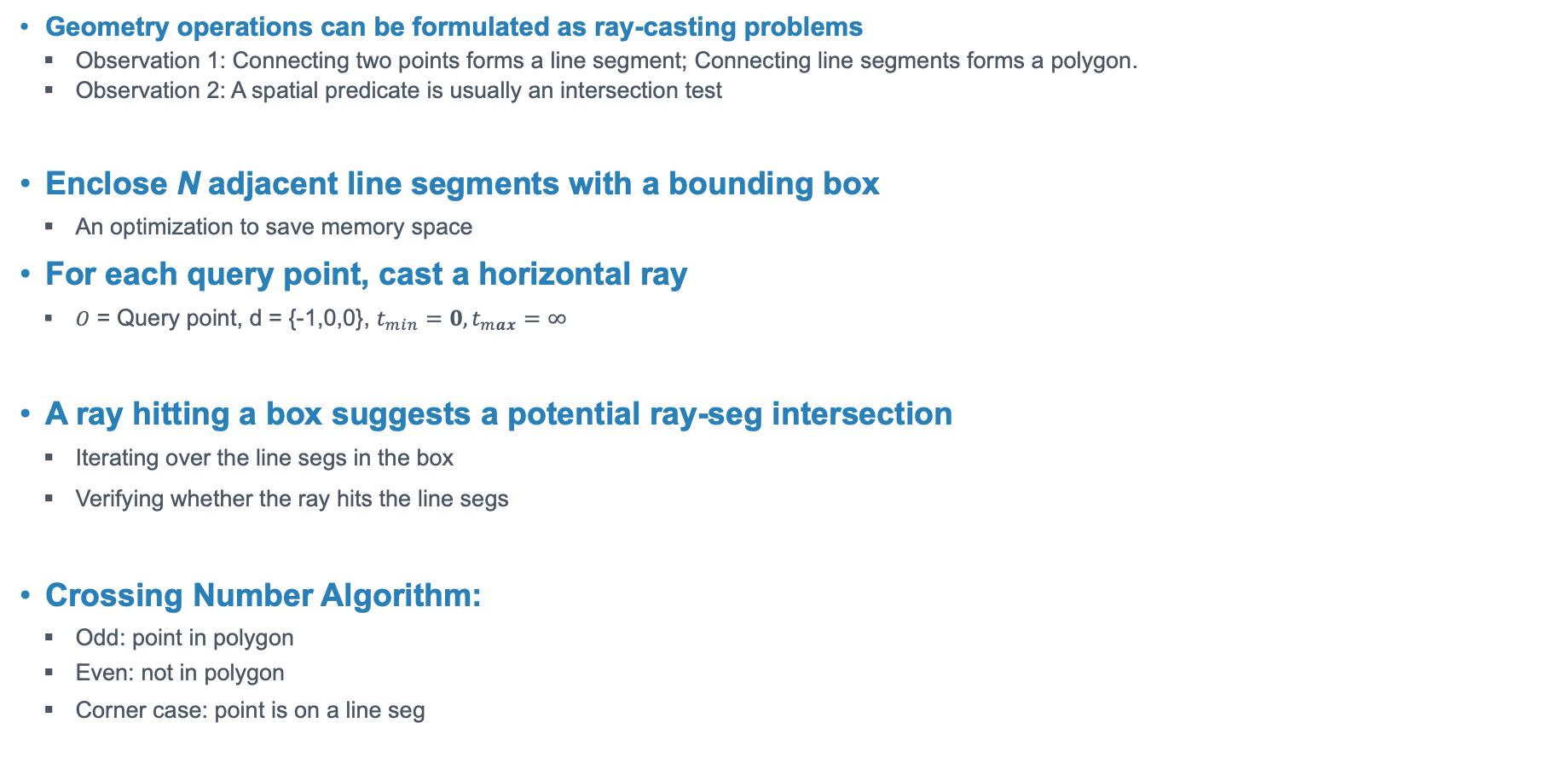
Example: Point-in-polygon by Ray-tracing
Geometry operations can be formulated as ray-casting problems
  Observation 1: Connecting two points forms a line segment; Connecting line segments forms a polygon.
  Observation 2: A spatial predicate is usually an intersection test
Enclose N adjacent line segments with a bounding box
  An optimization to save memory space
For each query point, cast a horizontal ray
  $O$ = Query point, d = {-1,0,0}, $t_{min}=0,t_{max}=∞$
A ray hitting a box suggests a potential ray-seg intersection
  Iterating over the line segs in the box
  Verifying whether the ray hits the line segs
Crossing Number Algorithm:
  Odd: point in polygon
  Even: not in polygon
  Corner case: point is on a line seg
Q₁
Q₂

Slide 26
The Bottleneck in Spatial Queries
The Problem: Spatial join is a major performance bottleneck
  Filtering: A coarse-grained pass finding Minimum Bounding Rectangle (MBR) intersections
  Refinement: A fine-grained pass that finds geometries in the MBRs that are truly intersected.
Exponential growth of geospatial data
  Rich data sources: Mobile devices, Satellite, LiDAR…
  Constantly updating
The Problem: Spatial join is a major performance bottleneck
  Filtering: A coarse-grained pass finding Minimum Bounding Rectangle (MBR) intersections
  Refinement: A fine-grained pass that finds geometries in the MBRs that are truly intersected.
Both stages can be performance bottlenecks
  Filtering: searching a spatial index involves lots of random memory accesses
  Refinement: computational heavy (offload to geometry libraries, e.g., GEOS)

Slide 27
The Bottleneck in Spatial Queries
Exponential growth of geospatial data
  Rich data sources: Mobile devices, Satellite, LiDAR…
  Constantly updating
A spatial query is significantly more compute-expensive than a regular SQL query
Complex data types (geometries) vs scalars
Expensive predicates vs regular boolean expr.
Multi-dim index vs single-dim
Spatial join is a major performance bottleneck
Filtering: A coarse-grained pass finding Minimum Bounding Rectangle (MBR) intersections
Refinement: A fine-grained pass that finds geometries in the MBRs that are truly intersected.
Both stages can be performance bottlenecks
Filtering: searching a spatial index involves lots of random memory accesses
Refinement: computational heavy (offload to geometry libraries, e.g., GEOS)
  Phase 1: Filter out rows that do not have spatial intersection
  Phase 2: Refinement results and keep rows that satisfy the predicate

Slide 28
The Bottleneck in Spatial Queries
Exponential growth of geospatial data
  Rich data sources: Mobile devices, Satellite, LiDAR…
  Constantly updating
A spatial query is significantly more compute-expensive than a regular SQL query
Complex data types (geometries) vs scalars
Expensive predicates vs regular boolean expr.
Multi-dim index vs single-dim
Spatial join is a major performance bottleneck
Filtering: A coarse-grained pass finding Minimum Bounding Rectangle (MBR) intersections
Refinement: A fine-grained pass that finds geometries in the MBRs that are truly intersected.
Both stages can be performance bottlenecks
Filtering: searching a spatial index involves lots of random memory accesses
Refinement: computational heavy (offload to geometry libraries, e.g., GEOS)

Slide 29
Breaking the Bottlenecks with HW Acceleration
Conventional GPU-acceleration for spatial joins is hard
  Pointer-chasing when traverse the spatial index
  Random memory access
New opportunity: Ray Tracing (RT) cores
  Widely available on modern consumer and enterprise GPUs.
  Originally designed for rendering, they excel at traversing Bounding Volume Hierarchies (BVH) and ray-geometry intersection.
Ideal HW for spatial workloads
  Similarity between rendering and spatial queries
  Having shown effectiveness in kNN, spatial joins, spatial index, and spatial metrics…
These powerful cores sit completely idle during SQL execution

Slide 30
Systematic Challenges for Production
Data Format Mismatch Issue
  WKB is a good format for storage
  But not good for computation – difficult to achieve random geometry access
Indexing Scalability
  High overhead of building millions of micro-indexes (e.g., PreparedPolygon) on GPUs.
Combinatorial Complexity
  Hundreds of geometry-predicate combinations to support
Notes:
While academic prototypes exist, building an industrial-grade engine poses unique challenges:

Slide 31
RT Cores Overview
What are the RT cores
Designed for accelerating ray-tracing rendering
Specialized units in modern GPUs to accelerate:
  Ray-triangle intersection tests
  Bounding Volume Hierarchy (BVH) traversal
  10x faster than the software emulation for BVH search
  Free up SMs to do other computing works
How to “Program” RT cores?
Actually, you can’t!
The only way you can use it is to convert your problem into ray-geometry intersection problems
Geometries are organized into a spatial index - BVH tree
You cast rays, and intersections are reported to the SMs by RT cores

Slide 32
Evaluation Setup (SpatialBench)
Evaluated using SpatialBench (derived from NYC Taxi data, realistic multi-scale urban skew).
Workload: Latency-sensitive joins and computationally heavy point-in-polygon (PIP) joins.
Hardware: AWS m7i.2xlarge (CPU baseline) vs. various GPUs (RTX 3090, A10, L4, L40S) and OSC (A100, H100).

Slide 33
Performance Results
Matches or slightly beats CPU for lightweight queries (avoiding GPU data-transfer regressions).
Massive gains on heavy joins: Up to 5.93x speedup on computationally intensive queries (Q10/Q11).
Refinement phase execution time slashed drastically.

Slide 34
Cost-Effectiveness
Performance is great, but what does it cost in the cloud?
Compared total AWS execution cost (Query Time x Hourly Instance Rate).
Using standard L4 or A10 instances, RayBooster reduces the total workload operational cost by 38.11% to 59.02%.

