Slide 1

LibRTS: A Spatial Indexing Library by Ray Tracing
Liang Geng⁺, Rubao Lee*, Xiaodong Zhang⁺
+ The Ohio State University
* Freelancer
Notes:
Hi everyone, I’m Liang from The Ohio State University.
We will present a library called “LibRTS” - A Spatial Indexing Library by Ray Tracing. This work was completed in collaboration with my two colleagues, Dr. Lee and Prof. Zhang.

Slide 2




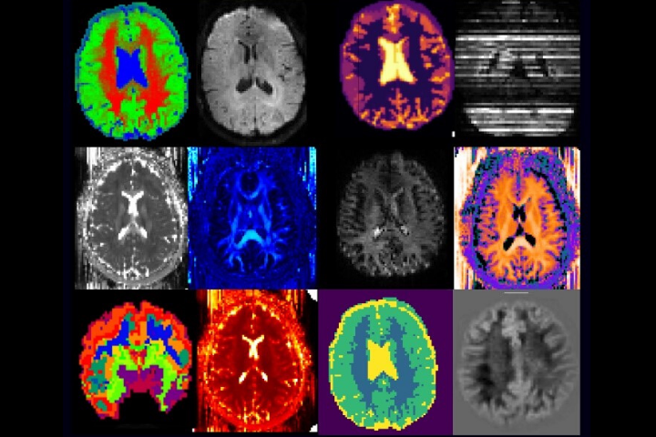

Spatial Data is Important
“80% of big data is spatial.” — ESRI
(Social Media)
Spatial Data
(Autonomous Driving)
(Medical Imaging)
(Ridesharing)
https://www.esri.com/about/newsroom/arcuser/five-reasons-every-data-science-team-needs-a-geographer/
Notes:
According to a report from ESRI, "80% of big data is spatial."
Specifically, there are many examples of how spatial data is used:
Autonomous vehicles utilize spatial data for path planning and navigation, ensuring safe and efficient driving.
Medical imaging involves processing MRI and pathology images, both of which are forms of spatial data used for diagnosis and analysis.
Location-based social networks leverage geospatial data collected from users to enhance content recommendations.
Ridesharing services like Lyft and Uber rely on real-time spatial data processing to efficiently connect drivers with customers.

Slide 3
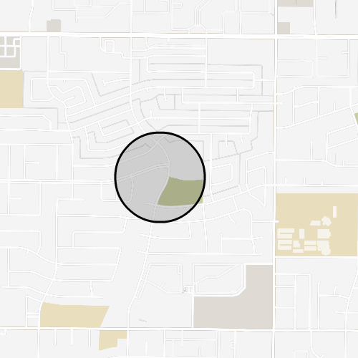
Real-world Example: Geofencing
Given a set of areas of interest (spheres representing fences)
Given a set of moving devices (points reporting their locations)
Monitor when an object enters or leaves a fenced area
  Fleet Management – A logistics company tracks when trucks enter or leave a warehouse
Properties & Requirements
  Large volume of data
  Constantly changing data
  Queries must have fast response times
https://tile38.com/topics/geofencing
Notes:
I will give you an example of geospatial data processing called Geofence to illustrate what a geospatial task looks like.
The goal of geofench is to monitor when a device enters or leaves a predefined area.
First, we have a set of areas of interest, represented by circles.
Then, we have a set of moving devices, represented by points.
Geofencing has many applications, including marketing, security, and logistics.
Requirements of Spatial Workloads
High data volume: The system must handle a large volume of spatial data due to the sheer number of devices.
Dynamic updates: The data is constantly changing because the devices are in motion.
Real-time processing: Spatial queries must be responded to in a timely manner.

Slide 4
Why Do We Need a Spatial Index
A spatial index enables
  Fast spatial queries
  Efficient storage
Typical queries
  Point queries
  Range queries
  Most commonly used spatial indexing methods are tree-based
  KD-Tree, Quad Tree, R-Tree, Bounding Volume Hierarchy (BVH) …
  Inefficient on GPUs due to random memory access, branch divergence
  GPUs are critical for high-performance data processing
Notes:
We need a spatial index to meet the requirements of spatial queries.
A spatial index enables fast spatial queries and efficient storage.
Additionally, most spatial indexes support point queries and range queries, which we will illustrate in the following slides.
We mainly talk about BVH which can be accelerated by the hardware

Slide 5
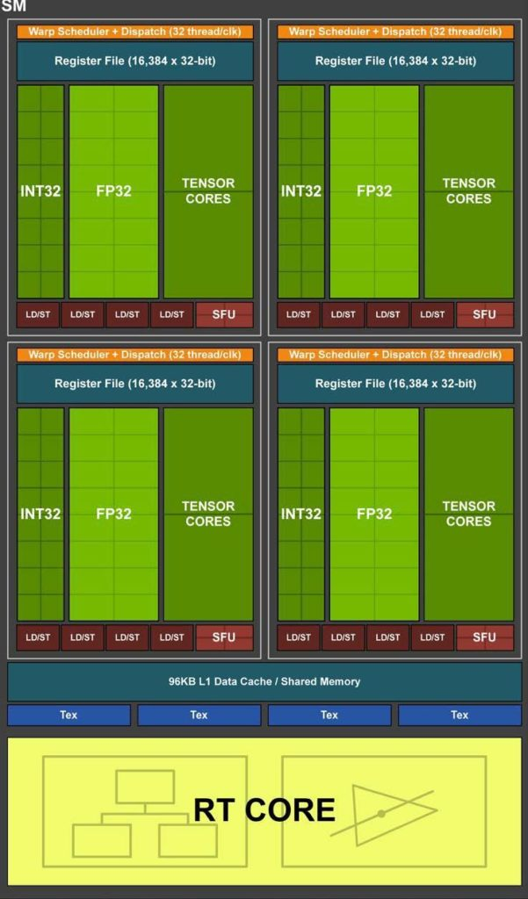
The Hidden Spatial Index Accelerator
NVIDIA introduced Ray Tracing (RT) cores in Turing architecture
RT cores are designed to accelerate RT-based rendering.
  Each SM has an RT core
  Accelerating ray-primitive intersection test
  Accelerating BVH traversal
Notes:
On the other hand, modern GPUs come with a hidden spatial index accelerator known as RT cores.
NVIDIA introduced RT cores in the Turing architecture.
RT cores are specifically designed to accelerate ray tracing (RT)-based rendering. They enhance performance by speeding up Bounding Volume Hierarchy (BVH) traversal and ray-primitive intersection tests.
As shown in the figure, each Streaming Multiprocessor (SM) has a dedicated RT unit.

Slide 6


RT Rendering
How does it work?
  Simulation of the light transportation
  BVH tree to accelerate the search for intersections
  Figure out how much radiance is reflected into the camera
View Ray
Light Source
Camera
Screen
Scene
Notes:
We need to introduce some ray tracing basics before we dive into RT Cores.
Ray tracing is a photorealistic rendering technique.
The principle of ray tracing is to simulate light transportation.
A rendering system has three components, camera, screen and scene. We also need a light source, otherwise we see nothing. The camera is a component in the rendering system to observe the scene.
Ray tracing based rendering begins by casting rays from the camera through the screen to find intersections.
If the ray hits a geometry, we cast rays from the geometry toward the light source to get how much energy will be reflected on the surface to the camera.
Since a scene consists of millions of geometries, we need a spatial index to identify which geometries are hit by a ray. Currently, BVH is the predominant data structure used in ray tracing.

Slide 7
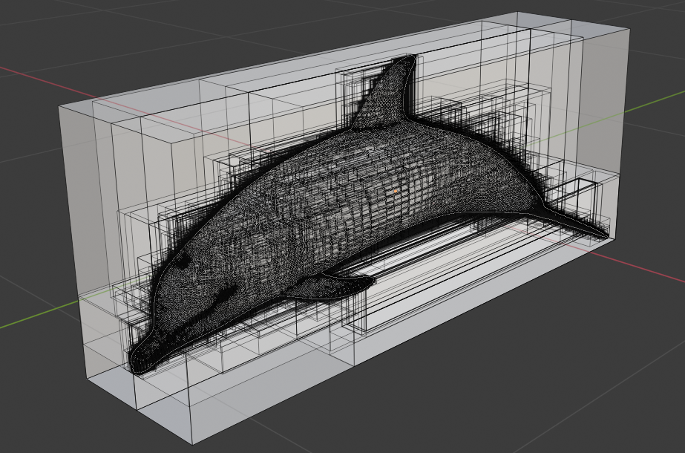
BVH Traversal
A model for rendering consists of millions of small triangles
We need to know quickly a ray hits which triangle
BVH serves as a spatial index to accelerate the search
https://robinoconnell.us/projects/ray-tracing/
Notes:
Now, let's introduce how the core data structure, Bounding Volume Hierarchy (BVH), works.
Why is BVH Needed?
In rendering, a 3D model can consist of millions of small triangles.
When a ray is cast from the camera, we need to determine which triangle it intersects.
BVH Structure
Consider a dolphin model as an example. You can see that it is enclosed within multiple nested bounding boxes.
On the right, there is a BVH tree, where:
Each node has a bounding box as its attribute.
A bounding box encloses all the boxes of its child nodes.

Slide 8
RT Cores vs Spatial Index
What are available?
  A Ray Tracing Accelerator
  Ray-Primitive Intersection
  High-performance (10 GRays/s)
  Only supports coordinate updates.
  Customized programming interface (OptiX, Vulkan…)
What we want to deliver
  A Spatial Index Library
  Support Point, Range Queries
  Need quick response
  Mutable, e.g., insert, delete geoms.
  An easy interface for programming
We develop LibRTS for the following two purposes
To repurpose RT core as a general spatial index
A library for non-RT programmers to use
Notes:
We observed that the RT core and a spatial index are closely related.
This motivates us to design a spatial index powered by RT cores

Slide 9





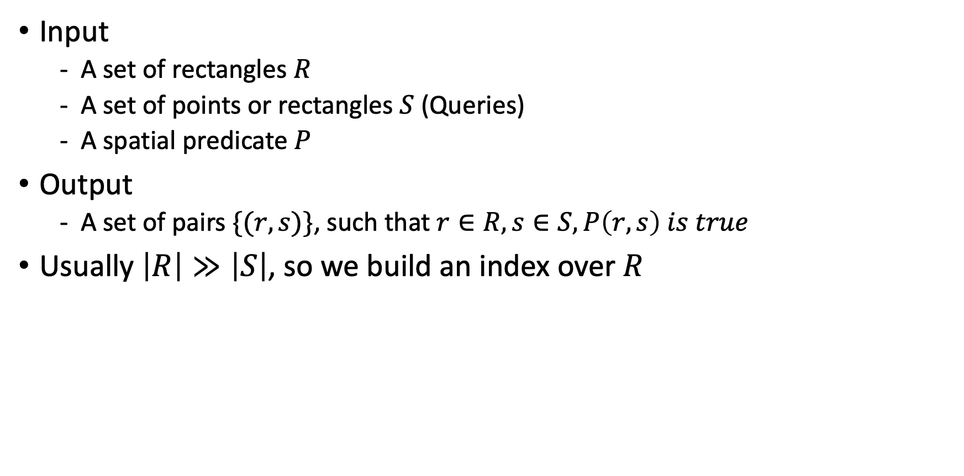

Challenge #1: Translation Spatial Queries
Input
  A set of rectangles $R$
  A set of points or rectangles $S$ (Queries)
  A spatial predicate $P$
Output
  A set of pairs $\{(r, s)\}$, such that $r∈R,s∈S,P\left(r,s\right) is true$
Usually $\left|R\right|≫\left|S\right|$, so we build an index over $R$
$$r$$
$$r$$
$$r$$
$$s$$
$$s$$
$$s$$
Point Query
Range-Contains Query
Range-Intersects Query
Notes:
Let’s dive into the details. The spatial query comes into this form
This work covers three most commonly used queries.

Slide 10









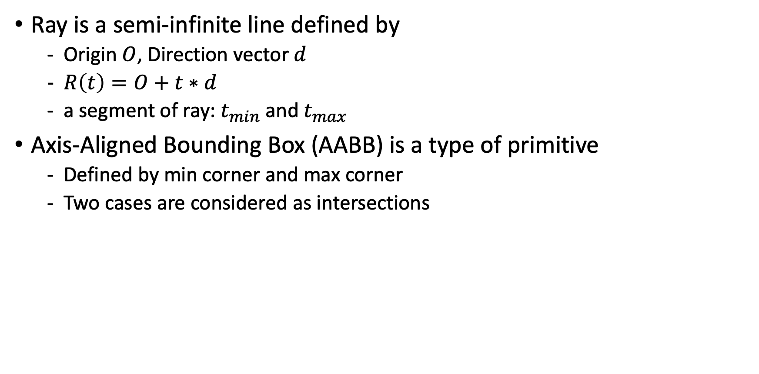


Ray & Ray-Box Intersection
Ray is a semi-infinite line defined by
  Origin $O$, Direction vector $d$
  $R\left(t\right)=O+t∗d$
  a segment of ray: $t_{min}$ and $t_{max}$
Axis-Aligned Bounding Box (AABB) is a type of primitive
  Defined by min corner and max corner
  Two cases are considered as intersections
$$O$$
$$d$$
$t_{min}$
$t_{max}$
$$O$$
max
max
$$O$$
$t_{hit}$
$t_{min}$
$$d$$
$$d$$
$t_{max}$
min
min
Case 1: Hit the boundary of an AABB
Case 2: Ray origin is within an AABB
Notes:
We are now introducing ray-AABB intersection conditions that will be used shortly to support the point query.
A ray is a semi-infinite line defined by an origin O and a direction vector d. Mathematically, a ray R is defined as O + t times d, the parameter t controls how far the ray goes.
Additionally, we can take a segment of the ray by giving tmin and tmax
AABB is a rectangle defined by a min corner and a max corner
There’re two cases are considered to be intersections.
First case is that the origin is out of the box but the ray hits the boundaries of the box
another case is that the ray origin is inside the box.

Slide 11















Solution to Translation Challenge
Point Query
  $R$ is a set of rectangles and $S$ is a set of points; Predicate $P$ is $Contains$
  Return a list of pairs $\{(r, s)\}$, such that $r∈R,s∈S and Contains\left(r, s\right) is true$
Use a short ray to simulate a point
  $t_{min}=0, t_{max}=FLT_MIN$
Miss
$$r_{1}$$
$$r_{1}$$
$$s_{1}$$
Hit, False Positive
$$s_{2}$$
$$s_{1}$$
Build BVH
$$s_{2}$$
Hit
$$r_{2}$$
$$r_{2}$$
Cast Rays
max
$$s_{3}$$
$$s_{3}$$
min
$$r_{3}$$
$$r_{3}$$
Case 2: Ray origin is
within an AABB
$$s_{4}$$
$$s_{4}$$
Notes:
Here’s the definition of the point query
The idea of accelerating the point query is to use a short ray to simulate a point, which can be achieved by giving tmin = 0 and tmax is a very small number.
There’s the example. We have three rectangles r1 to r3 and four query points s1 to s4. Each point casts a very short and the direction can be arbitrary because as long as the point falls within the rectangle, it will be identified as an intersection event due to case 2.
After casting the rays from the points, we have three cases
It is a miss if the ray does not hit anything
If the ray hits the boundaries of any AABB, it’s a falls postitive hit because the origin is not in the rectangle. Therefore, we should not include it in the query results (case #1).
Only the happening of case #2 should be included in the query results.
Therefore, we filter out the false positive hit in the IsIntersection shader.

Slide 12






Solution to Translation Challenge
Range – Intersects
  Observation: $Intersect\left(r,s\right) is true$ $↔$ One of the cases is true
  Case 1: Diagonal of $s$intersects $r$
  Case 2: Anti-diagonal of $r$ intersect $s$
  Case 3: (Anti-)diagonal and rectangle are mutually intersected
$$s$$
$$r$$
$$r$$
$$s$$
$$r$$
$$s$$
Case 1
Case 2
Case 3
Notes:
Here comes to the most complicated query the range query with a intersects predicate

Slide 13







Solution to Translation Challenge
Range – Intersects
  Any (anti)-diagonal-rectangle intersection suggests a rect.-rect. intersection
  The diagonal can be simulated with a ray!
  Cast rays from the diagonals of $R$ and $S$ to find all the intersections
  Merge the intersections found by the three cases
$$p_{2}$$
$$t_{max}=1$$
$$O=p_{1}$$
$$d=p_{2}−p_{1}$$
$$p_{1}$$
$$t_{min}=0$$
Notes:
Based on the observation, every rectangle – diagonal intersection suggests that there’s rectangle-rectangle intersection.

Slide 14



Challenge #2: Load Balancing
Single Ray Programming Model
  Each thread casts a single ray
  The shaders triggered by the ray will also be executed by the ray-casting thread, serially!
  This model may result in load-imbalance
$$y$$
1.0
Thread 1
3 Intersections
Thread 2
2 Intersections
Thread 3
1 Intersections
$$o$$
1.0
$$x$$
Notes:
OptiX adopts the single-ray programming model.

Slide 15




Our Load Balancing Solution
Why the existing GPU load-balancing does not work
  The number of intersections is unknown until the ray is cast.
  Thread block/warp synchronization primitives are unavailable.
Our technique: Ray-Multicast
  Divide the scene into non-overlapping sub-spaces
  Put the rectangles into subspaces in a round-robin manner
  Cast the ray into the sub-spaces
$$y$$
1.0
$$o$$
$$x$$
$$y$$
1.0
1.0
$$o$$
1.0
2.0
3.0
$$x$$
Notes:
Trade more rays for load balancing
We have a method to infer the best number of rays

Slide 16
Challenge #3: Mutability
How can we adapt to dynamic data processing?
  Insert/Delete/Update geometries
RT cores only support updating the coordinates of geometries (refit)
Rebuilding the BVH is not an option (too expensive)
Notes:
Here’s the last challenge.

Slide 17
Our Solution to Mutability
Insertion by Two-Level Acceleration Structures
  Accumulate a batch of insertions
  Build a separate BVH (BLAS) for the insertions
  Then, just rebuild the TLAS (very fast) to include the newly built BVH
Deletion by Degeneration
  Turn the deleted geometries into a degenerated form
  Then, we use the refit function provided by OptiX
TLAS
TLAS
Instance
Instance
Instance
Instance
Instance
Instance
[ ]
[ ]
[ ]
[ ]
[ ]
[ ]
Identitfy
Transformation Matrix
Incoming Insertions
BLAS
BLAS
BLAS
Build
[ ]
[ ]
Notes:
With the Instancing support by the RT cores, we workaround the insert restriction.
TLAS just link the BLAS, so rebuilding TLAS is very fast

Slide 18
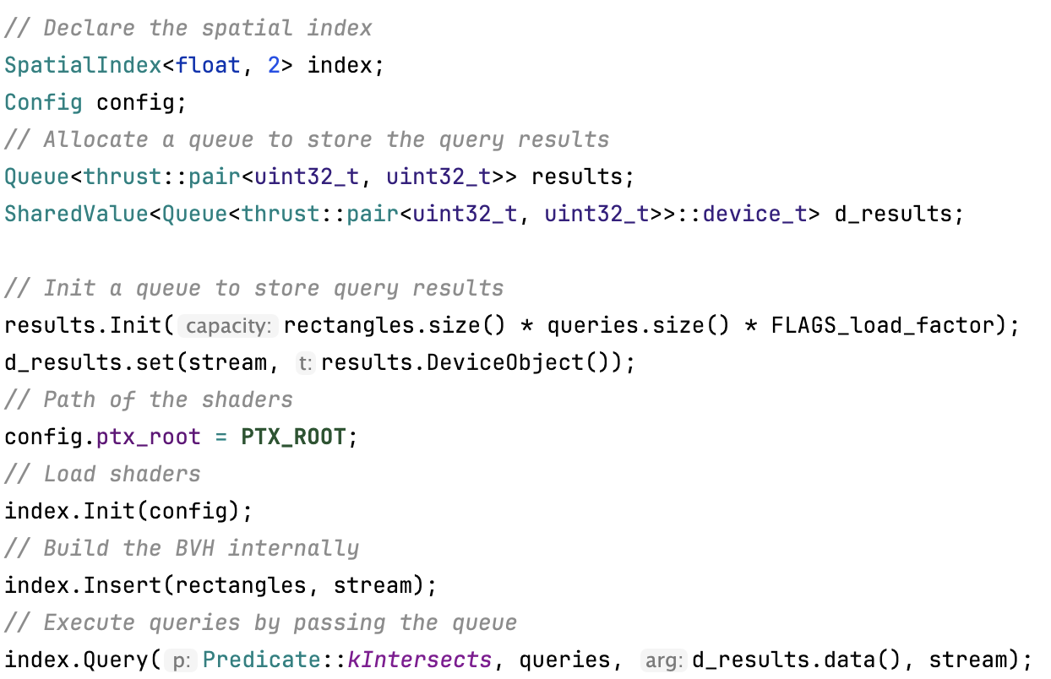
Interface
A Header Only Library
Don’t need to any write “RT code”
Only need to write a handler to process query results
There’s a builtin handler that collects query results to a queue
Notes:
LibRTS is a header only library, which does not require compile and very easy to use.
The user is not required to write any RT code. Instead, users only need to write a snippet of code called handler to process query results.
Here’s an example.
We first declare a spatial index that takes coordinate type and number of dimensions.
In addition, we initialize a queue to store the query results.
The next is to initialize the index by passing the path of shaders.
Now, the index is ready to use. We first insert the rectangles into the index. Then, execute a batch of queries. The query results will be automatically collected into the queue.

Slide 19
Evaluation
Artifacts in the evaluation
Artifact | Index Type | Query Type | Platform*
Boost | R-Tree | Point, Range | CPU
CGAL | KD-Tree | Point | CPU
ParGeo | KD-Tree | Point | CPU
GLIN | Learned Index | Range | CPU
LBVH | Linear BVH | Point, Range | GPU
cuSpatial | Octree | Point | GPU
RayJoin | BVH on RT cores | Point in Polygon (PIP) | GPU
LibRTS | BVH on RT cores | Point, Range, PIP | GPU
*All CPU-based artifacts are parallelized
Notes:
We include the most performant and popular spatial libraries, including Boost, CGAL, and cuSpatial from NVIDIA on both CPU and GPUs.

Slide 20
Evaluation
Environments
  GPU: NVIDIA RTX 3090
  CPU: AMD EPYC 7713 (128 cores)
  CUDA 12.3
  OptiX 8.0
Datasets
  From ArcGIS and OpenStreeMap (OSM)
Dataset | # of Polygons | Description
USCounty | 12.2 K | Boundaries of the U.S. Counties
USCensus | 248.9 K | U.S. Census Block Groups
USWater | 463.6 K | Boundaries of U.S. Water Resources
EUPark | 1.9 M | Parks and Green Areas in Europe (sampled from OSM)
OSMLakes | 8.3 M | Boundaries of Water Areas Worldwide
OSMParks | 11.5 M | Parks and Green Areas Worldwide
Notes:
Here’s the equipment in the experiments. Our GPU is an NVDIA RTX 3090 and the GPU is AMD EPYC
The data we use in the experiments are real-world geospatial datasets.
Most recongized datasets for evaluating spatial indexes.

Slide 21
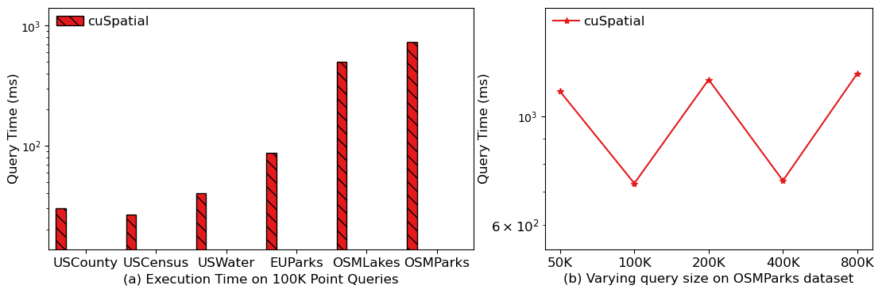
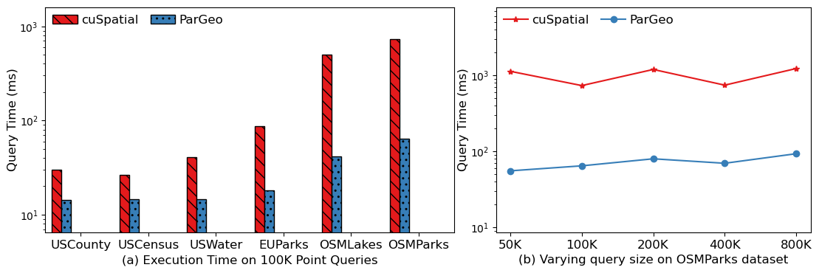
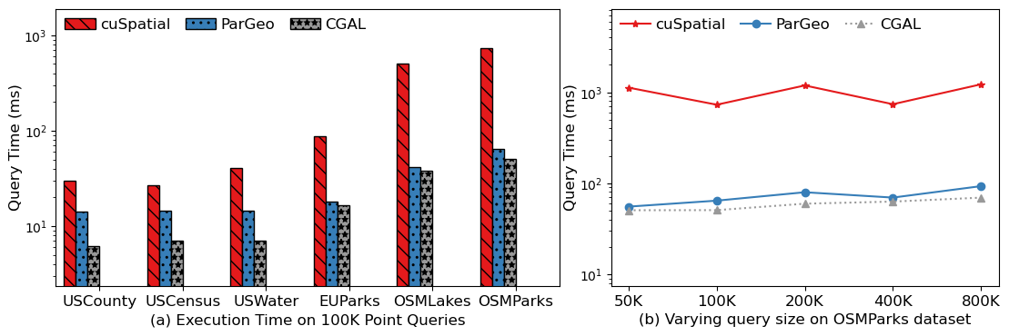
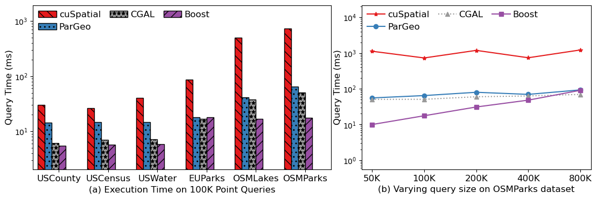
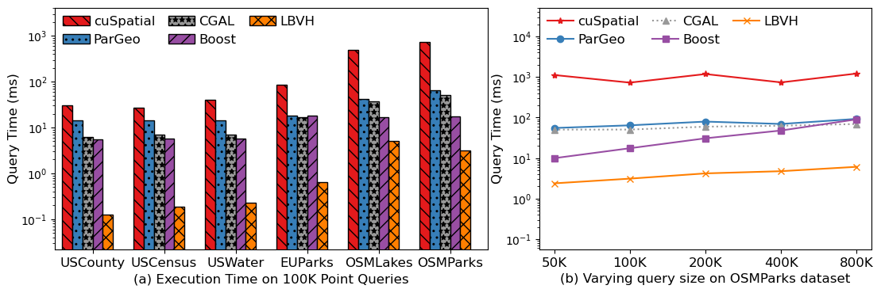
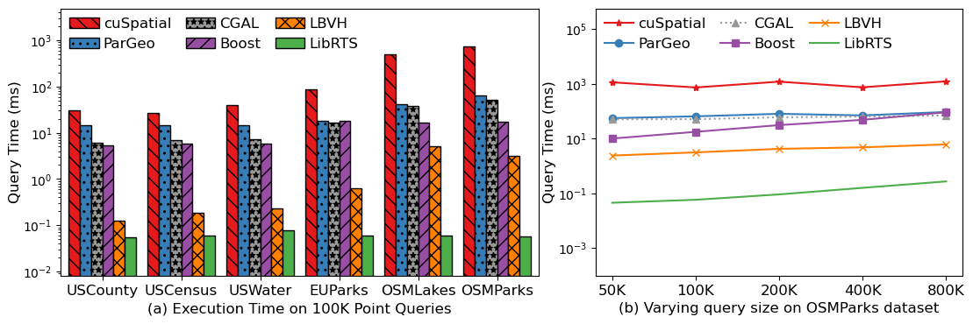
Point Query
Setting 1: Fix # of point queries to 100K
  Each query at least falls within a rectangle
Setting 2: Varying query sizes on OSMParks
up to
85.1x
Notes:
The left figure presents a comparison of running times for various artifacts across different datasets.
Our method benefits from the hardware acceleration of RT cores, exhibiting the lowest running time, achieving a speedup of up to 85.1×.
The right figure illustrates the trend in running time as the number of queries increases. Notably, our method consistently maintains the lowest running time, even as the query size grows.

Slide 22
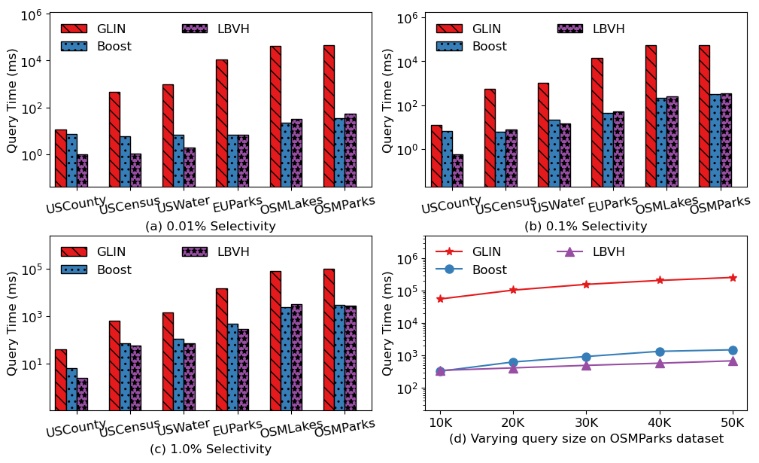
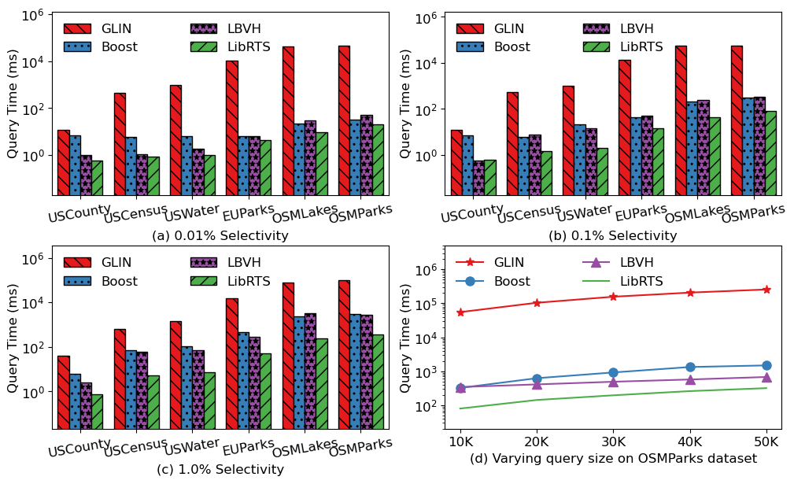
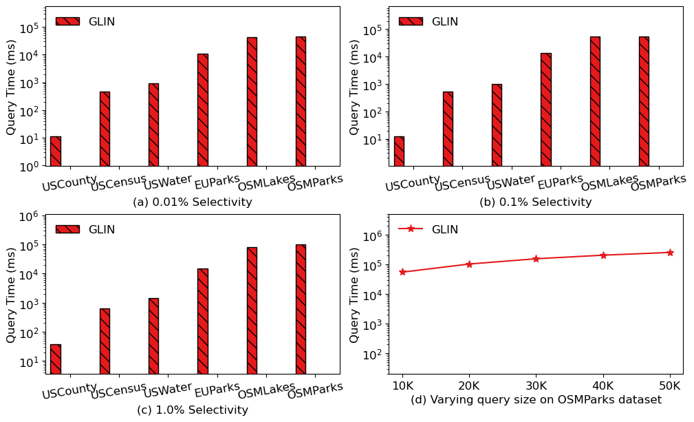
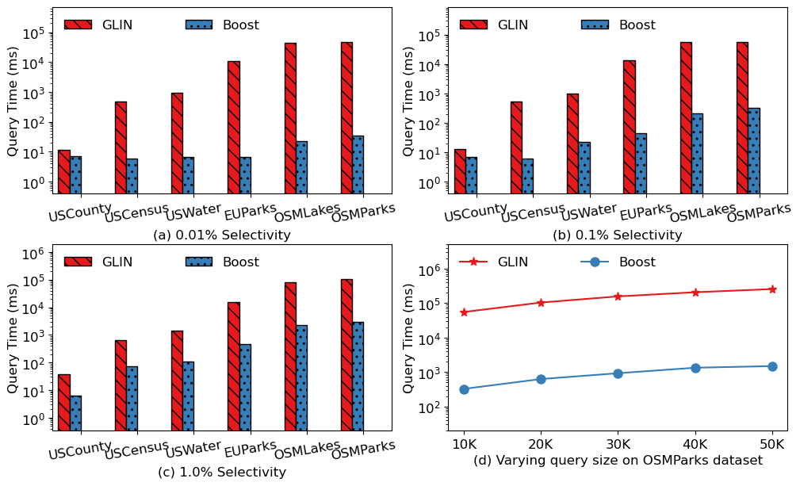
Range Query - Intersects
Setting 1: Fix # of range queries to 10K
  Varying selectivity by 0.01%, 0.1%, and 1%
Setting 2: Varying query sizes on OSMPark
up to 2.3x
up to 6.8x
up to 11.0x
Notes:
These are the performance results for the range-intersect query, which is more computationally intensive. Figures (a), (b), and (c) depict the query time as selectivity varies. As the increase of the selectivity, the fraction of the index being visited is also increasing.
The conventional indexes greatly suffer from the random memory access and branch divergence overhead. In contrast, our method is hardware-accelerated, so it is less susceptible from these issues, achieving speedups of up to 2.3×, 6.8×, and 11.0× over the best baseline performance.
Finally, Figure (d) illustrates the trend in running time as the number of queries increases. Notably, our method consistently maintains the lowest running time, even as the query size grows.

Slide 23
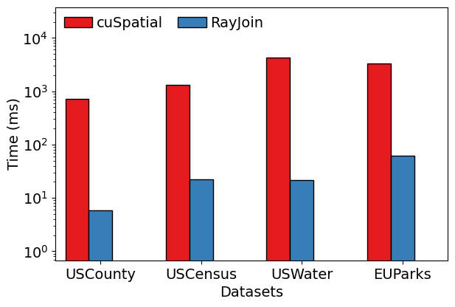
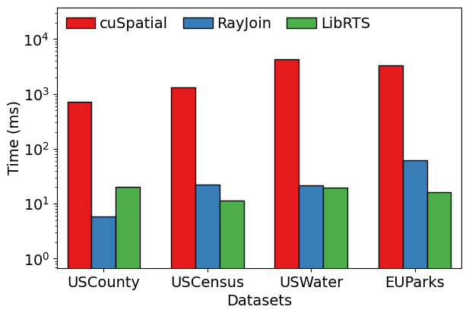
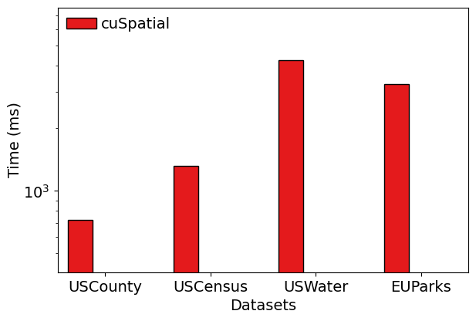
Real-world Application
Point in Polygon (PIP)
  Given a set of polygons and points
  Returns a point which polygon the point falls within End-to-end Time
  Compared to SOTA (RayJoin)
  RayJoin builds the index in line-segment level, which is costly in space&time
  Our general method builds the index on the polygon level
cuSpatial - NVIDA Spatial Library
RayJoin (ICS’24) - RT-based Spatial Join Library
1.9x
1.1x
3.8x
Notes:
Here are the performance results for a real-world example, Point-in-Polygon (PIP), which determines which polygon a given point falls within. PIP is widely used in geometric algorithms. We evaluate the end-to-end running time, including both index construction and query execution.
cuSpatial is NVIDIA’s spatial processing library, while RayJoin is the state-of-the-art (SOTA) spatial join library optimized for RT cores.
Our results show that cuSpatial consistently underperforms compared to both RayJoin and LibRTS. For the small dataset, USCounty, RayJoin outperforms LibRTS. However, on the three larger datasets, LibRTS surpasses RayJoin. This performance difference arises because RayJoin builds its index at the line-segment level, which is computationally expensive in both time and space. In contrast, LibRTS constructs its index over the bounding boxes of rectangles, resulting in a significantly smaller BVH and considerably lower running time.

Slide 24
Conclusion
We have successfully repurposed RT Cores to develop LibRTS, a general spatial index library
  Achieving top-tier performance as the fastest Spatial Indexing tool
Three major technical challenges have been addressed: translation, load-balancing, and mutability
  By graphics-only features on RT-cores, such as instancing, motion blur,- shader execution reordering, …
  Our solutions can be used for RT software development in other applications
LibRTS is developed for non-RT programming users too, aiming for broad adoption in applications community
  It is a header only library with an easy interface
Open-source LibRTS is available at https://github.com/RTSpatial/PPoPPAE
Thank you!
Email: geng.161@osu.edu
Notes:
RT can be repurposed to other workloads for high performance
LibRTS converted RT cores into a general-purpose spatial library

Slide 26
Three Challenges
Translation
  RT cores only works for ray-primitive intersection
  Spatial index needs to support various forms of queries with a specific predicate
Load-balance
  Single-ray model
  Intersection processed serially by the thread that casts the ray
Mutability
  RT cores only support updating the coordinates of primitives
  Spatial index needs to be able to insert/delete and update
Notes:
We face three major challenges when designing LibRTS
First is the translation challenge
In addition, we face the load-balance challenge. RT core adopts a single ray programming model, which means shaders triggered by a single ray are called by the same thread that cast the ray. Some threads will have few intersections, while some will have many intersections, leading to load-imbalancing.
Finally, it’s the mutability challenge. OptiX only supports updating the coordinates of primitives but you cannot insert new geometries or delete the existing geometries. However, a general spatial index would need this.

Slide 27











Translation Challenge: Range-Contains Query
Range – Contains
  Observation: Contains$\left(r,s\right) is true→r must contain center of s$
$$r$$
$$r$$
$$s$$
$$s$$
$r$contains $s$
$r$ contains the center of $s$
$$r$$
$$r$$
$r$does not contains $s$
$r$contains
the center of $s$
$$s$$
$$s$$

Slide 28


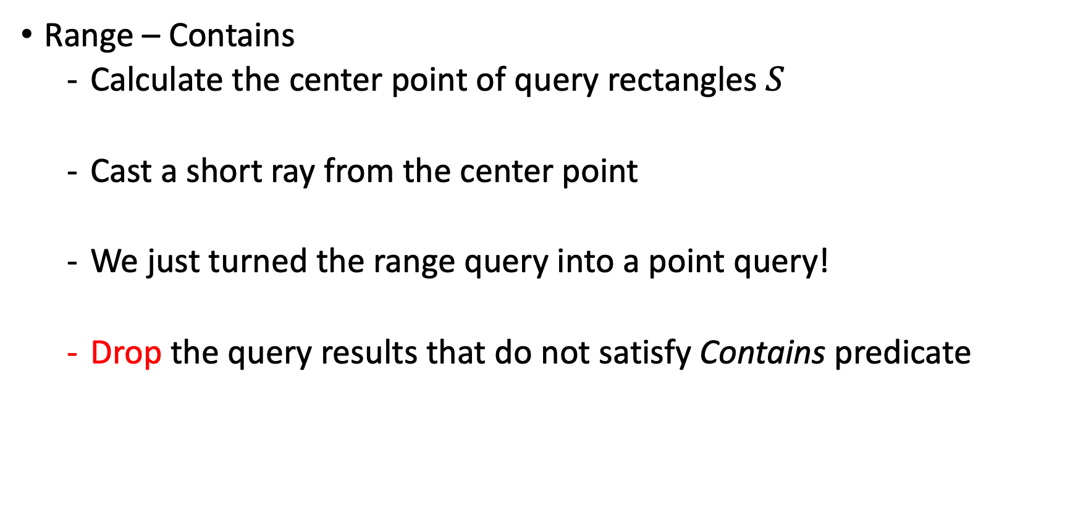



Translation Challenge: Range-Contains Query
Range – Contains
  Calculate the center point of query rectangles $S$
  Cast a short ray from the center point
  We just turned the range query into a point query!
  Drop the query results that do not satisfy Contains predicate
$$r_{2}$$
$$r_{1}$$
$$s_{1}$$
$$s_{2}$$
Notes:
With this observation, we can now translate the range query into a ray tracing problem

Slide 29





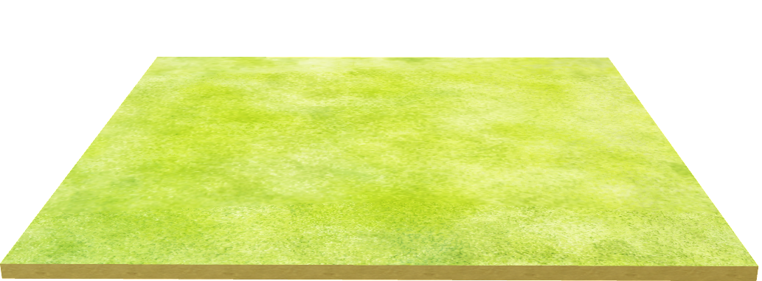

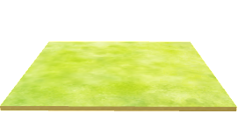

Exploiting a Feature: Instancing
Two-Level Acceleration Structure
  We exploit a feature called Instancing in graphics
  Bottom Level Acceleration Structure (BLAS)
  Top Level Acceleration Structure (TLAS)
BLAS
$$y$$
$$y$$
TLAS
$$o$$
$$x$$
Instance
Instance
[ ]
[ ]
[ ]
$$z$$
Local Coordinate System
Transformation
Matrix
BLAS
$$y$$
$$o$$
$$x$$
BLAS
BLAS
$$o$$
$$x$$
$$z$$
[ ]
[ ]
[ ]
$$z$$
Local Coordinate System
BLAS
Notes:
For example, we have two models in our rendering tasks.
There’s a flower model and a ground model.
The right is the scene, which has three flowers.
With the instancing technique, we don’t have to build three BVHs but only one. because they look like the same but on different locations.
We build a BVH for the flower and the ground, called BLAS
Then we use a TLAS to link the BLAS with different transformation matrix to move around the BLAS.

Slide 30
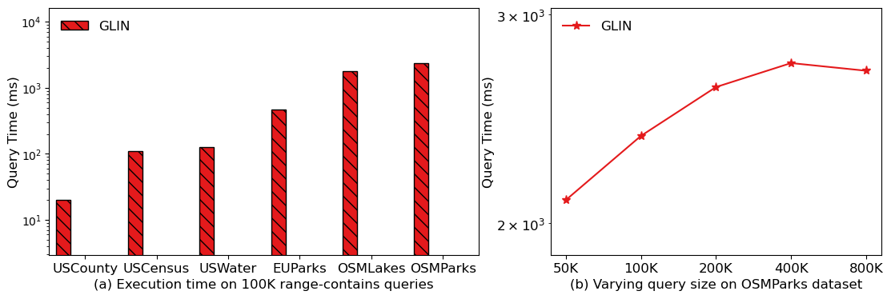
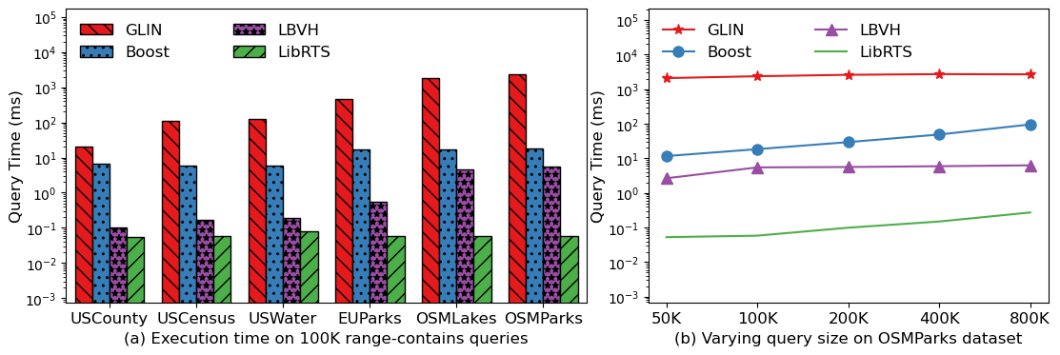
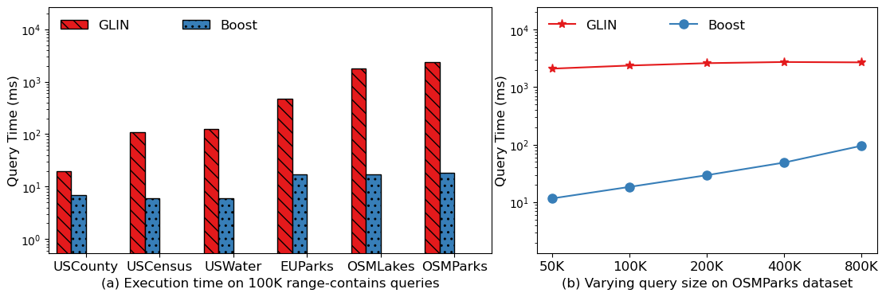
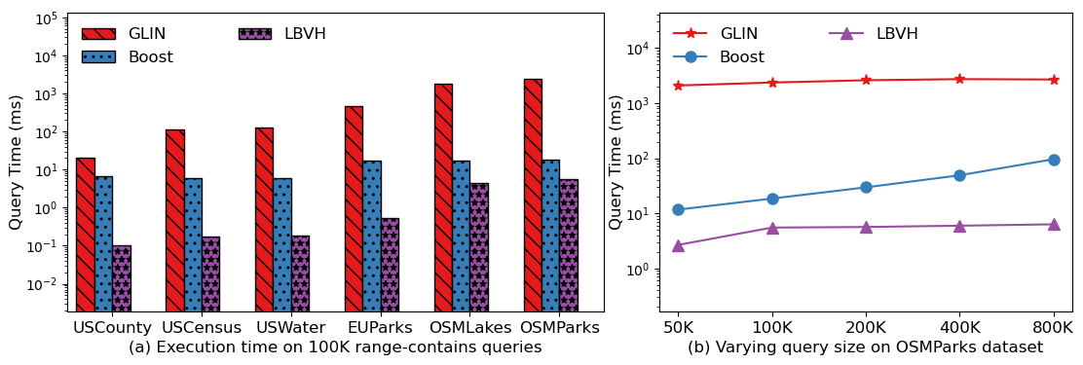
Range Query - Contains
Setting 1: Fix # of range queries to 100K
  Each query at least contains a rectangle
Setting 2: Varying query sizes on OSMParks
94.0x
1.9x

Slide 31
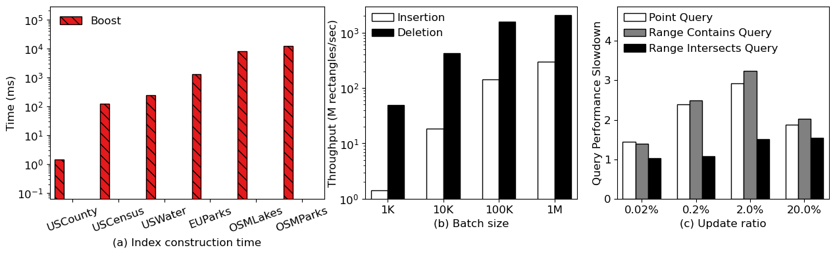
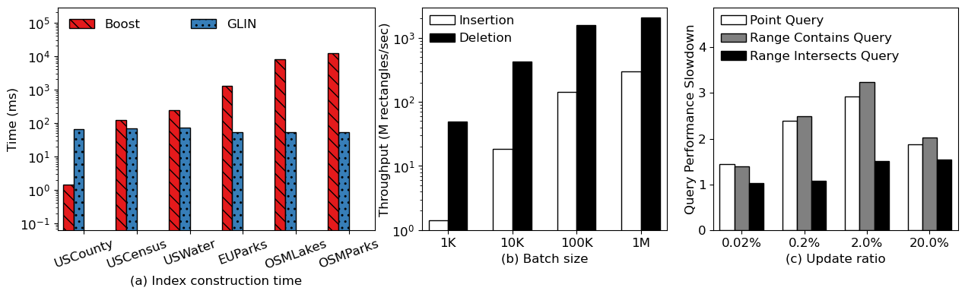
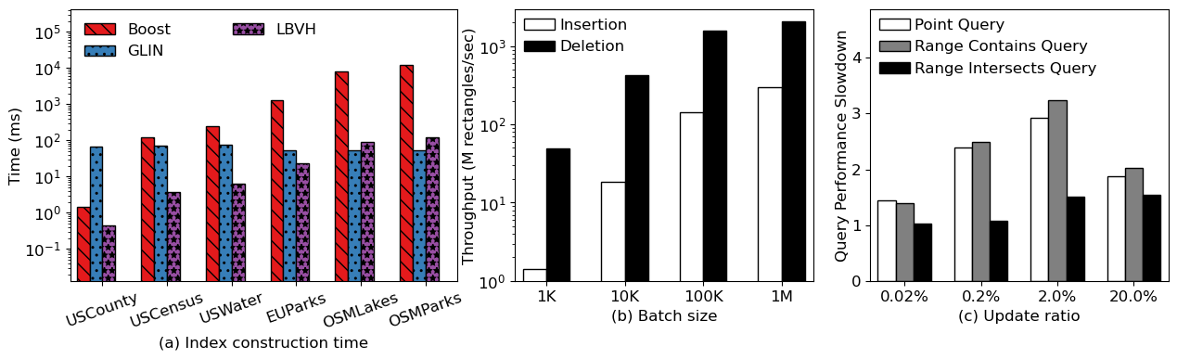
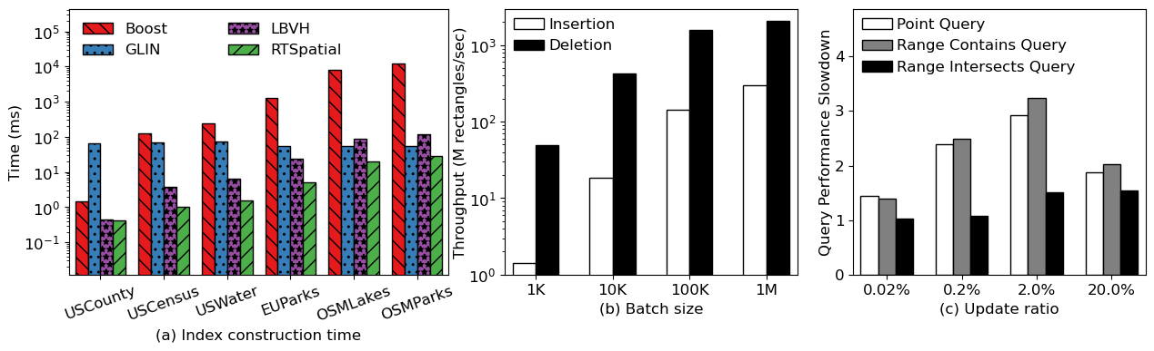
Bulk-loading Performance
Index Construction Time
  Boost and GLIN only support serial construction
  LBVH and RTSpatial use parallel construction algorithms
  When batch size = 1M, Insertion >100M rect./s
  Deletion >1000M rect./s

Slide 32
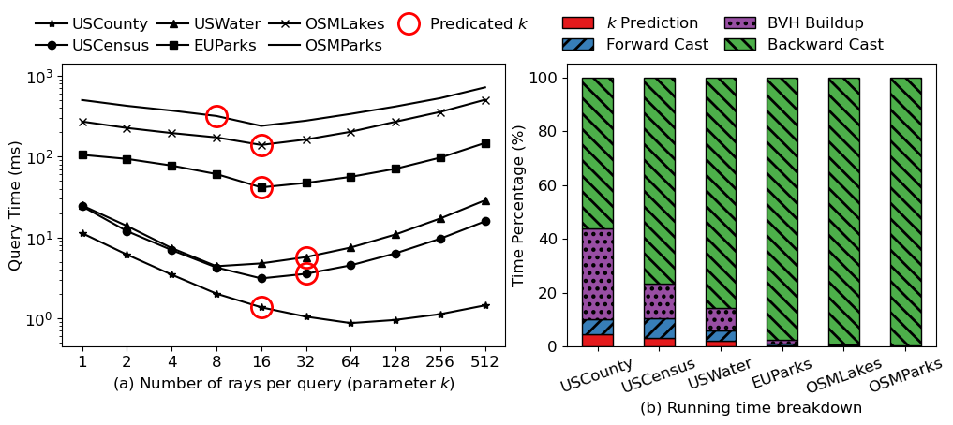

Effectiveness of Ray Multicast
Varying the number of rays per query
  # of rays per query ($k$) = 1 means disable the LB
  Red circle represents the optimal $k$ predicted by our method
  Overhead of predicting $k$ is negligible
Use LB
No LB

Slide 33
RT cores Programming Model
Using RT cores
  DXR, Vulkan, OptiX
  Focus on OptiX because of its interoperability to CUDA
Users implement shaders, which are invoked when a ray hits something
Build BVH
Handle
RayGen
BVH Traversal
Leaf
IsIntersection
No
AnyHit
Yes
Hit Prim.?
Primitives
Miss
Traversal
Completes
ClosestHit
Yes
Found a Hit?
No
Notes:
Many frameworks can invoke RT cores, such as DXR, Vulkan and OptiX.
We only focus on OptiX because of its interoperability to CUDA
OptiX requires users to implement shaders to cast ray and handle intersections
The procedure in green color is accelerated by the hardware, which is non-programmable. While the grey color is also non-programmable procedure

Slide 34
We propose LibRTS
LibRTS: A general spatial index powered by RT cores
  Providing various spatial queries
  High-performance powered by RT cores
  Mutable, including insert, delete, and update geometries
  Presenting an easy interface
Notes:
Here we present LibRTS: a general spatial index powered by RT cores
LibRTS provides various spatial queries, including point and range queries
LibRTS is also high-performance because of the using of RT cores
LibRTS is also mutable, including insert, delete and update geomtries
Finally, it provides an easy interface. The users do not need to know any RT-related knowledge.

Slide 35
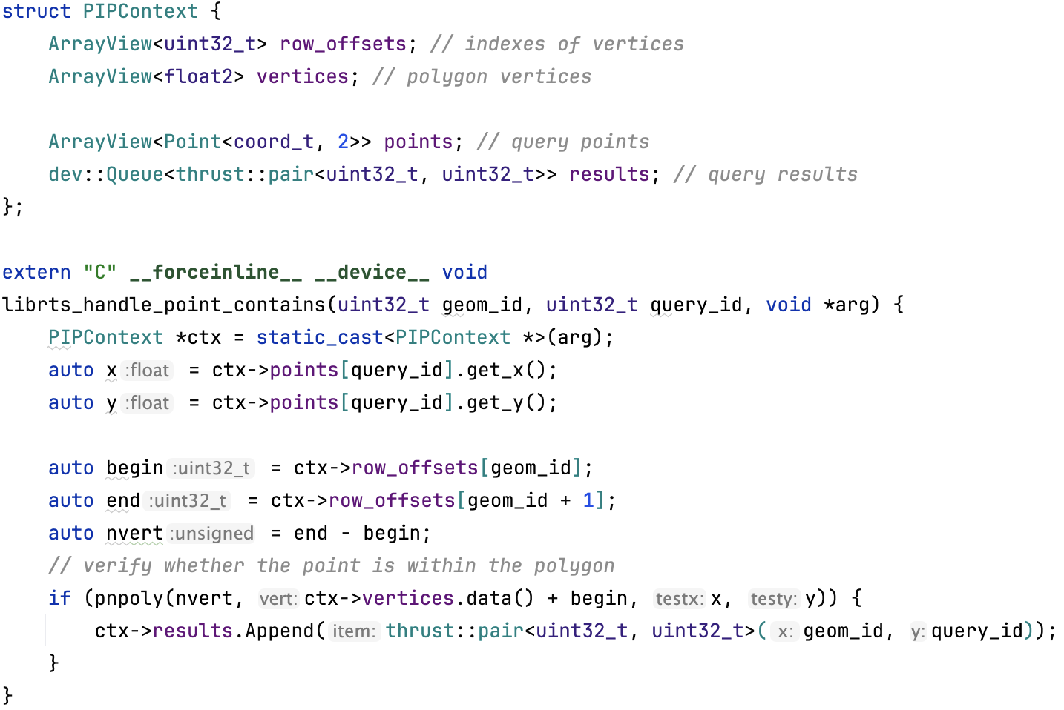
Interface – Point-in-polygon (PIP)
Users are also allowed to provide a customized handler
Declare a context to pass user provided data structures
Implement a customized handler to check whether a point in a polygon
Notes:
Users are also to allow the users to implement a customized handler to achieve more complex tasks.
Here’s an example called Point-in-polygon (PIP).
We declare a struct called context to passing user provided structures, such as polygon vertices and query points.
Then, we implement a handler that will be automatically invoked if a point falls within the bounding box of a polygon. In the handler, we verify whether a query point falls within a polygon.

